Slide 1
1

Slide 2
2

Slide 3
3

Slide 4
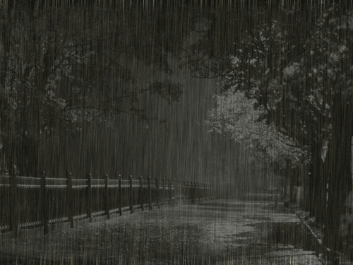
4

Slide 5
5

Slide 6
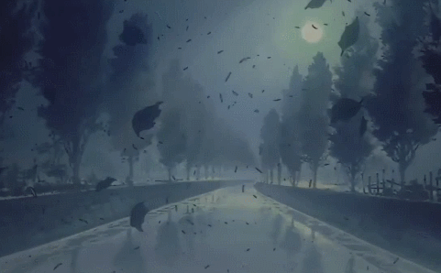
6

Slide 7
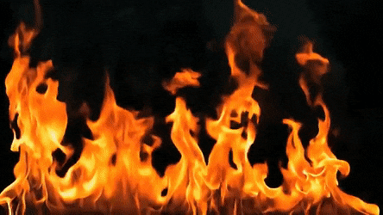
7

Slide 8
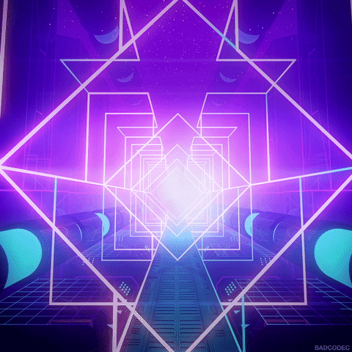
8

Slide 9
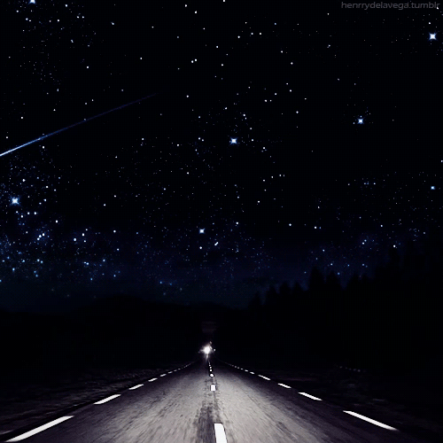
9

Slide 10
10

Slide 11
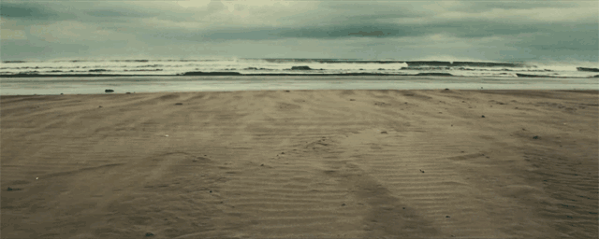
11

Slide 12
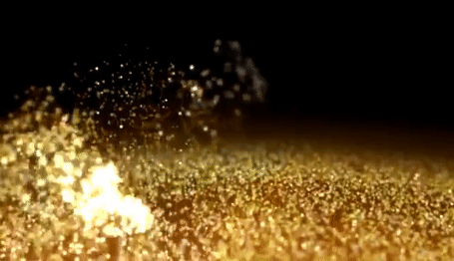
12

Slide 13
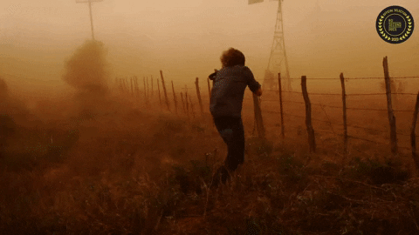
13

Slide 14
14

Slide 15
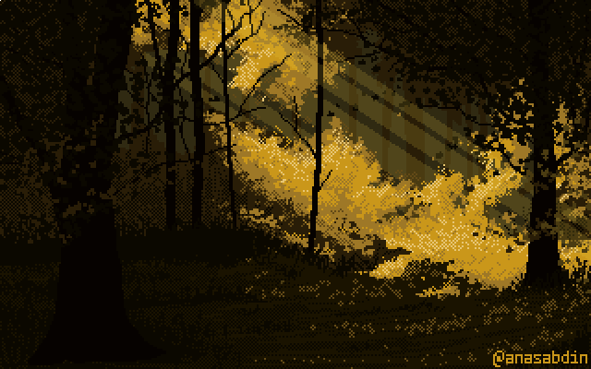
15

Slide 16
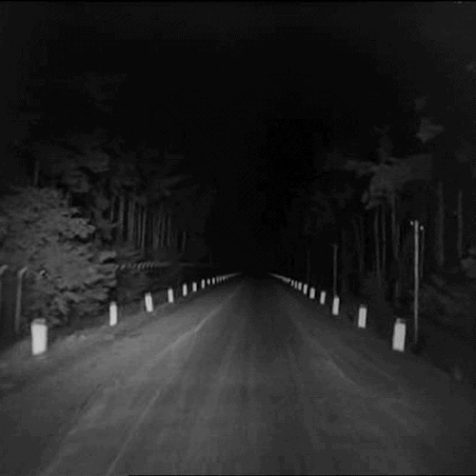
16

Slide 17
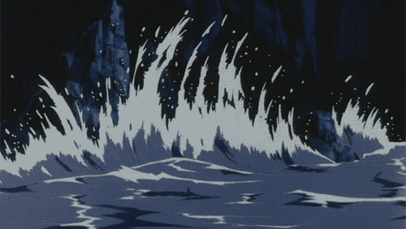
17

Slide 18
18

Slide 19
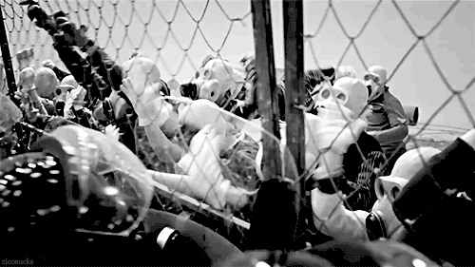
19

Slide 20
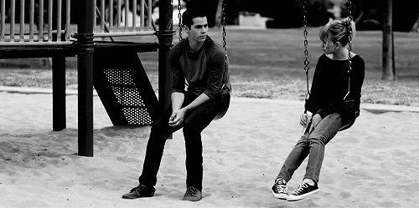
20

Slide 21
21

Slide 22
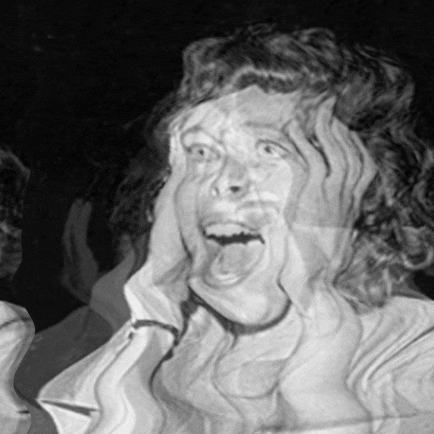
22

Slide 23
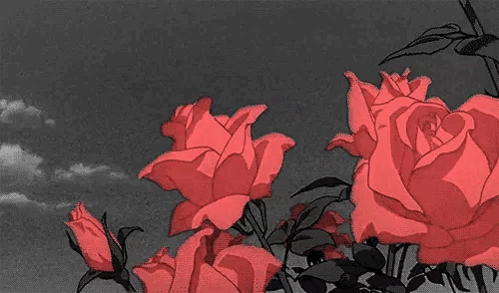
23

Slide 24
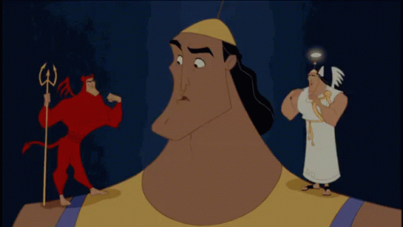
24

Slide 25
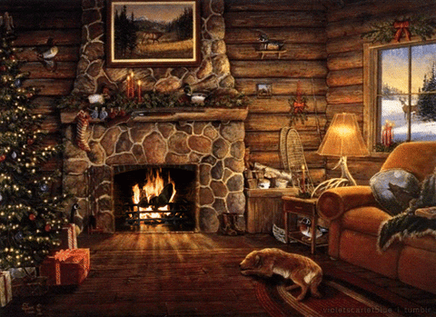
25

Slide 26
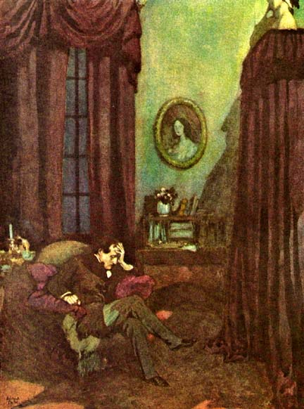
26

Slide 27
27

Slide 28
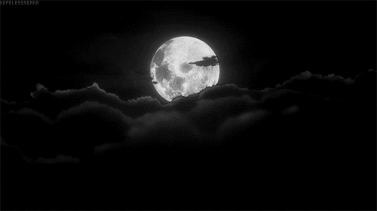
28

Slide 29
29

Slide 30
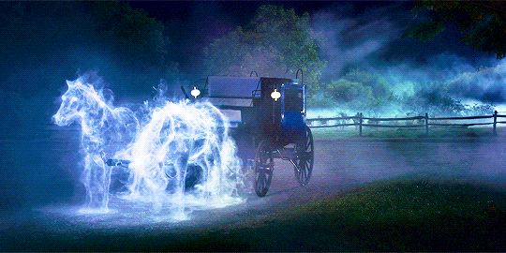
30

Slide 31
31

Slide 32
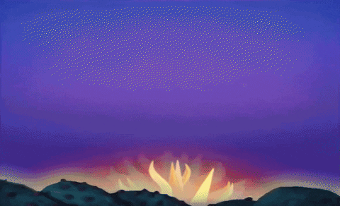
32

Slide 33
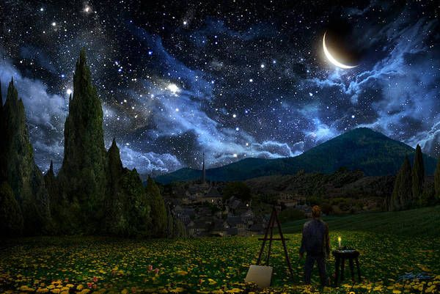
33

Slide 34
34

Slide 35
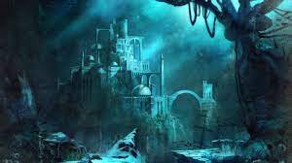
35

Slide 36
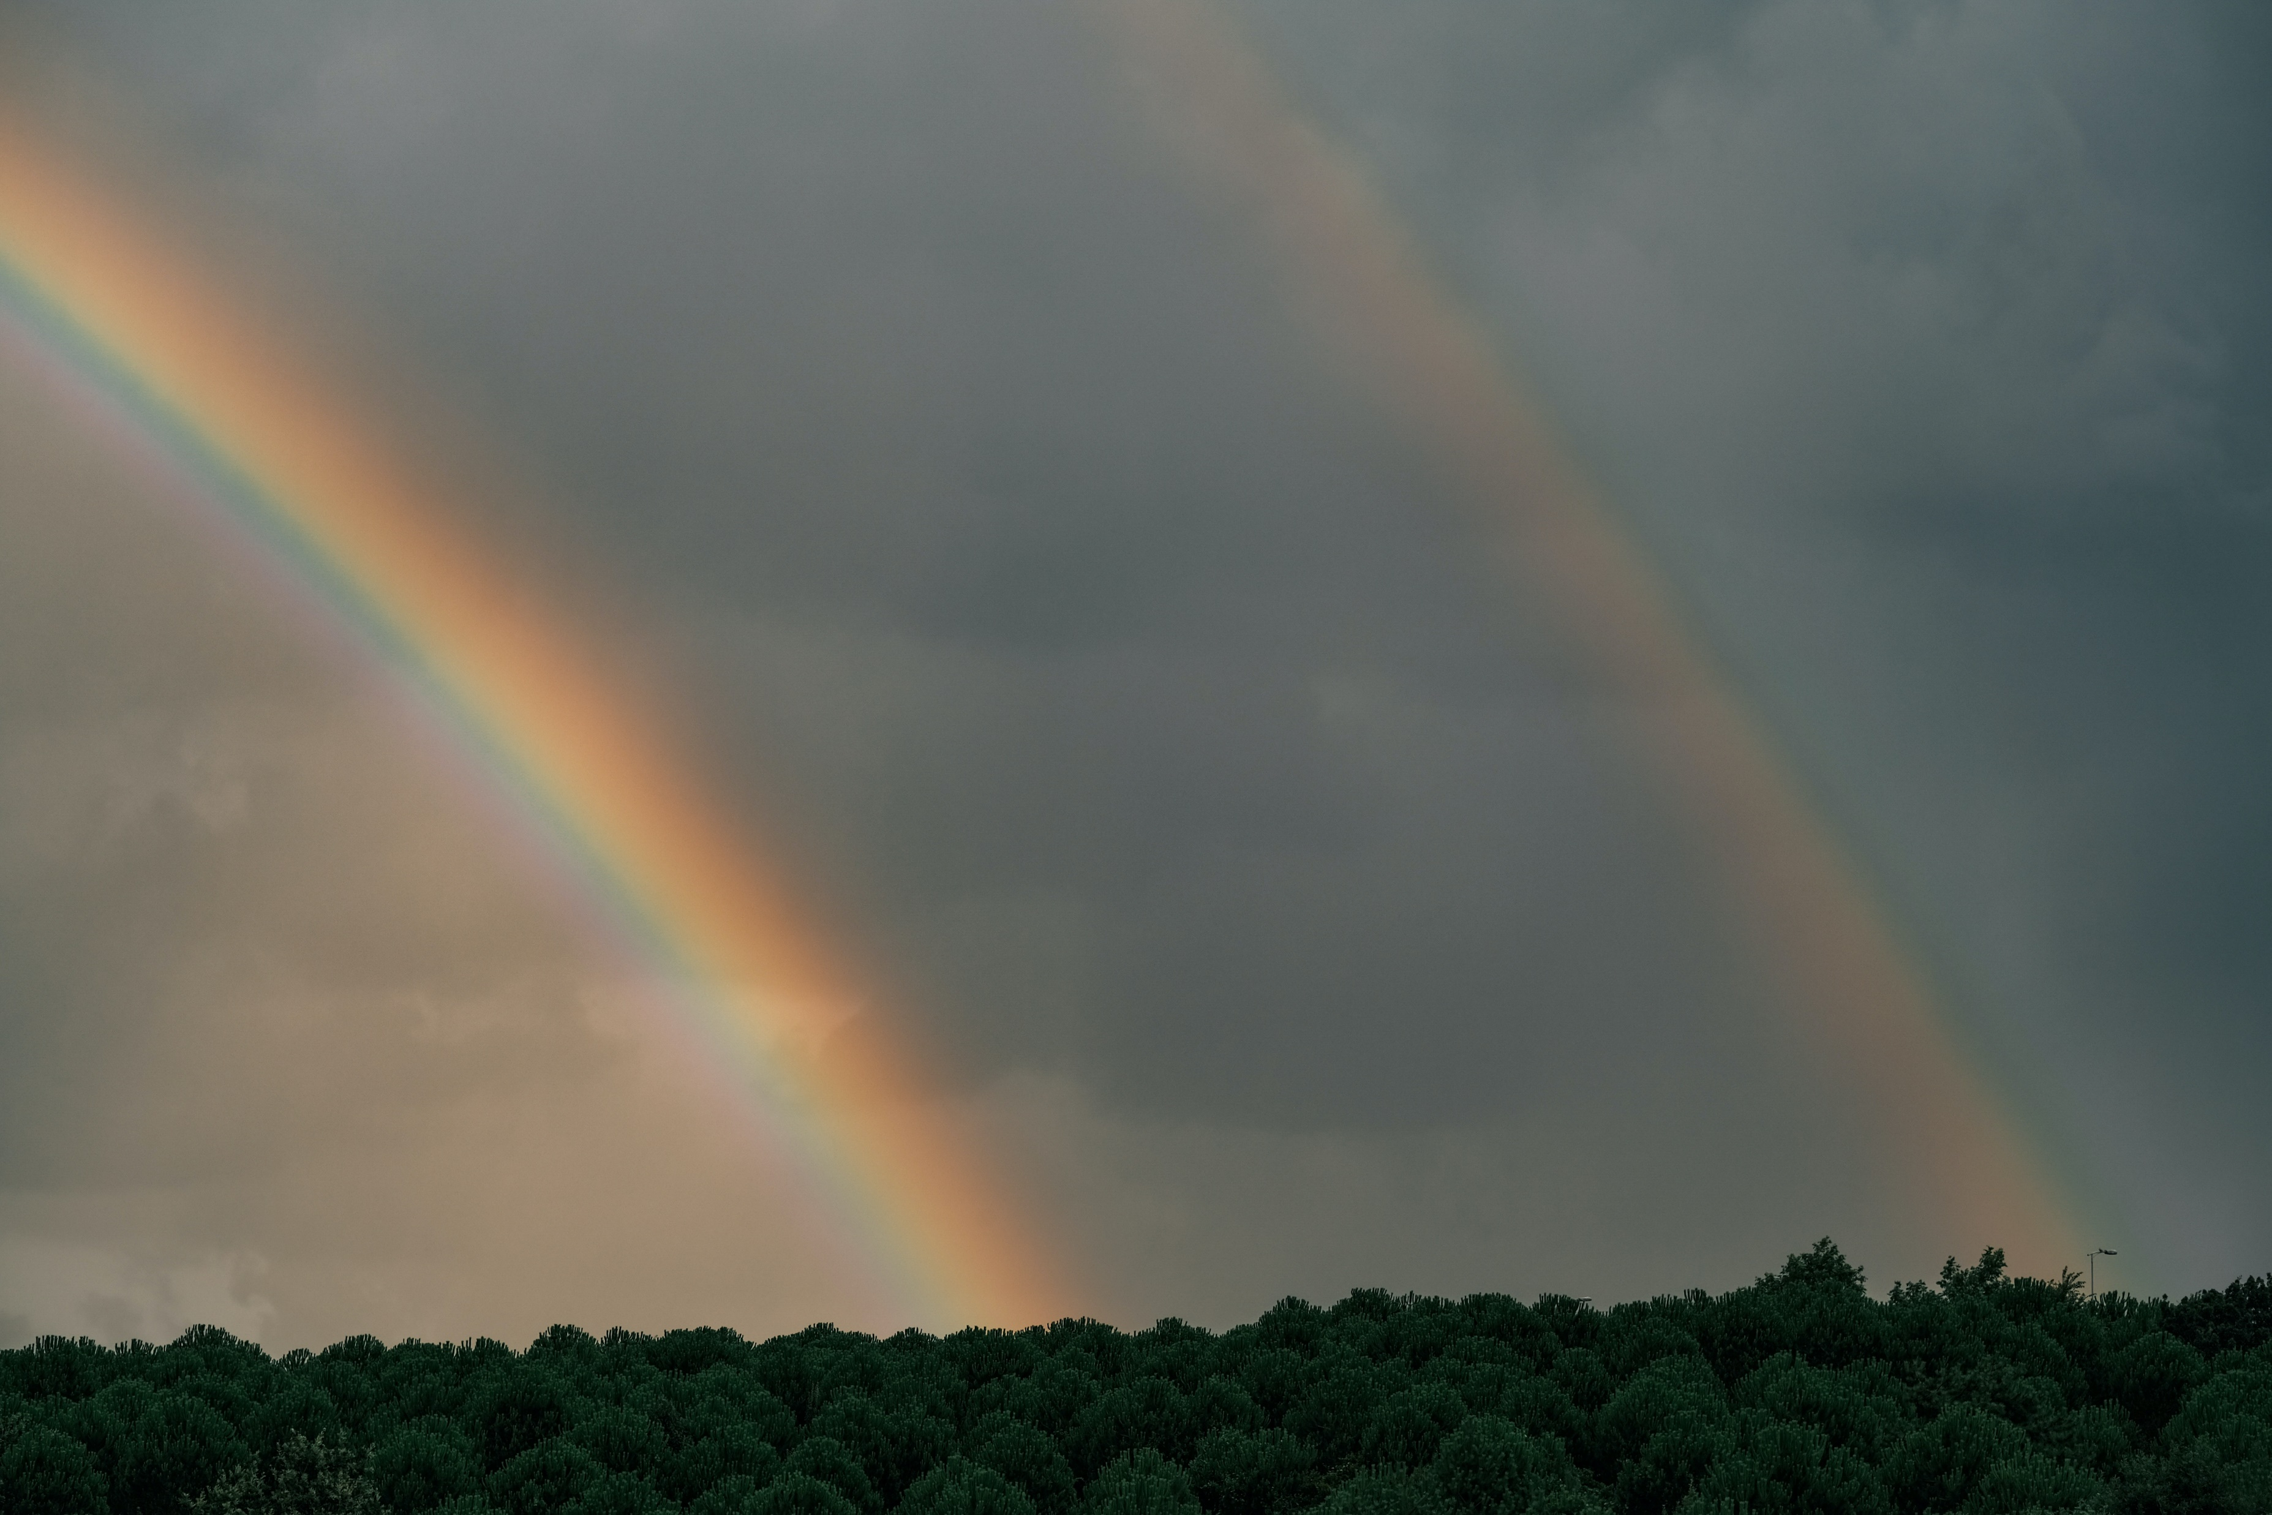
36

Slide 37
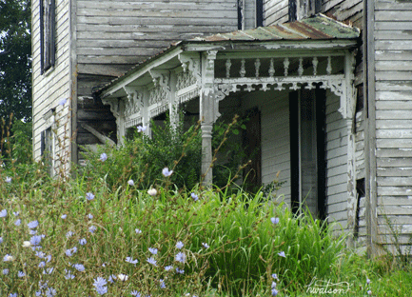
37

Slide 38
38

Slide 39
39

Slide 40
40

Slide 41
41

Slide 42
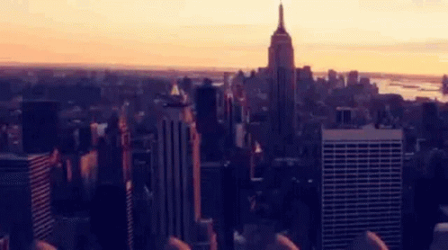
42

Slide 43
Explanation
Pick your number for the background
On the bottom of the page PUT A STAR, if you would like a different option than available. Suggest some possible topic.
Write a paragraph:
How does this background represent your poem?
What theme (reoccurring idea) or moral (lesson learned) is there in your poem? Does it connect with the background? Explain?
How does the background connect with ethos, pathos, logos, or kairos.
Ethos: Credibility/Reliability/Validity
Pathos: Emotion
Logos: Logic
Kairos: Timeliness

