Slide 1
The next 2 pages are the handout for students. Edit as required and print back to back
Copyright innovativeteachingideas.com

Slide 2
Personal Discovery Learning Project (Passion Project)
The purpose of this task is for you to learn something new; something that you have always wanted to do. Maybe you have wanted to learn how to play a guitar. Build a dog kennel, cook a gourmet meal, complete a family tree or even learn to make a movie.
There is absolutely no limit to what you want to learn as long as you are passionate about the subject area.
Through the completion of this task you will gain new skills, knowledge and understanding about something that is important to you and your own ability to learn. But there is a catch – you must learn this area well enough to share your knowledge with your peers, parents and teacher. And they will all be assessing you.
This task will take you the course of the term to complete, but you will need to complete a series of small tasks along using a blog or diary to communicate your progress with peers, parents and your teachers. This Project will culminate in the last week of term in a presentation of your choice no longer than 3 minutes demonstrating the skills, knowledge and journey of your learning process. We would like you to be creative in putting this presentation together and will be using our class sessions to explain some examples of how you might like to present your final project. Below is a timeline of tasks we are expecting you to stick to.
Weeks 1: Getting Started
Setting up your diary and / or accessing your blog and email if you choose to do this task online.
Discussing ideas with those around you and understanding the timeline and expectations of this project.
Week 2 & 3 Your Proposal?
You will explore your learning opportunities and submit a proposal to your teacher via paper or email your teacher for approval. Make sure you put some thought and research into what it is you want to do and above all else talk to mum and dad about it to see if it can happen?
Within proposal you will have to come up with a conclusion of how you will know if you have successfully learnt your task. Your teacher will let you know if your passion project has been approved.
Week 4: Research and Development
What skills, resources, information will you need to complete your task and what is the best way for me to learn this skill? This is the key Learning phase of the task. You will complete a lotus diagram on paper of the selected idea and submit it to your teacher.
Week 5, 6 & 7: Getting Hands on
Undertaking, completing and if necessary, refining your task. This is the doing phase of the project. It is here that you are assigned time to cook, build, learn and understand. Students will use the E Journal to make 2 entries on how they are going with their progress and identify any successes and failures they have come across.
Week 8 & 9: Presentation Creation
Reflecting and reporting on what you have learnt. This is where you make your 3-minute presentation on what you have learnt see the next page for ideas.
Week 10: It’s Showtime
Presenting: Presenting your final report to parents and your classmates and teacher for assessment and assessing your peers.
Copyright innovativeteachingideas.com

Slide 3
You can present your project in a variety of ways. Remember to make lots of entries in your blog and take lots of photos and collect any evidence of your work so that you can share it in your final presentation.
Here are some different ways you can present your Final Project:
Speech | Video | Poster | Blog / website
Scrapbook | Animation | Diorama | PowerPoint
Poetry | Mind Map | Booklet | Comic Strip
Podcast | Picture / Image | Theatrical | Music & Lyrics
PLEASE NOTE: that this is part of a bundle which includes a detailed description of each week and all additional tools and documents required to complete the project. Your Teacher should have this bundle and resources. Please click here if you wish to access the entire bundle.
Copyright innovativeteachingideas.com

Slide 4
The next page is a letter for parents
Copyright innovativeteachingideas.com

Slide 5
Dear Parents
As a celebration of the completion of our Personal Discovery Learning for term three all of our grade 5/6 students will be doing a brief presentation outlining their learning journey and share their insights and any finished products to their classmates and teachers.
Parents are invited to come and watch these presentations which will be held on Monday and Tuesday of next week. Presentations will run 2:30 – 3:30 and your child will be presenting theirs on
We hope you can make it and look forward to seeing you there.
Regards,
The Grade 5 / 6 Team
Copyright innovativeteachingideas.com

Slide 6
The next page is the matching assessment rubric to the presentation.
Copyright innovativeteachingideas.com

Slide 7
Passion Project Assessment Tool
 | Beginning 1 point | Intermediate 2 Points | Accomplished 3 Points
Evidence of Learning | Has little to no evidence of the learning process. | Has produced either photographs or the item itself with little other evidence to support their learning journey. | Has produced the item and photographs or other records of their learning process.
Reflecting on learning | Doesn’t identify things that they would change or keep in doing this again. | Can identify factors that made the process ineffective or effective. | Can clearly identify factors that assisted or confused the process and have alternate strategies in place to make the learning experience better in future.
Was the Goal Achieved? | No and there is no real explanation of why this happened. | Yes / no: but there is a clear understanding of why and if the goal was achieved it was partially successful. | The goal was achieved.
Speaking and Listening Skills The Presentation Phase | Has very little information prepared and it is unclear what happened during the learning process. | Has prepared a presentation and or speech and can communicate the learning process to others. | Can clearly articulate their learning journey through a prepared speech and other resources such as computer presentation tools.
Name:
Final Score: Additional Comments:
Copyright innovativeteachingideas.com

Slide 8
The remaining pages contain a range of tools for you to incorporate into your passion projects.
Copyright innovativeteachingideas.com

Slide 9
Copyright innovativeteachingideas.com

Slide 10
Self-Reflection Tool
Date:
What did I do?
What was successful?
What was a failure?
What is my next step?
What did I see today that gave me a new insight or idea?
Copyright innovativeteachingideas.com

Slide 11
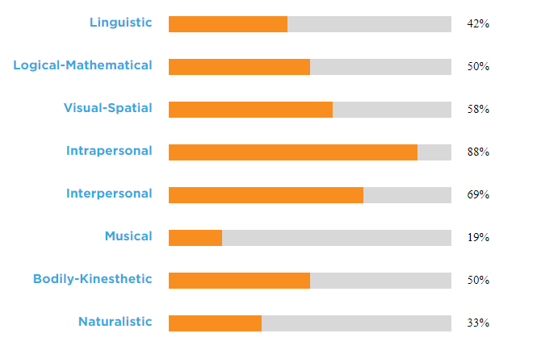
Multiple Intelligence Reflection
Like everything else in life we are all unique learners. Howard Gardner, a famous educational researcher came up with 8 different styles of learning, and you both learn more about them and complete a simple 5 minute test to identify your learning style here.
Copy your results over the one to the right and fill out the reflection tool below to examine your preferred learning styles and explore whether you agree with them.
edutopia.org/multiple-intelligences-assessment
My strengths according to the test were…
My weaknesses according to the test were…
Do I agree with these? And why?
Copyright innovativeteachingideas.com

Slide 12
Passion Project Action Planner for Students
Action Steps (List in priority) | When will it be done? | What tools & Resources do I need? What have I got? | Are there any barriers which may impede me? Thoughts? | Completed?
Copyright innovativeteachingideas.com

Slide 13
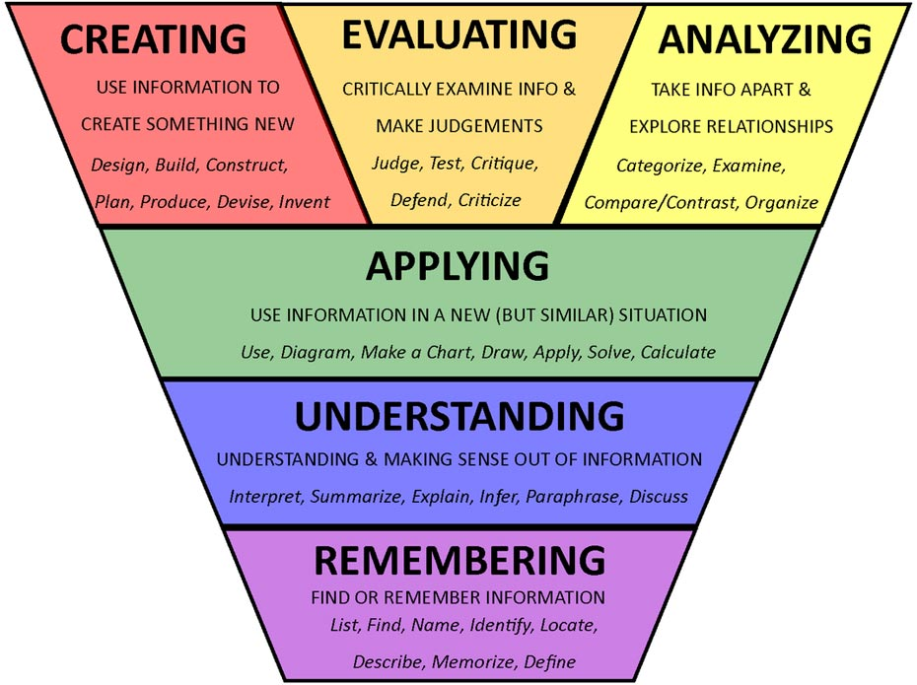
Bloom’s Taxonomy Learning Checklist.
I created…
I evaluated…
I analysed..
Identify what elements of Bloom’s Taxonomy you addressed throughout the completion of this project.
Fill out the boxes above and below with the most relevant information you can for each of the elements described in the graphic to the right.
I applied…
I understood…
I remembered..
Copyright innovativeteachingideas.com

Slide 14
Passion Project Brainstorming - Idea # 1
Come up with three ideas for your passion project to share with your teacher. Fill out this planner, and then you can discuss exploring it further.
Idea title:
Explain your idea
What would you require to do this? | Where, and how will I find information on this topic?
 | What are some roadblocks I could foresee?
Copyright innovativeteachingideas.com

Slide 15
Passion Project Brainstorming - Idea # 2
Come up with three ideas for your passion project to share with your teacher. Fill out this planner, and then you can discuss exploring it further with your teacher.
Idea title:
Explain your idea
What would you require to do this? | Where, and how will I find information on this topic?
 | What are some roadblocks I could foresee?
Copyright innovativeteachingideas.com

Slide 16
Passion Project Brainstorming - Idea # 3
Come up with three ideas for your passion project to share with your teacher. Fill out this planner, and then you can discuss exploring it further with your teacher.
Idea title:
Explain your idea
What would you require to do this? | Where, and how will I find information on this topic?
 | What are some roadblocks I could foresee?
Copyright innovativeteachingideas.com

Slide 17
SMART Goal Setting Tool
My goal is:
S | Specific | What do I want to accomplish Why do I want to do it? What are the requirements What are my tools? What are my barriers?
M | Time-Measurable | How will I track my progress? How will I know hen the goal I accomplished?
A | Achievable | How can the goal be accomplished? What are the obvious steps?
R | Relevant | Is this a worthy project? Is the time right to do this? Can I realistically achieve this? How does it connect to other goals in life?
T | Time-Bound | What is the expected time frame to complete this? When is it due? When am I going on this?
Copyright innovativeteachingideas.com

Slide 18
Passion Project Self Evaluation & Teacher Feedback Tool
Name:
Please answer in detail and provide to your teacher when presenting your passion project.
After completing this project I am most proud of…
The biggest thing/s I learned from this project was…
The most difficult part of the project for me was…
This project has inspired me to consider trying new things such as…
What would you change about this for future students undertaking it?
Copyright innovativeteachingideas.com

Slide 19
Passion Project Timeline
Name:
Please answer in detail and provide to your teacher when presenting your passion project.
After completing this project I am most proud of…
The biggest lesson/s I learned from this project are…
The most difficult part of the project for me was…
This project has inspired me to consider trying new things such as…
What would you change about this for future students undertaking it?
Copyright innovativeteachingideas.com

