Slide 1
Welcome to
Damonte Ranch High School

Slide 2
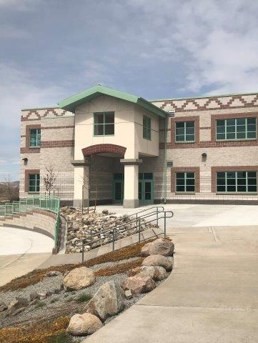
Mustang Pride!
Signature Academy
Performing Arts Center
Dance
Theater
Music
Clubs
Athletics
Academic Supports
Damonte Ranch students pride themselves on being part of the Mustang Family!

Slide 3
High School vs. Middle School
Semester vs. Quarter grading periods
8 classes, FS each day
1800 vs. 700 students
No houses/teams
Homework every day!
All credits must be earned for a diploma
Credits are earned by passing all classes

Slide 4
Infinite Campus
This tool provides up-to-date information on:
Grades
Attendance
Teacher contact info
Check Infinite Campus at least once a week to make sure students are being successful. Email teachers for more specific information.
Reach out to DRHStech@washoeschools.net for assistance
*Please keep your Infinite Campus contact information current to help the school communicate with you.

Slide 5
Grades
Be on the lookout for:
Progress Reports
Every 4½ weeks if any grade is a C or below
Report Cards
Every 9 weeks (quarterly)
Grades at semester go on the transcript!!!
This Photo by Unknown author is licensed under CC BY-SA-NC.

Slide 6
Our goal....... Graduation!

Slide 7
Freshmen Schedule
Students will be selecting courses in December when DRHS Counselors visit the Middle Schools
All freshman electives are listed on their registration sheet
Freshman courses are yearlong
English | Math
Science | PE/ Military Science
Foreign Language/Comp Sci | Art/Humanities
Freshman Seminar 7th period | Freshman Seminar 8th period

Slide 8
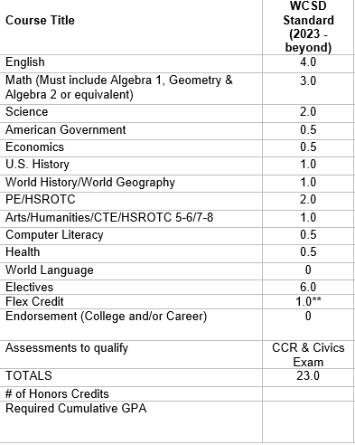
Diploma Options

Slide 9
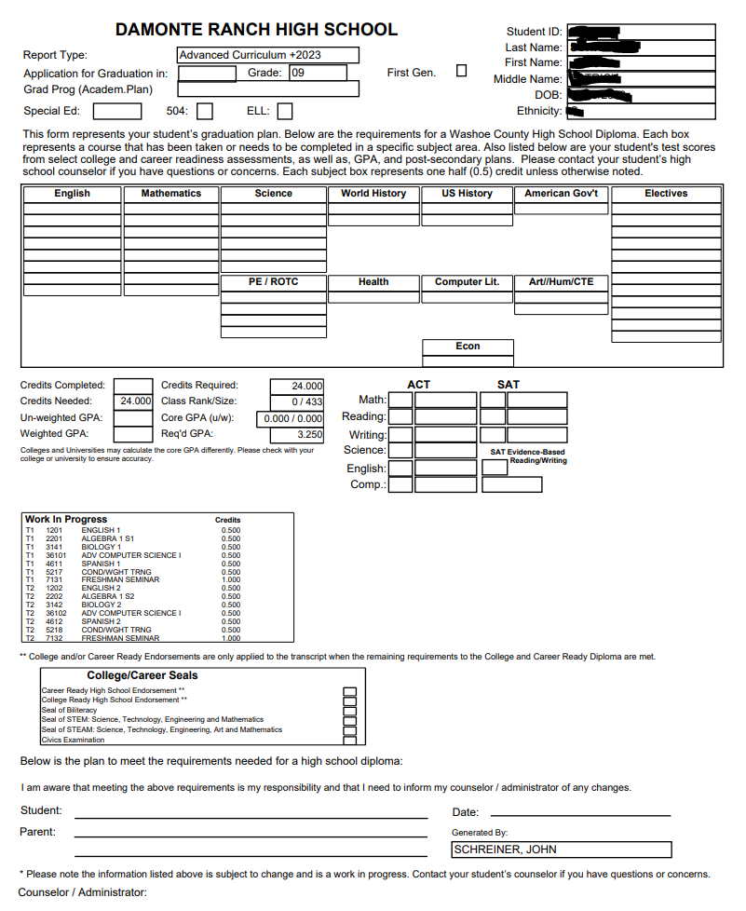
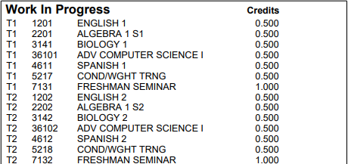

Slide 10
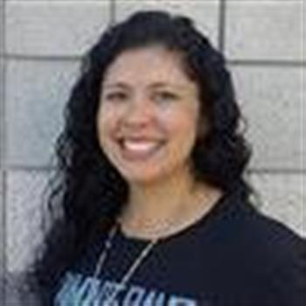
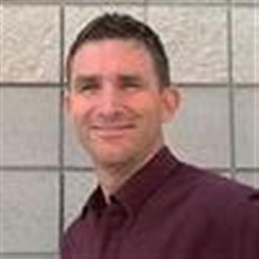
Have a GREAT YEAR!
See your counselor or Mr. Cabada in the College & Career Center with any questions!
Ms. Lazear
A-C
Mr. Woodard
D-Hi
Ms. McColl
Ho-Mi
Ms. Barnard
Mo-Sa
Mr. Schreiner
Sc-Z
Mr. Cabada
College & Career Center

