Slide 1
Indigenous Americas
1000 BCE-1980 CE

Slide 2
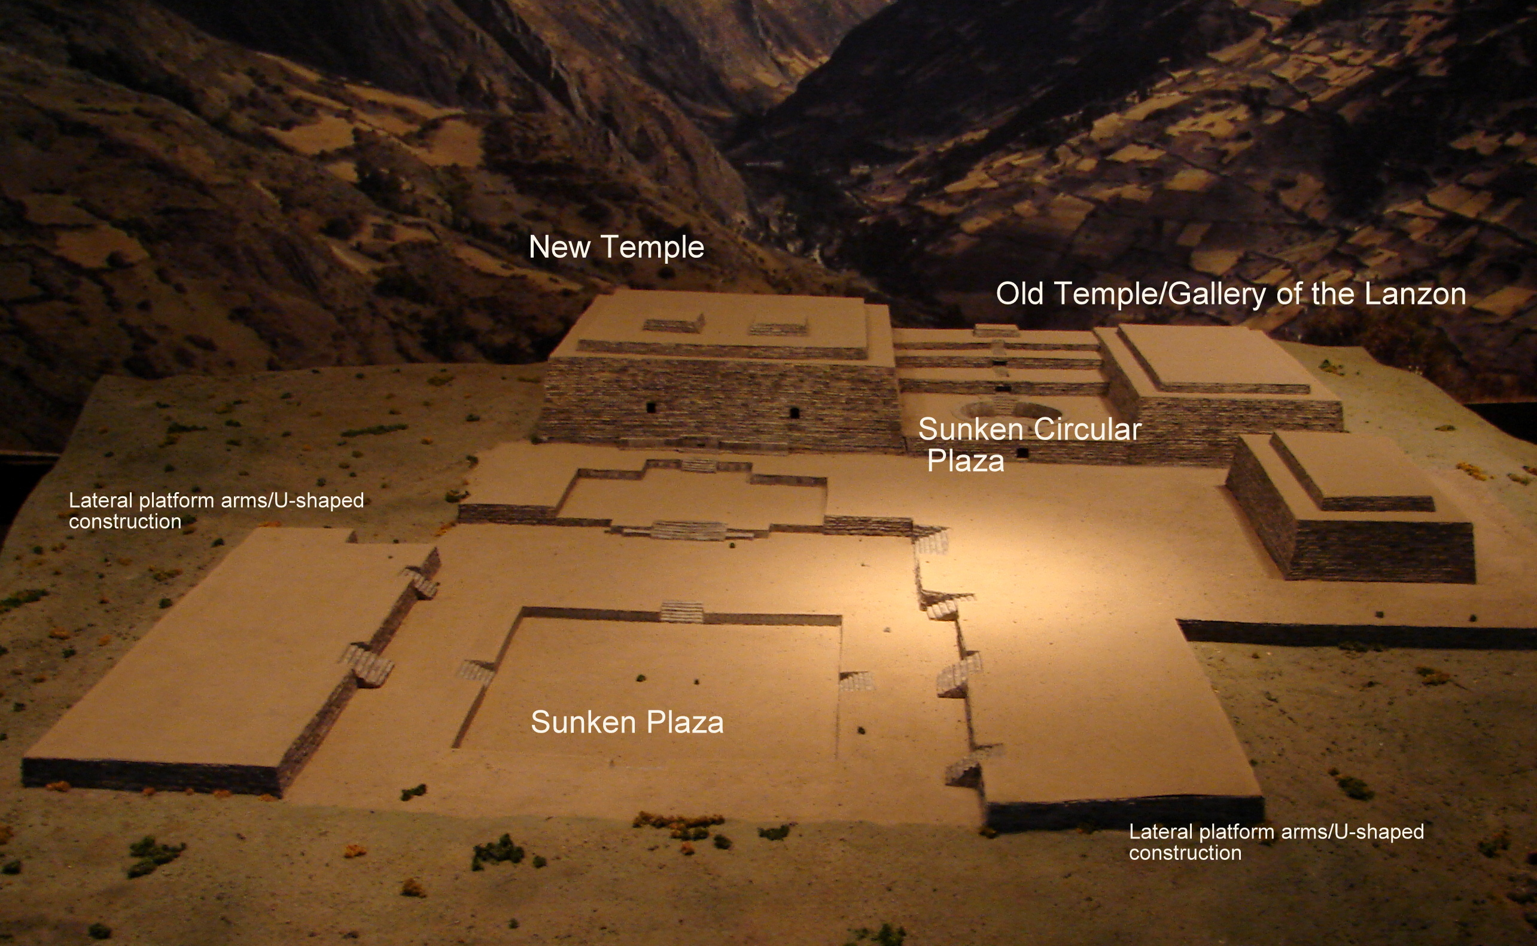
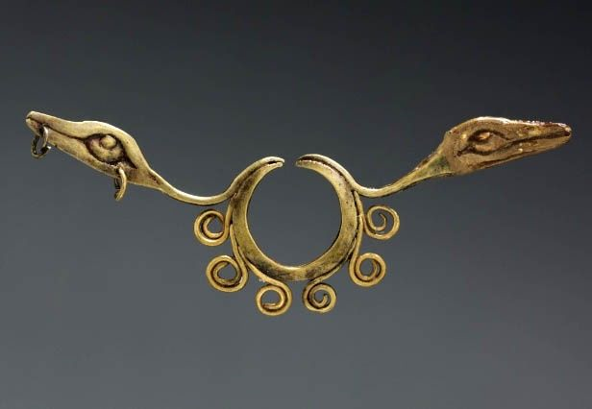
Chavin de Huantar
Setting: Northern highlands, Peru
Medium: Stone, granite, hammered gold alloy
https://www.khanacademy.org/humanities/ap-art-history/indigenous-americas/a/chavin-de-huantar1

Slide 3
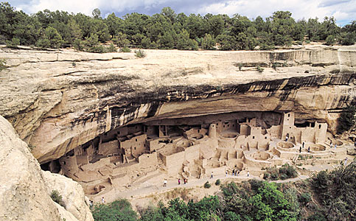
Mesa Verde cliff dwellings
Setting: Montezuma County, Colorado (450-1300CE)
Medium: sandstone
https://www.khanacademy.org/humanities/ap-art-history/indigenous-americas/a/mesa-verde-cliff-dwellings

Slide 4
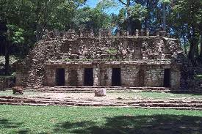
Yaxchilan
Setting: Chiapas, Mexico. Maya
Medium: limestone
https://www.khanacademy.org/humanities/ap-art-history/indigenous-americas/a/yaxchilan-lintels

Slide 5
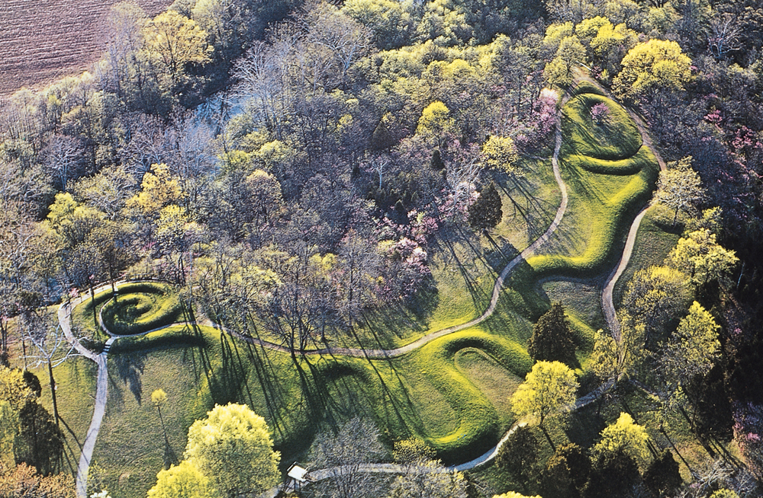
Great Serpent Mound
Setting: Adams County, southern Ohio
Medium: earthwork/effigy mound
https://www.khanacademy.org/humanities/ap-art-history/indigenous-americas/a/fort-ancient-culture-great-serpent-mound

Slide 6
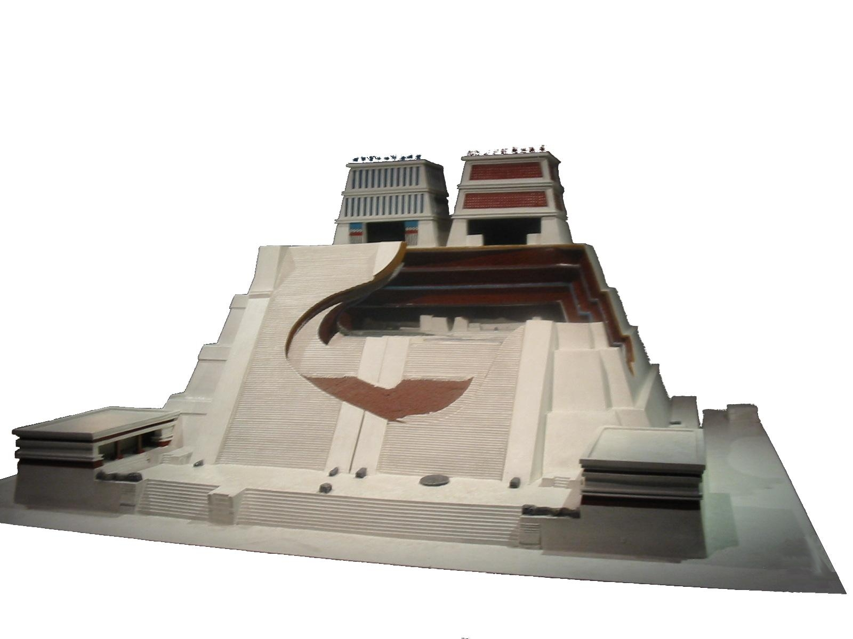
Templo Mayor (Main Temple)
Setting: Tenochtitlan (modern Mexico City, Mexico) Aztec
Medium: Stone (temple) Volcanic stone (coyolxauhqui stone)
https://www.khanacademy.org/humanities/ap-art-history/indigenous-americas/a/templo-mayor-at-tenochtitlan-the-coyolxauhqui-stone-and-an-olmec-mask

Slide 7
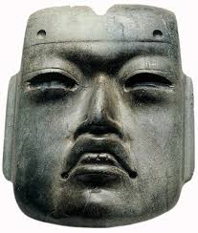
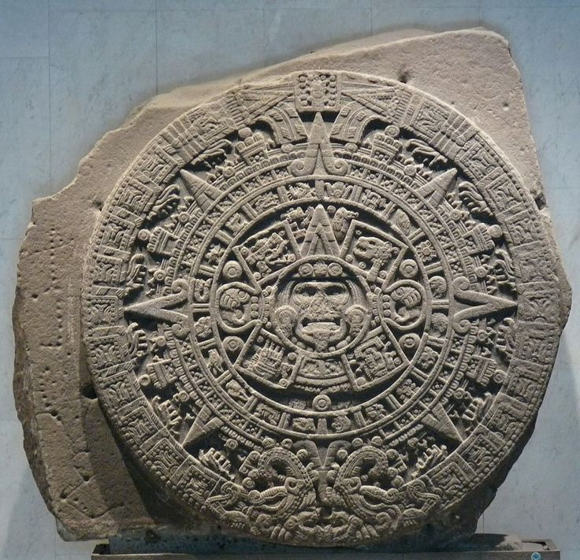
Templo Mayor (Main Temple) (cont.)
Medium: basalt (calendar stone), jadeite (Olmec-style mask)

Slide 8
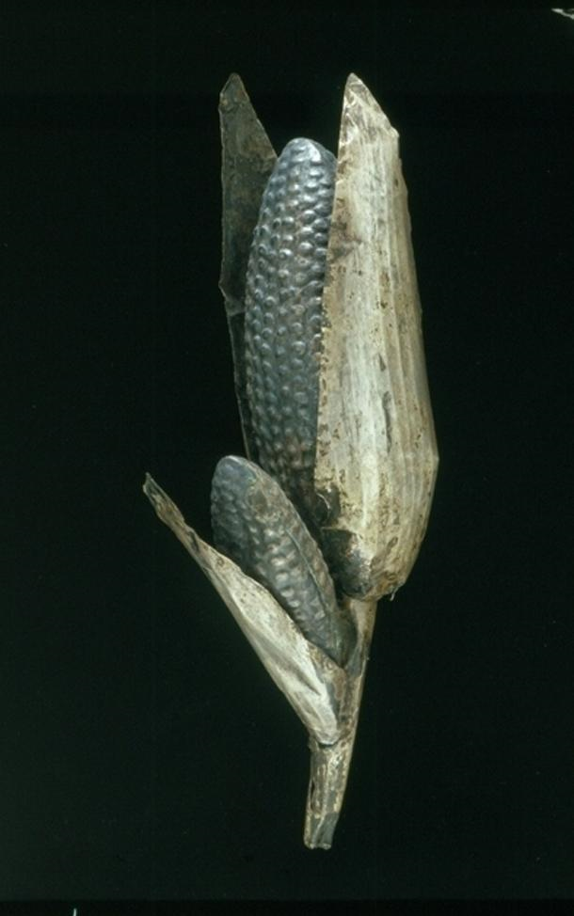
Silver and Gold maize cobs
Setting: Inka
Medium: sheet metal/repousee, gold and silver alloys
https://www.khanacademy.org/humanities/ap-art-history/indigenous-americas/a/maize-cobs

Slide 9
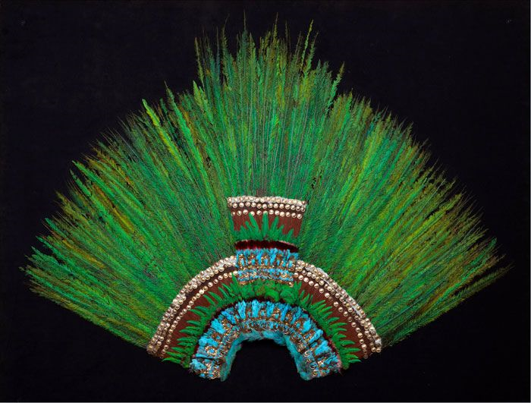
Ruler’s feather headdress (probably of Motecuhzoma)
Setting: Mexica (Aztec)
Medium: feathers and gold
https://www.khanacademy.org/humanities/ap-art-history/indigenous-americas/v/feathered-headdress-aztec

Slide 10
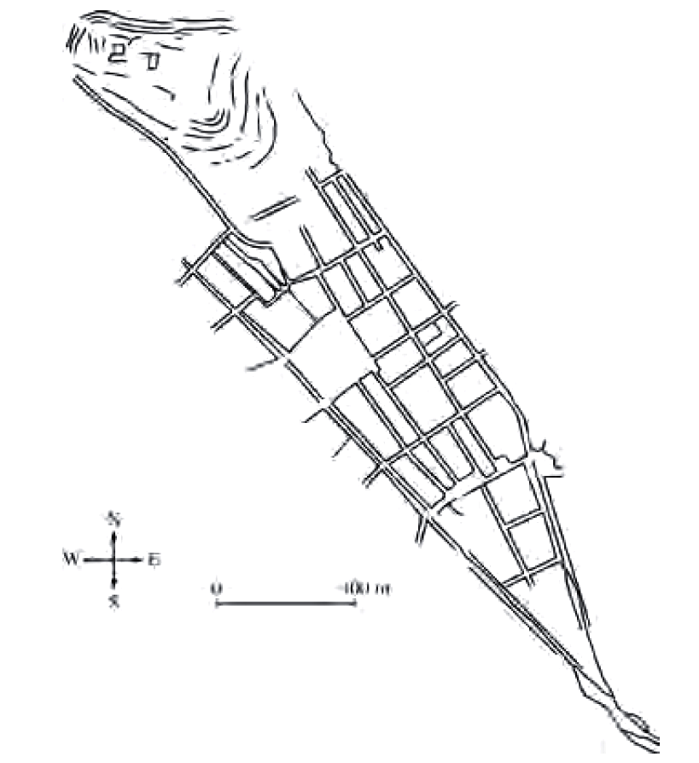
City of Cusco, including Qorikancha (main temple/church and covent of Santo Domingo) and Walls at Saqsa Waman (Sacsayhuaman)
Setting: Central highlands, Peru
Medium: Sandstone
https://www.khanacademy.org/humanities/ap-art-history/indigenous-americas/a/city-of-cusco

Slide 11
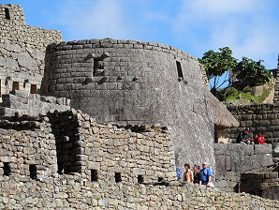
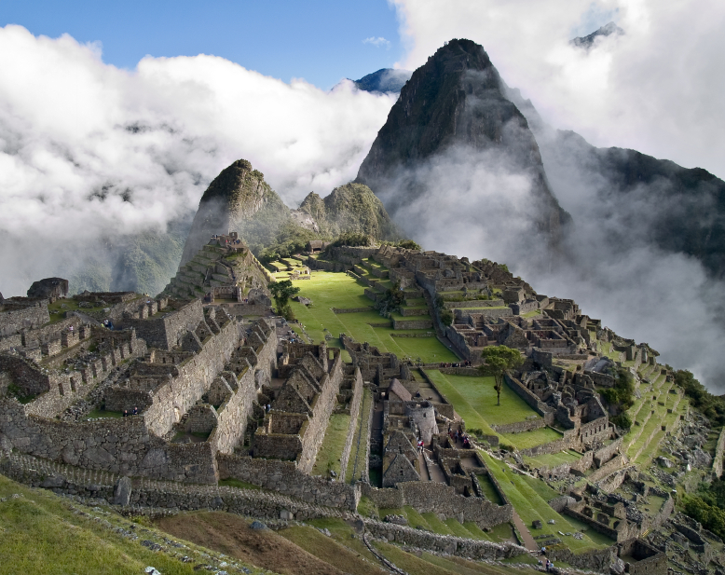
City of Machu Picchu
Setting: Central highlands, Peru. Inka
Medium: Granite
https://www.khanacademy.org/humanities/ap-art-history/indigenous-americas/a/machu-picchu

Slide 12
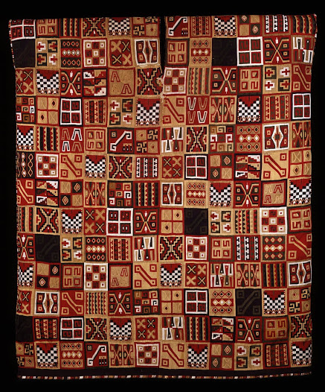
All-T’oqapu tunic
Setting: Inka
Medium: Camelid fiber and cotton
https://www.khanacademy.org/humanities/ap-art-history/indigenous-americas/a/all-toqapu-tunic

Slide 13
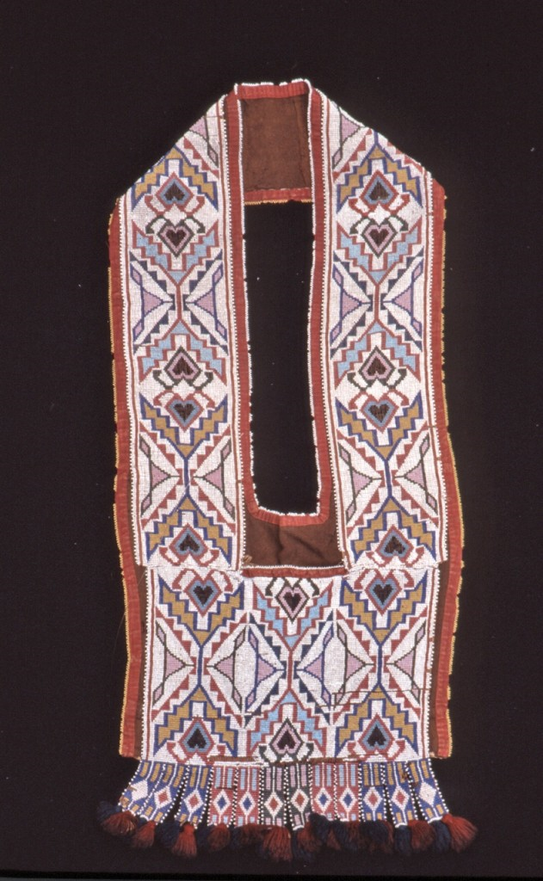
Bandolier bag
Setting: Lenape (eastern Delaware) tribe
Medium: beadwork on leather
https://www.khanacademy.org/humanities/ap-art-history/indigenous-americas/a/bandolier-bag

Slide 14
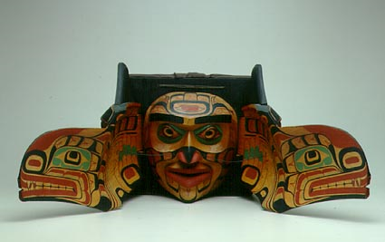
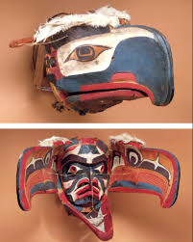
Transformation mask
Setting: Kwakiutl, Northwest coast of Canada
Medium: wood, paint, and string
https://www.khanacademy.org/humanities/ap-art-history/indigenous-americas/a/transformation-masks

Slide 15
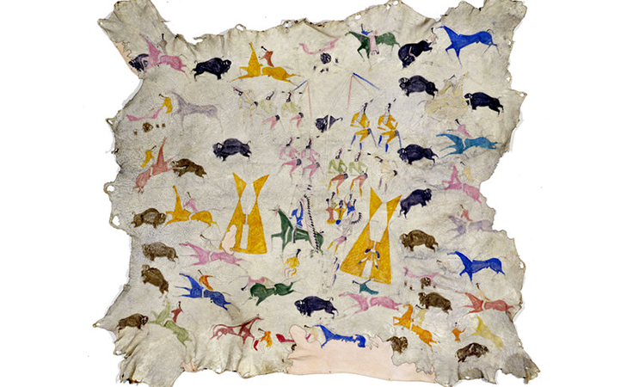
Hide painting of Sun Dance
Setting: Eastern Shoshone, Wind River Reservation, Wyoming
Medium: Painted elk hide
https://www.khanacademy.org/humanities/ap-art-history/indigenous-americas/a/eastern-shoshone-hide-painting-of-the-sun-dance-attributed-to-cotsiogo-cadzi-cody

Slide 16
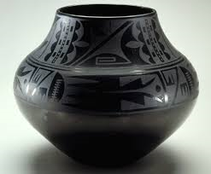
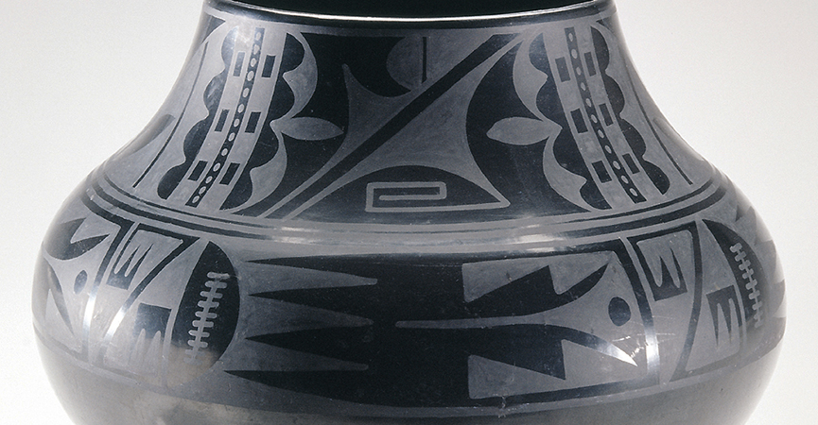
Black-on-black ceramic vessel
Artist: Maria Martinez and Julian Martinez
Setting: San Ildefonso Pueblo, New Mexico
Medium: Blackware ceramic
https://www.khanacademy.org/humanities/ap-art-history/indigenous-americas/a/puebloan-maria-martinez-black-on-black-ceramic-vessel

