Slide 1
Welcome Team Morris

Slide 2
Meet the Team
2
MS. MORRIS
MRS. CRAMER
MS. GOULART
MRS. LUNDY
MRS. MULLIN
SOCIAL STUDIES
SCIENCE
MATH
ELA
COUNSELOR

Slide 3
Expectations: Students
3
Fill out agendas daily & weekly Check grades on IC Communicate with teachers TRY
Participate
Learn from mistakes
Be prepared

Slide 4
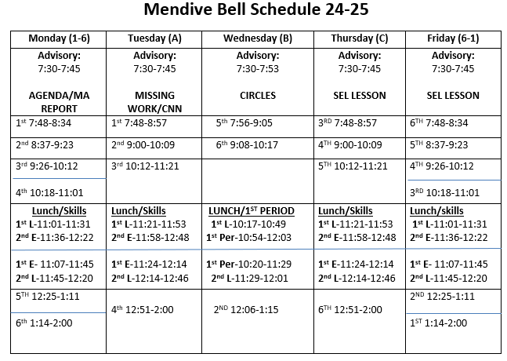
Daily
4
Schedule

Slide 5
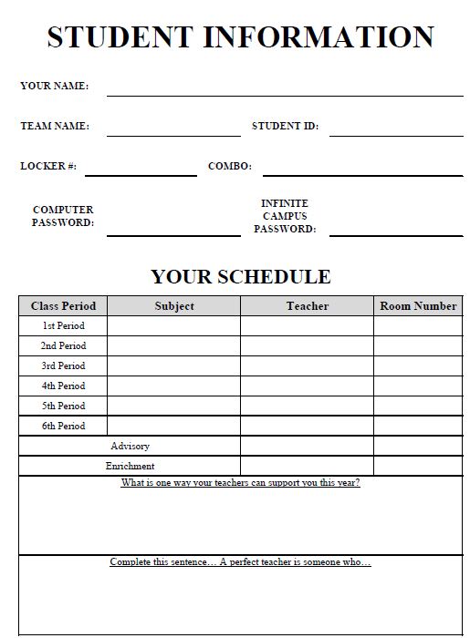
Agenda Book
5

Slide 6
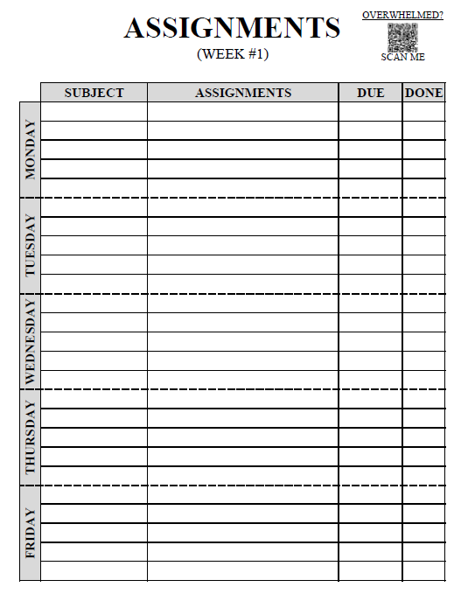
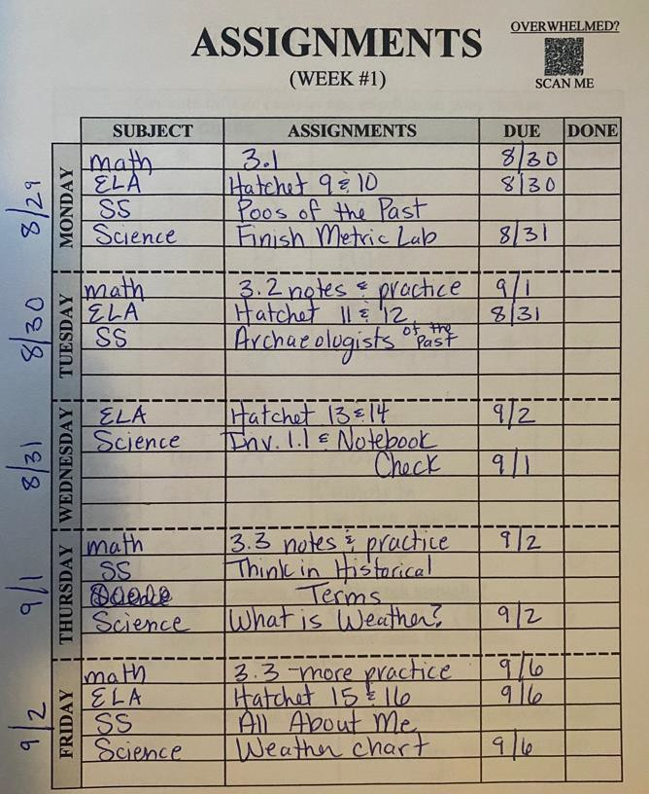
Agenda Book
6

Slide 7
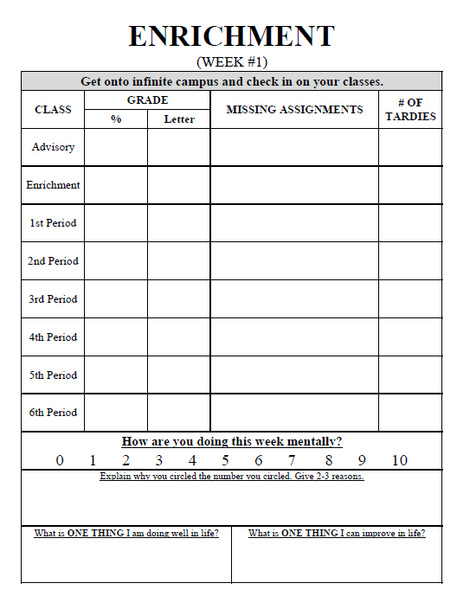
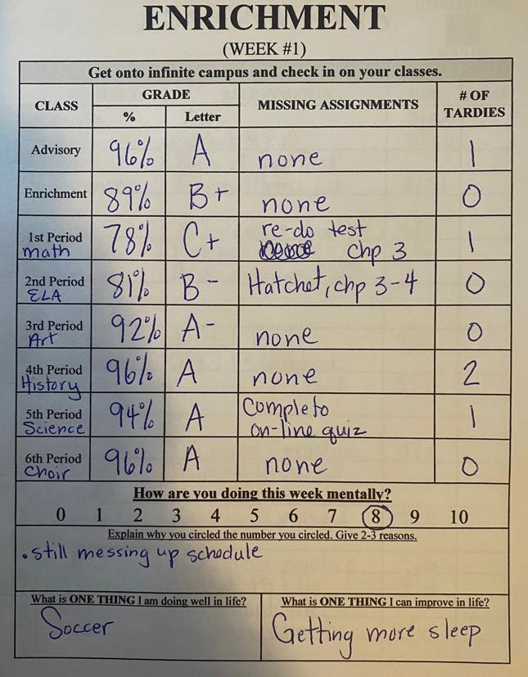
Agenda Book
7

Slide 8
8
Used for daily announcements
Get students ready for the day
Go over weekly assignments
SEL
Grading
Participation- 15 pts./week
Agenda Checks- 15 pts./week
Advisory

Slide 9
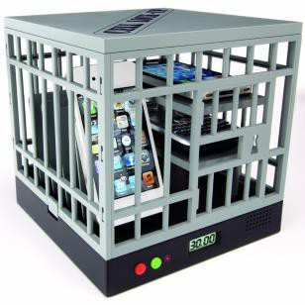
Cell Phones and Ear Buds
10
Cell Phone: Cell phones and earphones/ear pods are NOT allowed during class.
NO see, NO hear!
1st occurrence = warning, cell phone/ear pods will be taken away and student can pick up at end of the day, parent notified.
2nd occurrence = cell phone/ear pods given to office, student can pick up after school, parent notified.
3rd occurrence = phone/ear
pods given to office and parent must pick up after school.

Slide 10
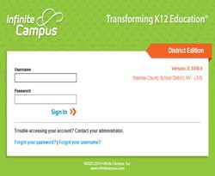
Critical for success
Logins are reset through Ms. Morris
12
INFINITE CAMPUS
Check often and please email teachers
Missing vs 0's
The team teachers will send out
a weekly messenger through IC every Friday. This will include weekly
assignments, homework, and due
dates

Slide 11
12
Late Work Policy:
In most cases, assignments will be completed during class. However, some assignments may need to be completed at home.
Students will be given an additional 2 weeks from the assigned due date to complete and turn in any missing assignments.
Once assignments are 2 weeks late, the students will be given a 0, and will no longer have the ability to complete and turn in the missing work.
If you or your student have a question about a grade, please contact the teacher immediately.
INFINITE CAMPUS

Slide 12
Expectations: Parents
13
Help your child organize/prepare for classes with clean backpack, supplies, & time to study
Check IC at least weekly; Communicate with teachers or help you child advocate for him/herself

Slide 13
Expectations: Teachers
14
Update IC weekly
Team Board / Website washoeschools.net/teammorris Support all students
Rigorous & relevant lessons

Slide 14
Keeps students proactively organized
○ Great Resources
15
Includes a page for each teacher and weekly agenda
Team Website
To access Team Morris website, type the following into your address bar:

Slide 15
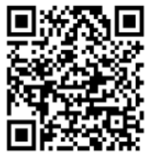
Parent Teacher Home Visit Coordinator-
-The goal of these visits is to build rapport and relationships with our students and their families. The majority of the visits are conducted in the home, while some are conducted at sporting events, parks, birthday parties, even virtually.
Schedule your home visit today!!!
15
Maegen Mullin-Counselor
Maegen.mullin@washoeschools.net
775.327.3995

Slide 16
Absences
Student’s
Responsibility
Communication
w/teachers to clarify is a must
Make-up assignments will be
given

Slide 17
18
It is a part of the student’s
academic grade
We use it to support kids
Rotations
All work in enrichment is classwork-
Students are given time to complete all assignments if time is used appropriately- unless absent.
When students rotate, they can no longer turn in late work for the previous rotation.
Skills

Slide 18
“
19
Team Tardy Policy
Tardies are recorded in IC as UMI- unexcused missed instruction
Excessive tardies will result in lunch detention, parent phone call home, and recording in in Infinite Campus.

Slide 19
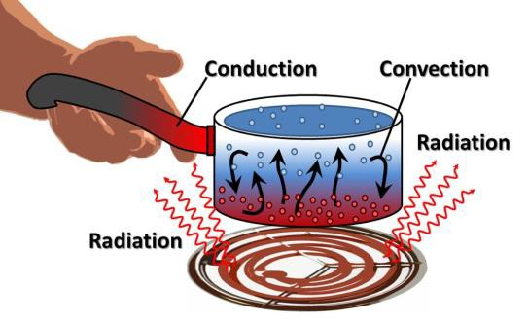
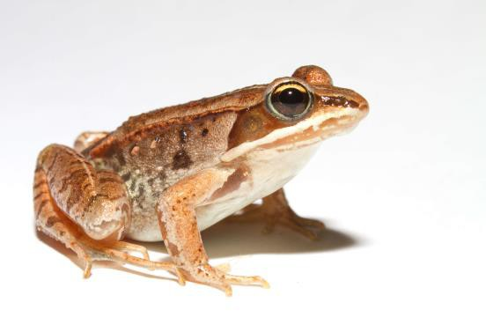
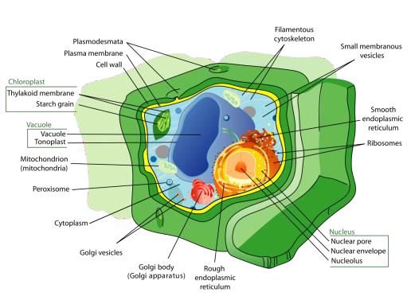
Welcome to 6th grade SCIENCE
20
70%
Classwork, Labs, and HW.
30% Quizzes and
Projects
OpenSciEd
6.1 Light and Matter
Mrs. Cramer
Room 510
Phone: 775-353-5990 X41311
Email: owilson@washoeschools.net

Slide 20
21
Units of study

Slide 21
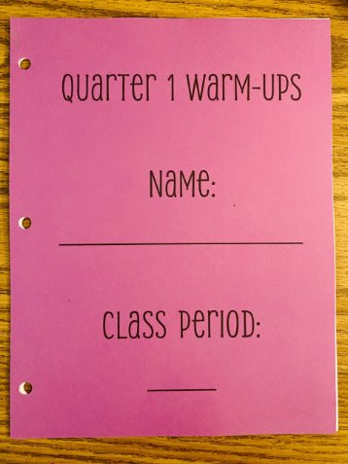
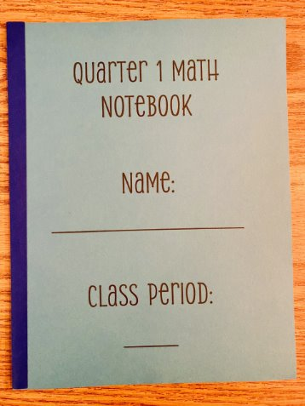
Important Information:​
Warm Up Packet
Notes Packet​
Test Corrections​
Quiz Corrections​
Canvas​
Homework?
22
15
MATH
Grades:
45% Tests
30% Quizzes
15% Classwork
10% Final Exam
Topics Covered:
Number Sense ( Integers, Rational Numbers, Percents etc.)
Ratios and Proportions (Measurement, tables, etc.)
Expressions and Equations (solving for x, PEMDAS, etc.)
Geometry (area, volume, etc.)
Statistics and Probability (representing data, etc.)

Slide 22
23
ELA Department Grade breakdown: 60% Classwork
40% Assessments
ELA
Mrs. Lundy

Slide 23
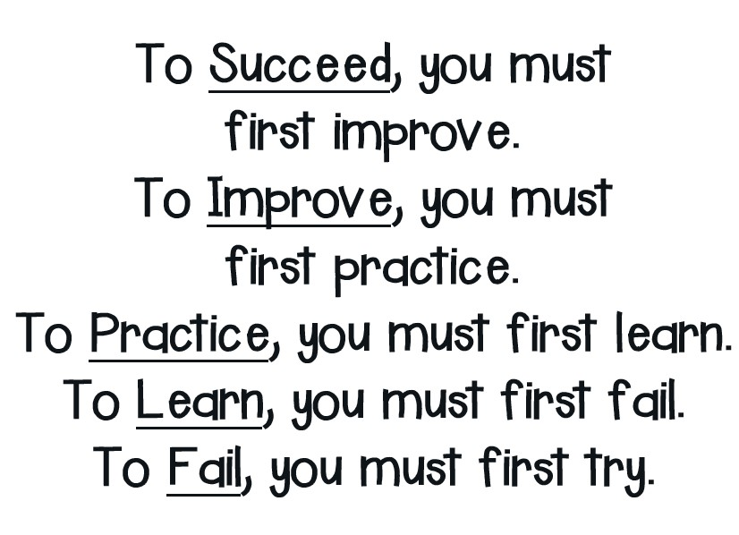
Final Thoughts
25

Slide 24
Final Thoughts... Gen A slang
25

Slide 25
THANK YOU FOR JOINING US!
We hope to also
see you for our
team luncheon
on 9/20!!

