Slide 1
Global Contemporary
1980 C.E. to Present

Slide 2
All Works Listed
The Gates by Christo and Jeanne-Claude 1979-2005 C.E.
Vietnam Veterans Memorial 1992 C.E.
Horn Players by Jean-Michel 1983 C.E.
Summer Trees by Song Su-nam 1983 C.E.
Androgyne III by Magdalena 1985 C.E.
A Book from the Sky by Xu Bing 1987-1991 C.E.
Pink Panther by Jeff Koons 1988 C.E.
Unitiled (#228) by Cindy Sherman 1990 C.E.
Dancing at the Louvre by Faith Ringgold 1991 C.E.
Trade by Jaune Quick-to-See Smith 1992 C.E.
Earth’s Creation by Emily Kame 1994 C.E.
Rebellious Silence, from the Women of Allah series photo by Cynthia Preston 1994 C.E.
En la Barberia no se Llora by Pepon Osorio 1994 C.E.
Pisupo Lua Afe by Michel Tuffery 1994 C.E.
Electronic Superhighway by Nam June Paik 1995 C.E.
The Crossing by Bill Viola 1996 C.E.
Guggenheim Museum Bilbao by Frnk Gehry 1997 C.E.
Pure Land by Mariko Mori 1998 C.E.
Lying with the Wolf by Kiki Smith 2001 C.E.
Darkytown Rebellion by Kara Walker 2001 C.E.
The Swing (After Fragonard), Yinka Shonibare 2001 C.E.
Old Man’s Cloth, El Anatsui 2003 C.E.
Stadia II, Julie Mehretu 2004 C.E.
Preying Mantra, Wangechi Mutu 2006 C.E.
Shibboleth, Doris Salcedo 2007-2008 C.E.
MAXXI National Museum of XXI Century Arts, Zaha Hadid 2009 C.E.
Kui Hua Zi (Sunflower Seeds), Ai Weiwei 2010-2011 C.E.

Slide 3
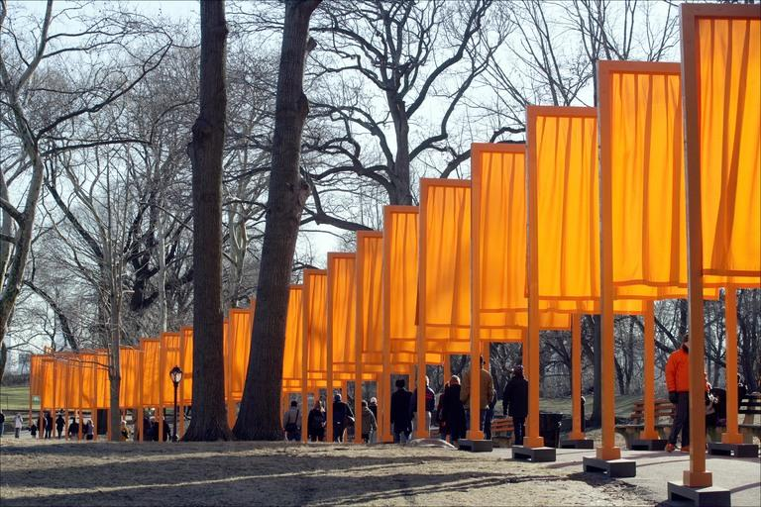
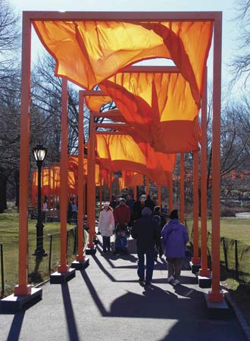
The Gates by Christo and Jeanne-Claude 1979-2005 C.E

Slide 4
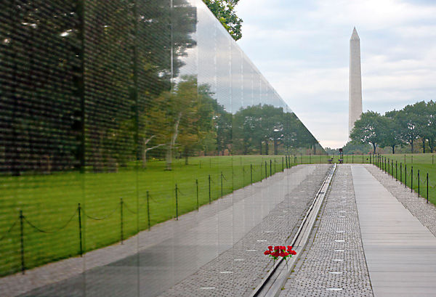
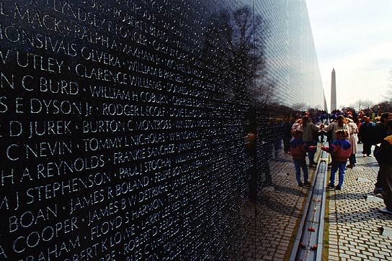
Vietnam Veterans Memorial 1992 C.E.

Slide 5
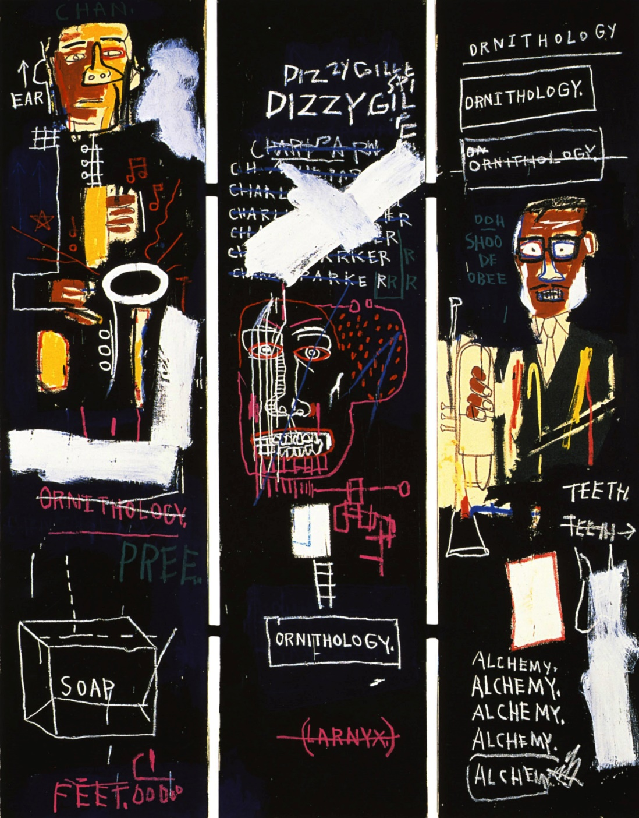
Horn Players by Jean-Michel 1983 C.E.

Slide 6
Summer Trees by Song Su-nam 1983 C.E.

Slide 7
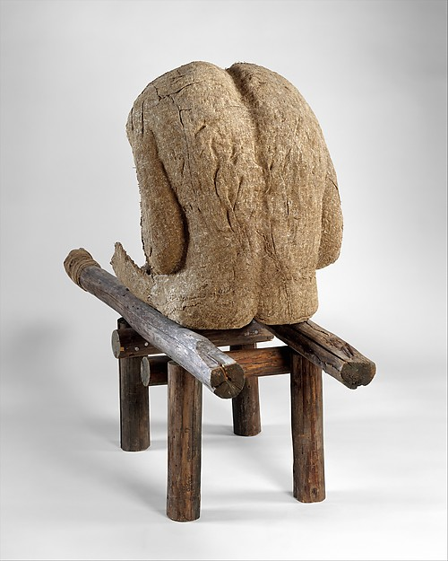
Androgyne III by Magdalena 1985 C.E.

Slide 8
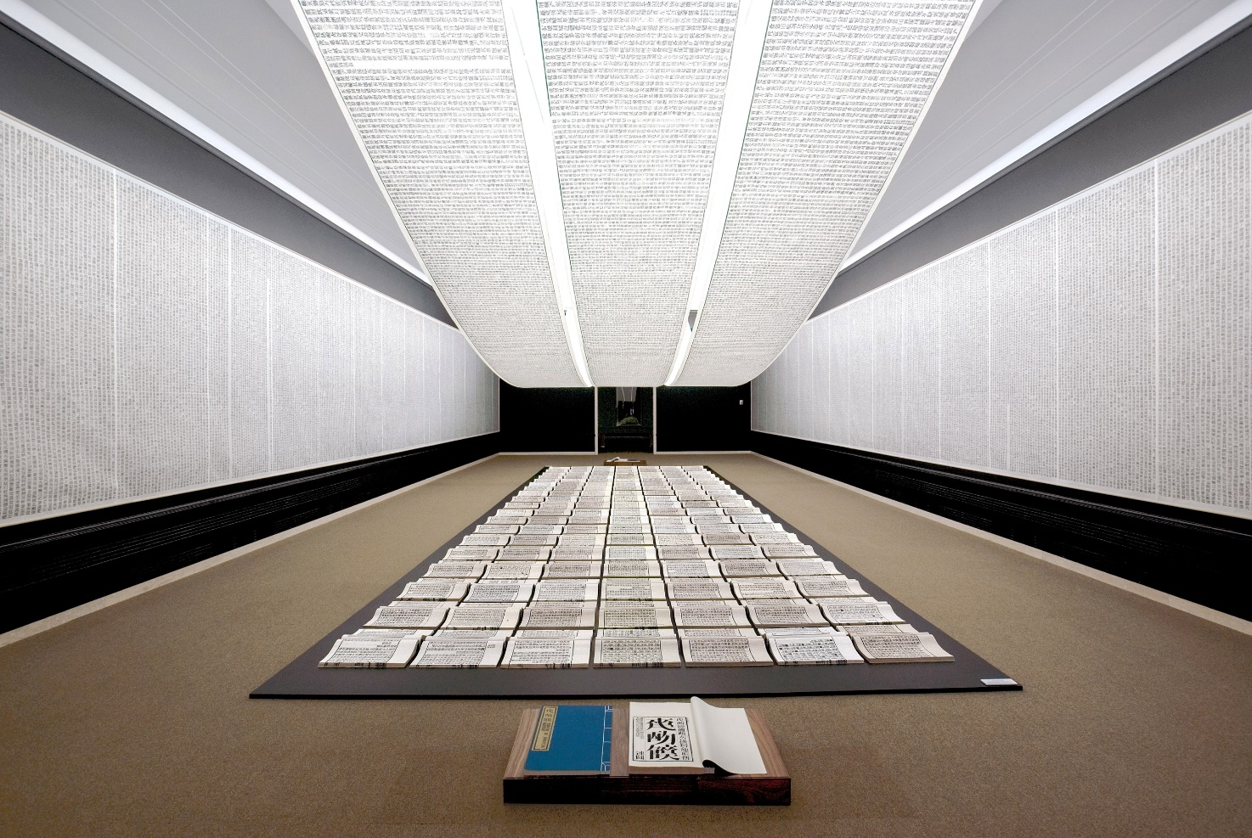
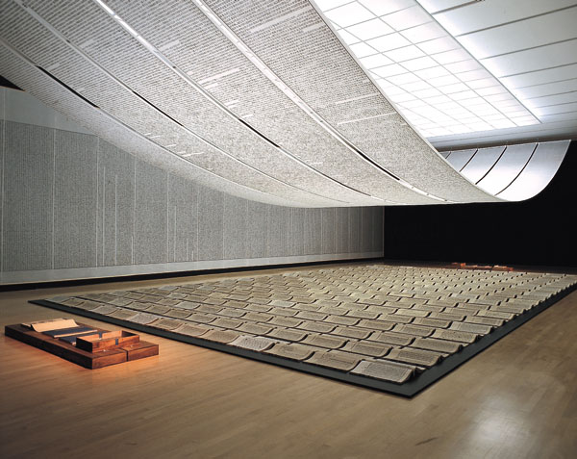
A Book from the Sky by Xu Bing 1987-1991 C.E.

Slide 9
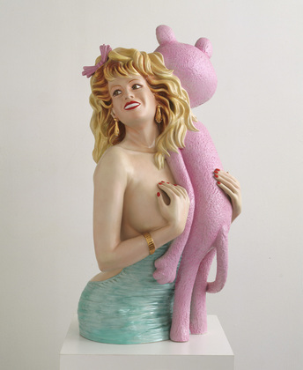
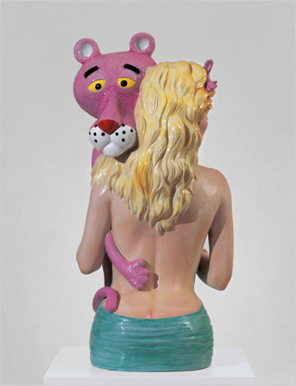
Pink Panther by Jeff Koons 1988 C.E.

Slide 10
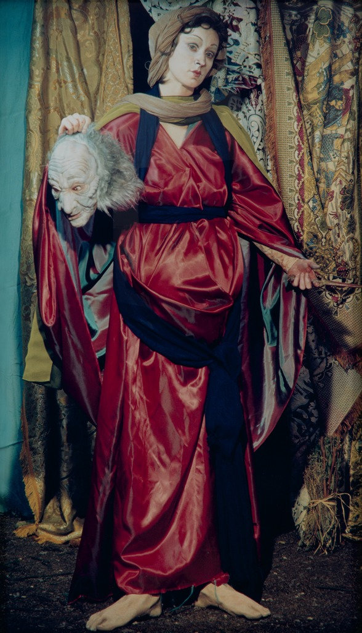
Untitled (#228) by Cindy Sherman 1990 C.E.

Slide 11
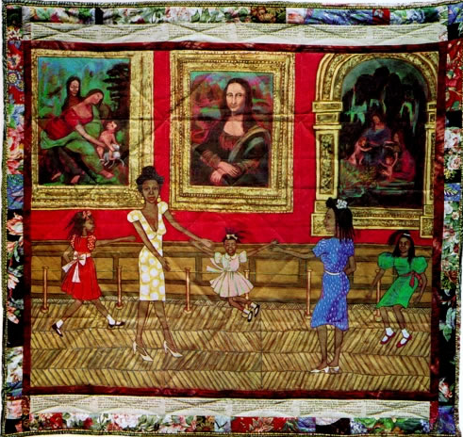
Dancing at the Louvre by Faith Ringgold 1991 C.E.

Slide 12
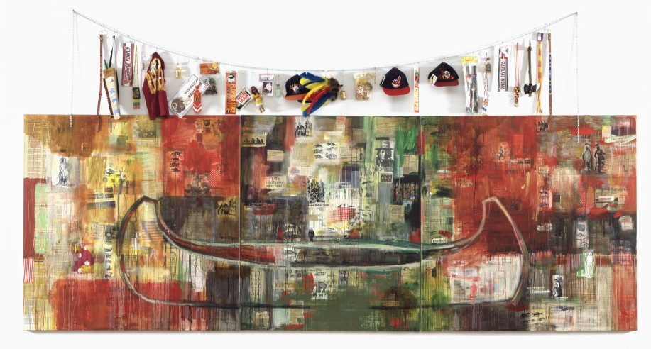
Trade by Jaune Quick-to-See Smith 1992 C.E.

Slide 13
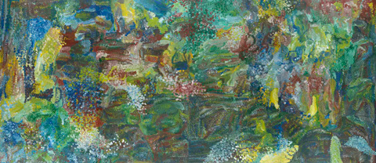
Earth’s Creation by Emily Kame 1994 C.E.

Slide 14
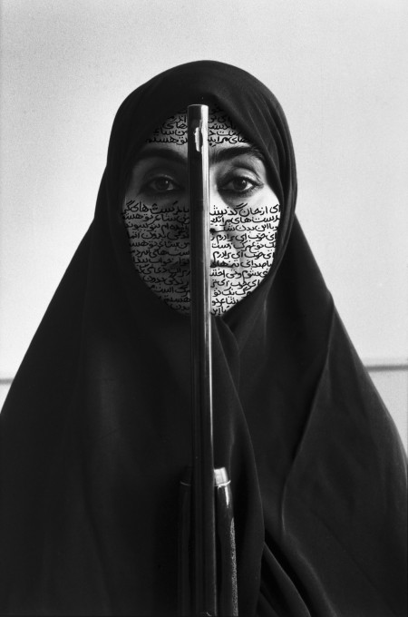
Rebellious Silence, from the Women of Allah series photo by Cynthia Preston 1994 C.E.

Slide 15
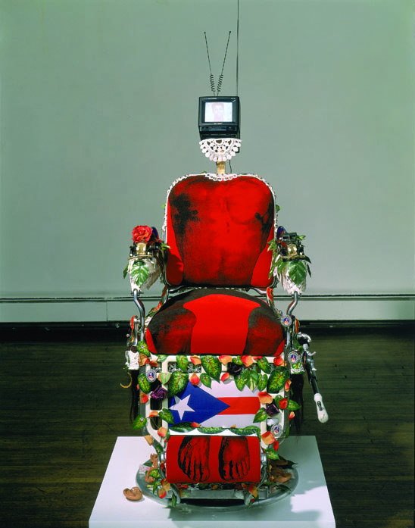
En la Barberia no se Llora by Pepon Osorio 1994 C.E.

Slide 16
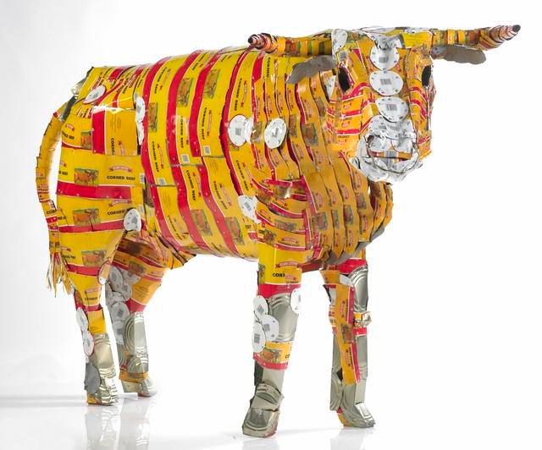
Pisupo Lua Afe by Michel Tuffery 1994 C.E.

Slide 17
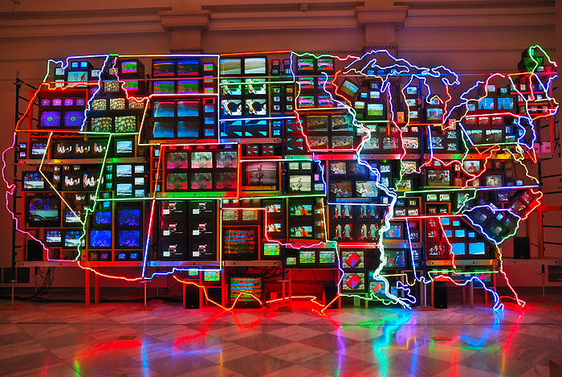
Electronic Superhighway by Nam June Paik 1995 C.E.

Slide 18
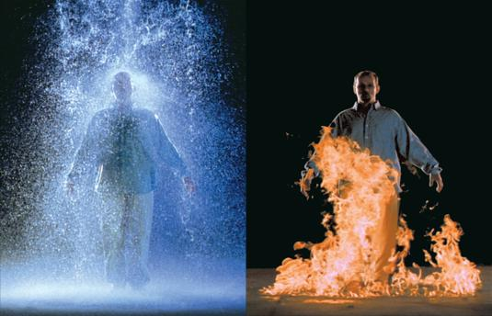
The Crossing by Bill Viola 1996 C.E.

Slide 19
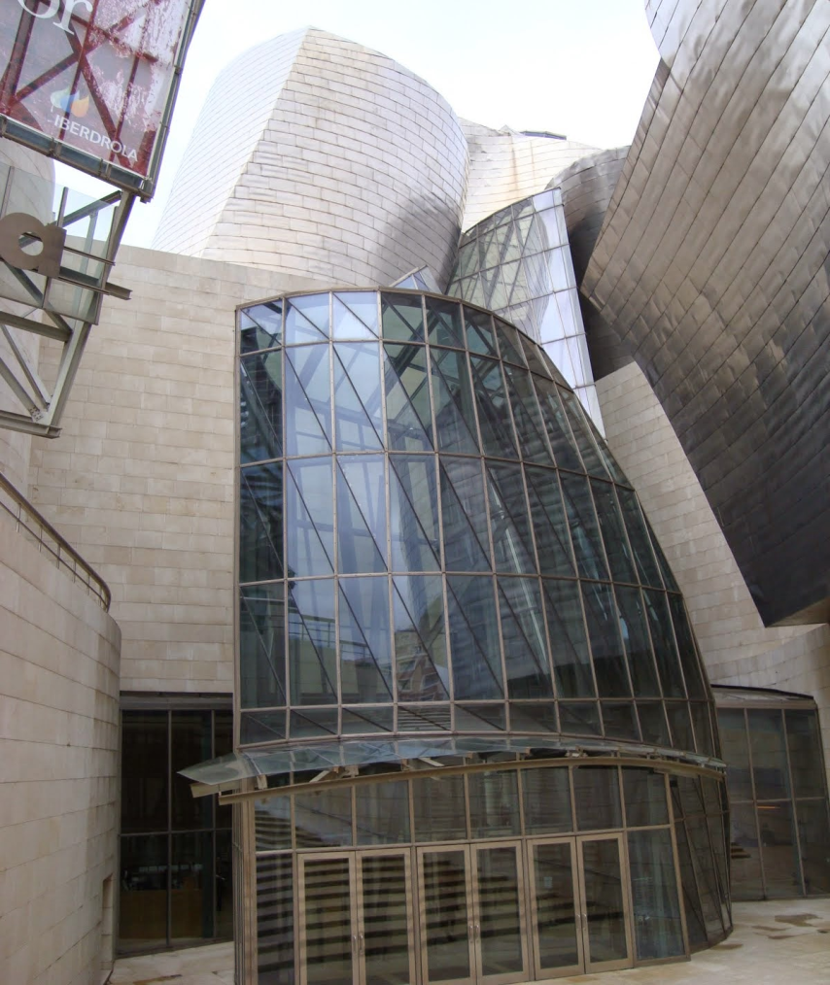
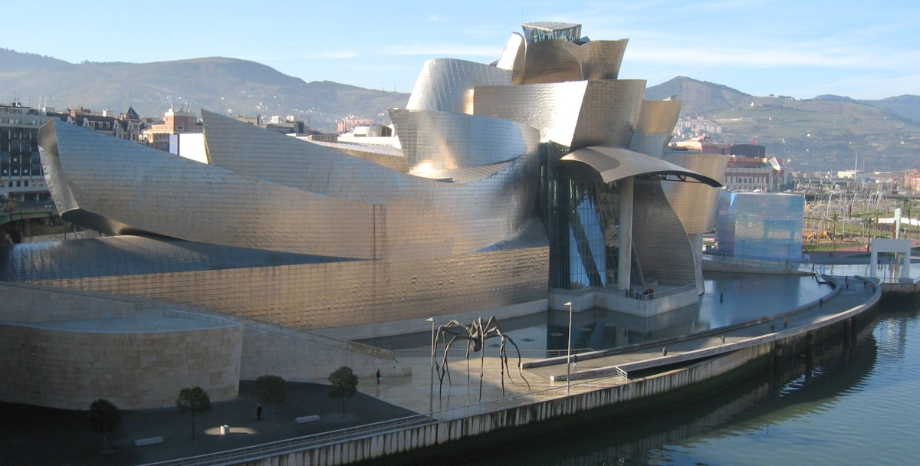
Guggenheim Museum Bilbao by Frank Gehry 1997 C.E.

Slide 20
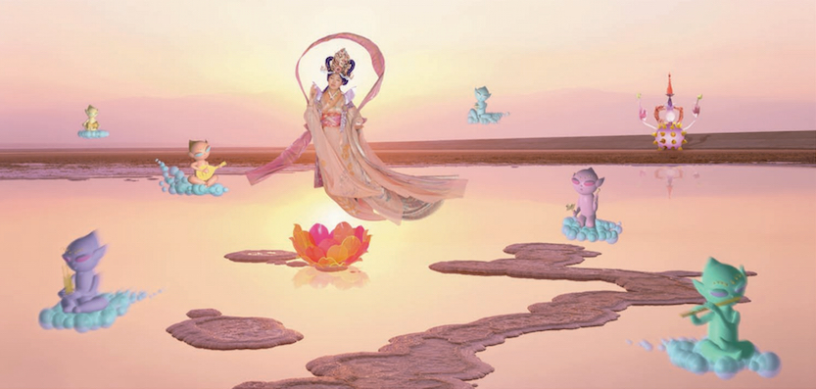
Pure Land by Mariko Mori 1998 C.E.

Slide 21
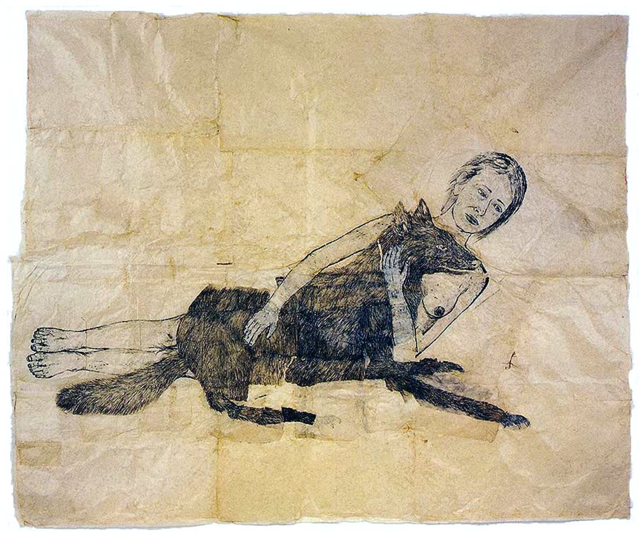
Lying with the Wolf by Kiki Smith 2001 C.E.

Slide 22
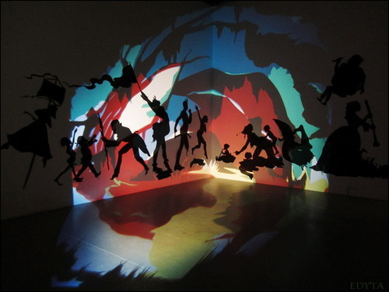
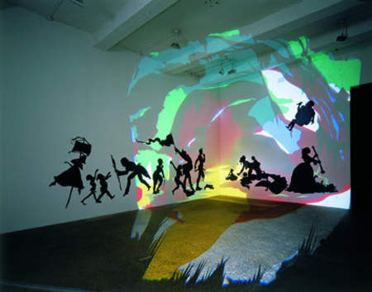
Darkytown Rebellion by Kara Walker 2001 C.E.

Slide 23
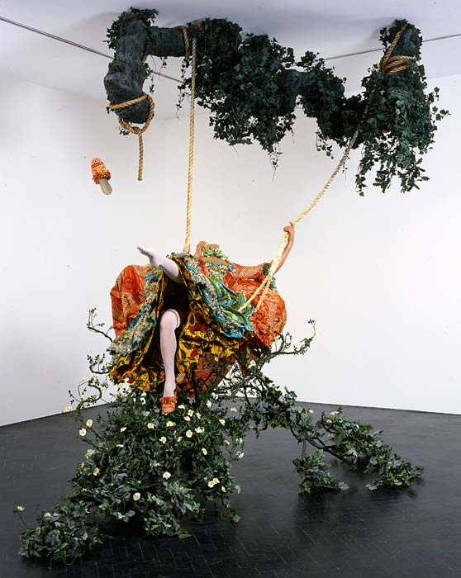
The Swing (after Fragonard) by Yinka Shonibare. 2001 Mixed Media Installation

Slide 24
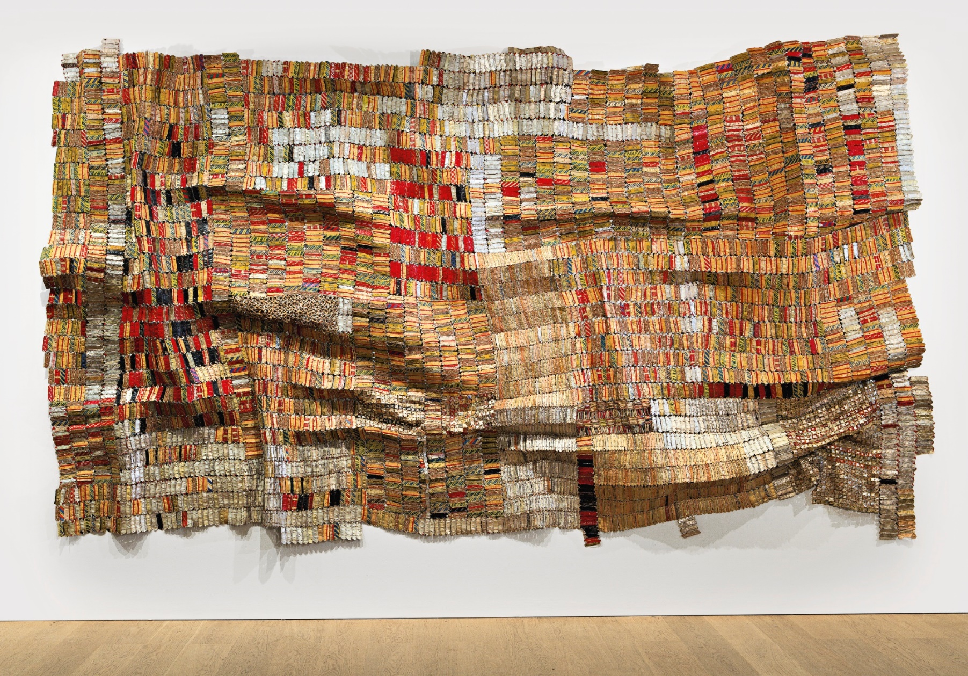
Old Man’s Cloth. Eli Anatsui. 2003 Aluminum and copper wire

Slide 25
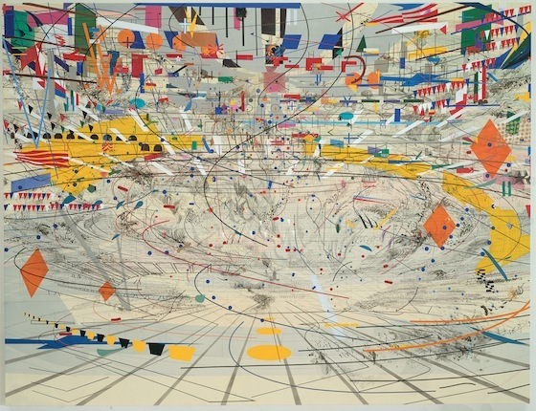
Stadia II by Julie Mehretu. 2004 Ink and acrylic on canvas

Slide 26
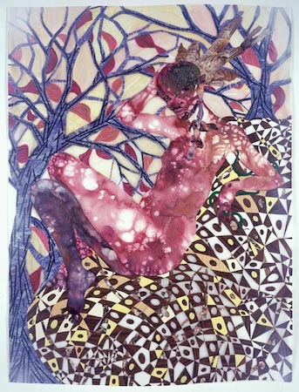
Preying Mantra by Wangechi Mutu. 2006 Mixed Media on Mylar

Slide 27
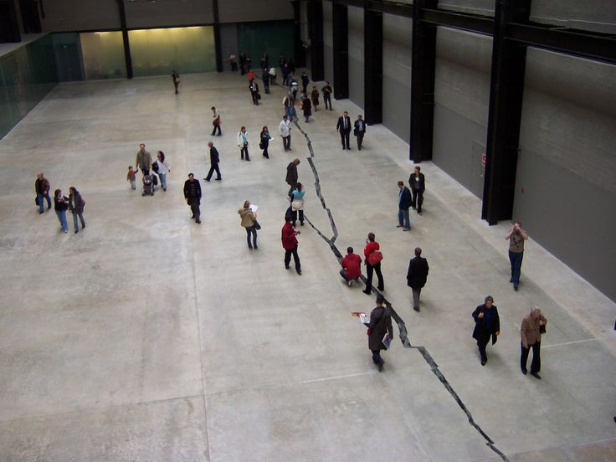
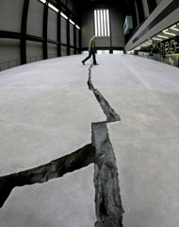
Shibboleth by Doris Salcedo. 2007-2008 Installation

Slide 28
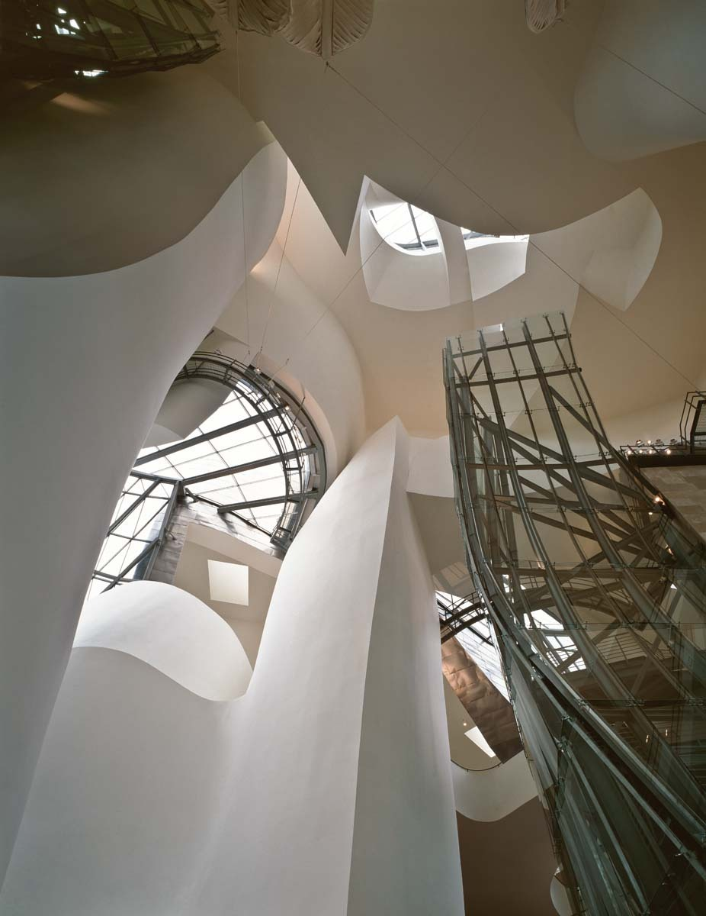
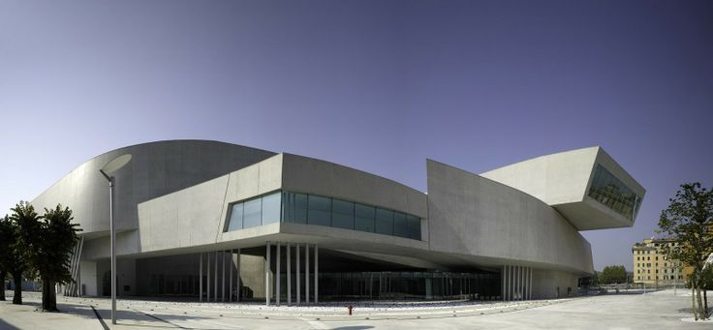
MAXXI National Museum of XXI Century Arts by Zaha Hadid. Rome, Italy. 2009 Steel, Glass and cement.

Slide 29
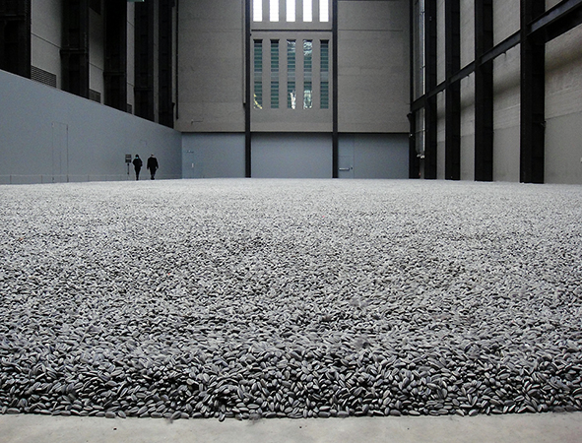
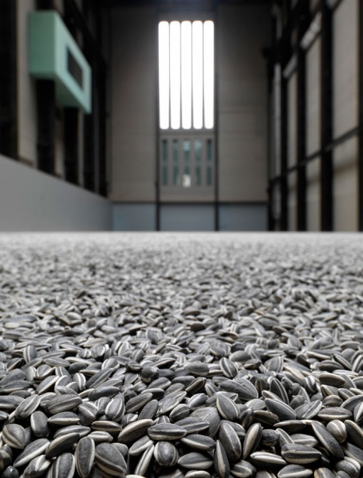
Kui Hua Zi (Sunflower Seeds) by Ai Weiwei. 2010-2011 Sculpted and Painted porcelain.

