Slide 1
Bullying Training
Presented by:
Judy Prutzman, Director of Civil Rights Compliance

Slide 3
Inclusive Welcoming Activity
What challenges do you face when responding to a report of bullying at your school?
Notes:
How many of you are new APs?
How many of you have been an AP for a year?
2-5 years?
More than 5 years?
More than 10 years?

Slide 4
Objectives/Outcomes ​
Ensure a safe and respectful learning environment for all students
This will be accomplished by:
Creating awareness of the laws and District policies that address student bullying, cyber-bullying, harassment and discrimination.
Understanding how to respond to reports of bullying
Reviewing WCSD’s 3-Point Criteria for bullying
Knowing where and when to get guidance/resources
Notes:
Outline for Course: 3 Point Criteria Application; Investigations, Analysis, evidence, and conclusions; and Documentation.

Slide 5
Why do we care about providing a safe and respectful
learning environment for all students?
It’s required by law
Results in better student learning outcomes
Supports WCSD Strategic Plan Goal 3: Safety and Belonging
Protects the District and staff from liability/lawsuits
Notes:
Because we have to. It’s required by law: NRS Chapter 388 is Nevada’s anti-bullying law first passed in 2009. The requirements for how a school responds to bullying were expanded in 2015
Better student learning outcomes
WCSD Strategic Plan Goal 3: Safety and Belonging
Protect the District and staff from liability (mention Hailee Lambert in CCSD and recent $9 million settlement)

Slide 6
WCSD Board Policies and Regulations
BP 5700 – The District seeks to create a safe and respectful learning environment free from race discrimination, bullying, and cyber-bullying in order for students to achieve success.​
AR 5701 – Procedures for student on student bullying.
AR 5702 – Procedures for staff on student bullying​
Notes:
These Regulations contain specific definitions of discrimination based on race, bullying and cyber-bullying that mirror Nevada’s anti-bullying law, and also define “harassment”
Step-by-step procedures for handling reports of bullying

Slide 7
​
State and Federal Laws May Also Apply
State criminal laws
Sexting by minors (distributing sexual images)
Taking/distributing photos of private areas
Hazing
Title VI of the Civil Rights Act
Discrimination based on race
Racial harassment
Title IX of the Education Amendment
Discrimination based on sex
Sexual harassment
Notes:
Some bullying behavior will implicate other laws
If Title IX sexual harassment involved, AR 9201 applies
Quid pro quo
Unwelcome conduct that is SPOO
Sexual assault (rape, fondling, incest, dating violence, domestic violence, stalking)

Slide 8
WCSD 3-Point Criteria​
Did Harm or Threat of Harm Occur? ​
​
2. Was the Action Unwelcome?​
​
3. Was the Action Severe, Persistent, or Pervasive?​
Notes:
3-point criteria is the District’s way to simplify the State’s definition of bullying

Slide 9
Criterion One: Harm or Threat of Harm​
Physical harm or threats of harm to a person or the person’s property​
Intimidating or hostile environment;​
Repeated or pervasive taunting or name-calling or single severe incident;​
Non-verbal threats;​
Damaging or manipulating relationships with others (i.e., false rumors); and​
Conduct related to a person’s protected class (i.e., racial slurs, slut shaming).​
Notes:
Conduct can cause harm even if not directed at a student if the conduct intimidates or creates a hostile learning environment for the student

Slide 10
Criterion Two: Unwelcome
Did the alleged victim initiate contact?
Was the alleged victim an equal participant (peer conflict)?
Is the alleged victim responding defensively to an attack?
Is the alleged victim actively avoiding areas where they might see the alleged offender?
Notes:
Legislative update: mutual disagreement or conflict is not bullying
Look for imbalances of power (older vs. younger student or many students vs. one student)

Slide 11
Criterion Three: Severe OR Persistent OR Pervasive
Must be only one of these, not all three:
A single incident can be severe (physical assault, racial slurs) and does not have to be persistent or pervasive;
Persistent—classic bullying behavior that is repeated and becomes increasingly threatening; or
Pervasive—involves many participants targeting the victim. (i.e. cyberbullying).

Slide 12
Whole Group Activity Application of the 3-Point Criteria
Notes:
We want them to spot issues:
John is a member of protected class;
Information regarding young men is unclear, so move forward;
Is information regarding Jane unclear, if so proceed, or is it severe? Only one time?;
What steps do you take?

Slide 13
Scenario #1 Hypothetical
John Doe is a devout Hasidic jew and attends high school in the WCSD. A group of young men, who also attend the same high school, constantly comment on John’s braids, clothes, and heritage. Jane Doe attends the same high school as John. One day, Jane tells John that she really likes his clothes. John, tired of hearing about his dress, takes offense to these comments and reports to you that the young men and Jane bullied him. He does tell you that he thought Jane was a friend and only made the comment once. Thoughts?
Notes:
Group of young men = Harmful (related to protected class), unwelcome and persistent/pervasive. One racial slur would be severe
Jane = is one comment severe enough to be bullying?

Slide 14
Scenario #1 Cont’d.
After John Doe filed his complaint, a student unrelated to the other students, draws a swastika in the dirt on John Doe’s car. John Doe reports it to you, and he has no clue who did it. You look at tapes of the parking lot and identify the student who drew the swastika as James Doe. John does not know James at all. Thoughts?
Notes:
This is a single severe act related to John’s race/religion.
This is bullying even though James did not know John. This is discrimination based on race under State law.
May also be a Title VI racial harassment situation

Slide 15
Initial Response to Complaints​
Apply 3-point criteria to evaluate a report of possible bullying.
A reporter does not need to use the words “bullying” or ”cyber-bullying” to be a bullying complaint.
Put a safety plan in place.
Notify the parents/guardians of all involved students.
Notes:
3 Possible outcomes of screening continued:​
If allegations meet 3-Point Criteria, move forward with investigation, or​
If allegations are unclear, move forward with investigation.
Stress Safety Plan in place immediately
What are some common elements of a safety plan?
If moving forward with investigation, notify parents of all involved students
Notify on same day, if complaint occurs before school day ends; or Notify next school day, if after school or during off hours.​
Open administrative investigation in IC and documentsafety plan/notice

Slide 16
Other Preliminary Matters​
​
Contact the DoCRC if the allegations involve:​
Racial Harassment or Discrimination​
Sexual Harassment or Misconduct
Staff on Student Bullying​
Violent or criminal actions should be reported to law enforcement.
Notes:
Discuss what sexual misconduct looks like
Law Enforcement delays administrative investigation – Usually law enforcement investigation is complete before administrative investigation.
Note in IC request to delay

Slide 17
Staff on Student Bullying (AR 5702)​
Complete a Confidential Request for Investigation Form (CRIF)
Administrative Investigator does the investigation in collaboration with Administrator
Administrator remains responsible for notice to parents/guardians and safety plan.​

Slide 18
Scope of the Investigation
The 3-Point Criteria serves as framework for the investigation.
What evidence needs to be collected and preserved?
Who are the witnesses?
Investigations must be completed in five school days unless complex, then get 2 additional days.

Slide 19
Interviewing Witnesses Student on Student Bullying
Interview alleged victim first and alleged offender next.
Ask open ended questions and let student do the talking.
Listen carefully and ask follow-up questions to clarify.
Identify and interview other witnesses.
Explain protections of retaliation and importance of confidentiality.
Be aware of your own biases.
Be kind, considerate and concerned.
Take good notes and/or collect written statements.

Slide 20
Staff on Student Bullying
Unless necessary to prevent further harm to a student, avoid asking staff member about allegations.
Questions asked without notice could be construed to violate due process rights.
If AI’s preliminary report indicates the 3-Point Criteria has been met, staff member receives IDP notice.
IDP Interview will be with AI, DoLR, and Administrator.
Notes:
Big different here is the OP (staff) member gets interviewed last because of the IDP. Do not talk to them before hand.

Slide 21
Credibility Determinations
Interviewer’s job to determine if witnesses are being truthful:
Observe demeanor (argumentative, nervous, hostile, overly agreeable, etc.);
Consistency with timelines; and/or
Reasons for possible bias (friend of victim or offender, implicated in wrong-doing).
Make notes during interview regarding the witnesses’ credibility

Slide 22
Whole Group Activity The Investigation

Slide 23
Scenario #3 Hypothetical
Donald is a middle school student in WCSD. During the assembly, Donald tripped and fell in front of the whole school. When he tripped, he was walking past Dewey. The fall was recorded by Huey, and Louie posted a Tik Tok mocking Donald. A teacher becomes aware of the video through students at school and brings it to your attention. Donald says that he is friends with Huey, Dewey, and Louie, but the teacher tells you otherwise. Donald does NOT complain of bullying. Thoughts?
Notes:
We want them to spot issues related screening:
Complaint does not need to mention bullying for it to be bullying;
Cyberbullying;
Even if unsure, must start investigation;
Who would they interview? (Teacher) What evidence would they collect?
What questions would they ask? Are Huey, Dewey, and Louie friends? Shows they may have planned together.
How did Louie get the tape?
How did Huey know to record it?
What did Dewey see when Donald fell?
What was the purpose of putting on Tik Tok?
What steps would they take?
How would they screen it? Run through 3-Point Criteria.

Slide 24
Analysis and Conclusions
Apply the facts of Investigation to the 3-Point Criteria
Look at totality of circumstances; and
Determine what makes the most sense to the objective person.
Show your work!

Slide 25
Documentation
Final Report to all parties = letter to parents/guardians of involved students.
Do not be conclusory. Use Three-Point Criteria and facts from investigation to support finding or not finding bullying.
The analysis in the Final Report should also go in IC.
At the end of the investigation, label the incident consistent with the result.
Properly identify victim, offender, participants and witnesses in IC.
Notes:
Remind them not to label something as mutual aggression and yet name an aggressor and a victim. If there is an aggressor and a victim, then bullying protocol must be followed. It can also be battery or something else and still be bullying. THEY ARE NOT MUTUALLY EXCLUSIVE.

Slide 26
Whole Group Activity Analysis & Conclusions, Documentation

Slide 27
Scenario #3 Hypothetical
Going back to Donald’s complaint. You interview Donald who says that Huey, Dewy, and Louie are his friends. They deny that they did anything wrong. They tell you Donald is their friend and he thought it was funny. They tell you he agreed to do it. You go back to Donald and ask him if he agreed to fall, and he says, “No, he was embarrassed he fell.” You interview the teacher, who shares that Donald does not completely understand what a real friend is because of cognitive issues. You sent the notice home to mom, who has since viewed the video and Tik Tok.

Slide 28
Resources

Slide 29
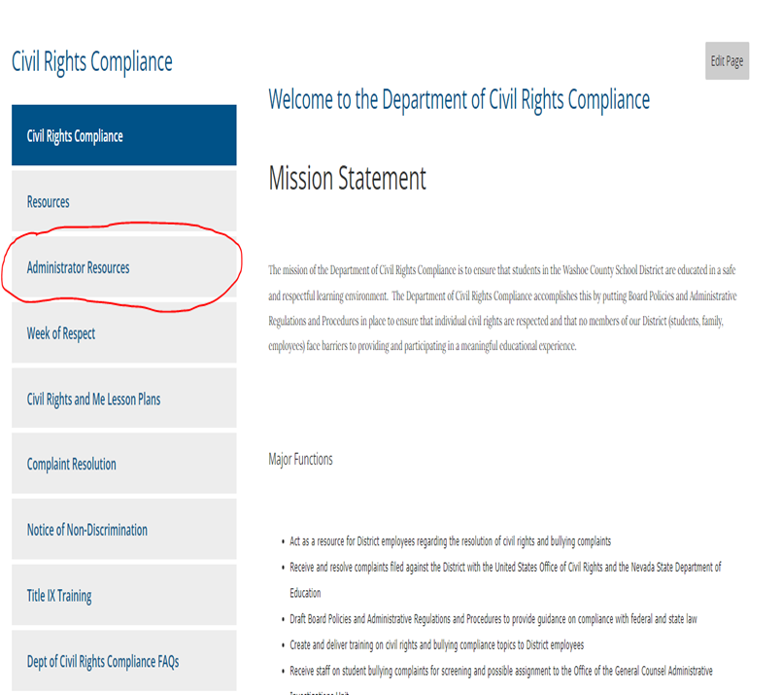
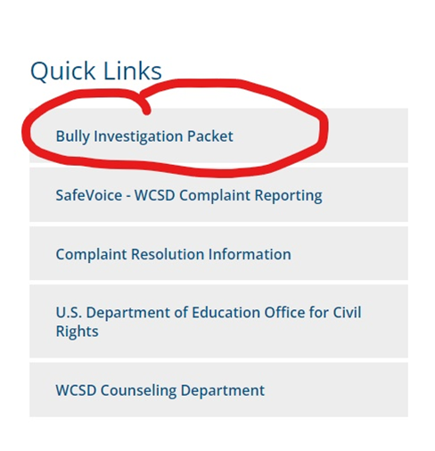
Bullying Packet
Can be found on WCSD website
Civil Rights Compliance Page under:
Quick Links; or
Civil Rights Compliance Right Side Bar – Administrator Resources
Must be signed in.
Notes:
Remind them they must be signed into website.
Remind them of witness statement for bullying.
Remind them of bullying checklist/report that they can use.

Slide 30
Office of the General Counsel 775-348-0300
Judy Prutzman, Esq.
Director of Civil Rights Compliance
Judy.Prutzman@washoeschools.net

Slide 31
Intentional Closer
Moving Forward With the Work
“What have you learned that you plan to
apply in the year ahead?”

