Slide 1

How to make an AMAZING PowerPoint!!
By: Maya and Mckayl

Slide 2

Have you wanted to know the secret for making an Amazing PowerPoint?? We will show you how…

Slide 3
The beginning
In this step we will show you how we begin all of our PowerPoints.

Slide 4
The beginning….
To begin our PowerPoints we always start with a blank slide.
Next think about what your engagement is about and then that will be your theme.
Then we always Google an image for the background of our title slide.
For example we will show you our Primitive Fire title slide.

Slide 5
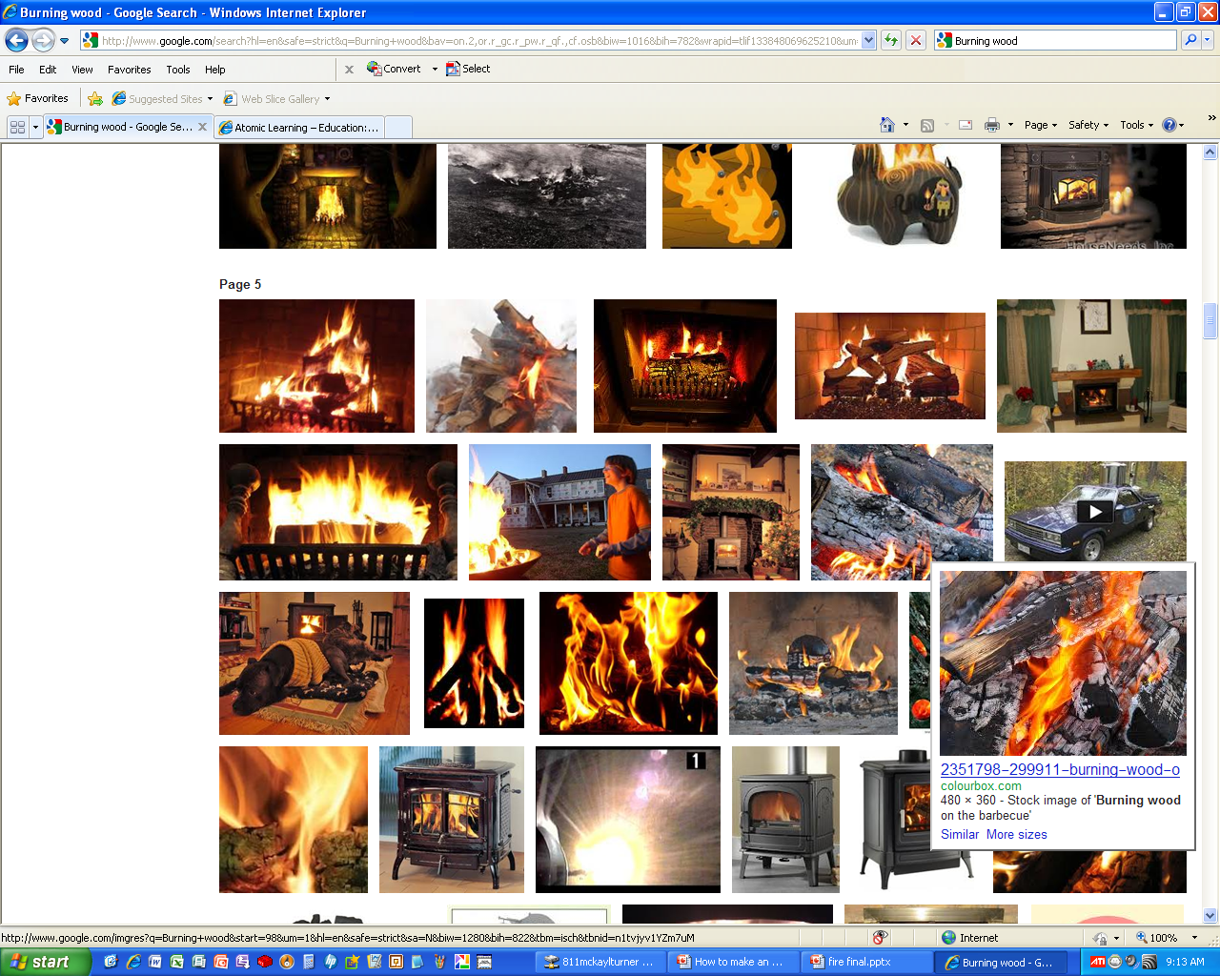
To start we looked up burning wood images because it matched our theme.
Then we chose a picture the we believed would make a good background. We clicked on the image then copied and pasted it into our PowerPoint.

Slide 6
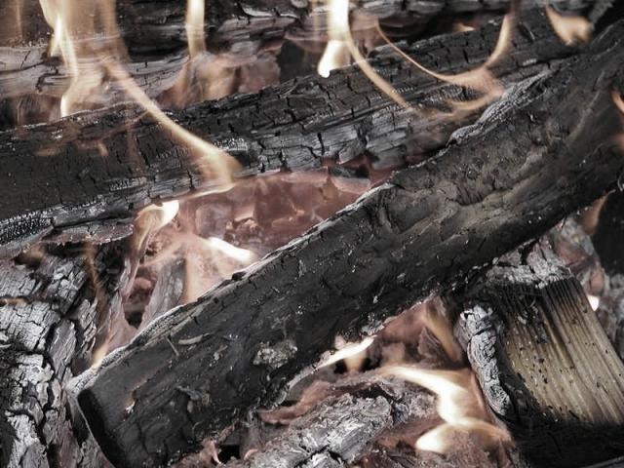
Sometimes it helps to recolor your image so that your text pops out more and the background is more subtle. To recolor simply click on the image then click format then click recolor.

Slide 7
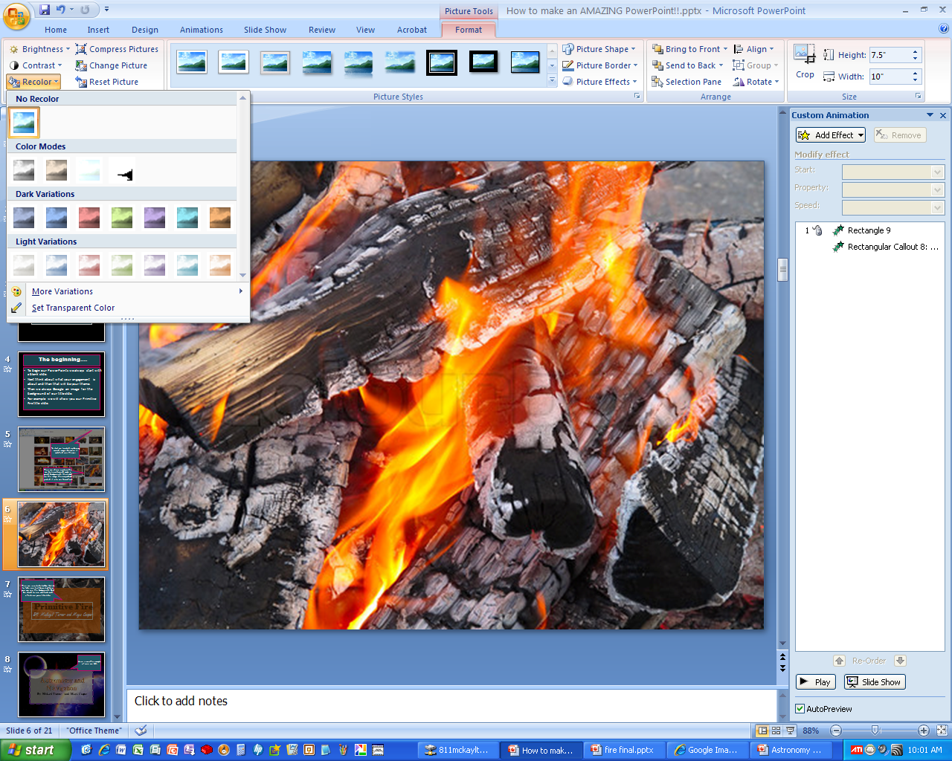
Click recolor then choose the color you want,
Click on the picture then click format.

Slide 8
Primitive Fire
Then we inserted a textbox. We like to fade our text boxes slightly so you can see the background. Don’t be afraid to use cool fonts and effects on your title slide.
Primitive Fire
BY: Mckayl Turner and Maya Casper
By: Mckayl Turner and Maya Casper

Slide 9
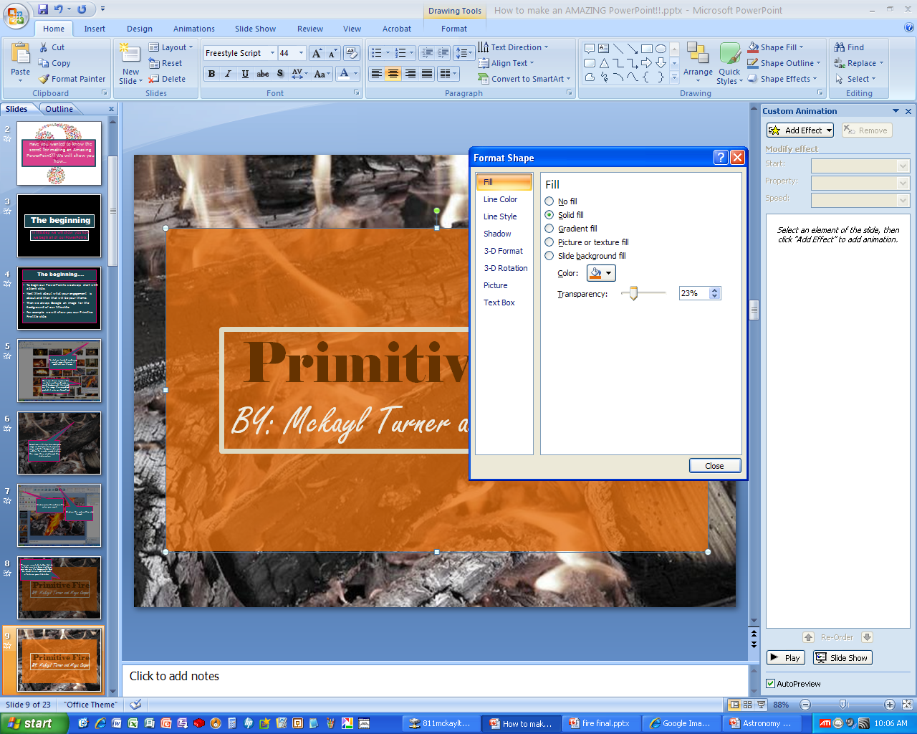
Primitive Fire
Primitive Fire
BY: Mckayl Turner and Maya Casper
Right click the textbox then click format shape. Then choose a fill then click transparency and then scroll the dial over until it looks good to you.
By: Mckayl Turner and Maya Casper

Slide 10
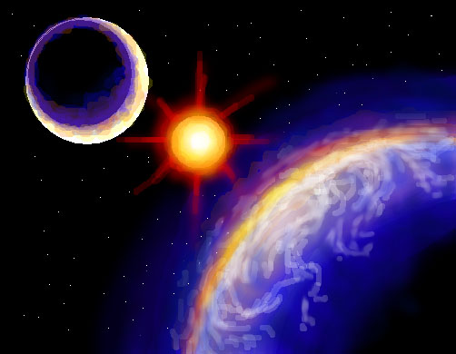
Astronomy and Navigation
By: Mckayl Turner and Maya Casper
Here is another example of one we did.

Slide 11
Personalizing
In this step we will show you how we add cool extras to slides to make it more interesting. (Make sure to still keep it simple so your information is the main point.)

Slide 12
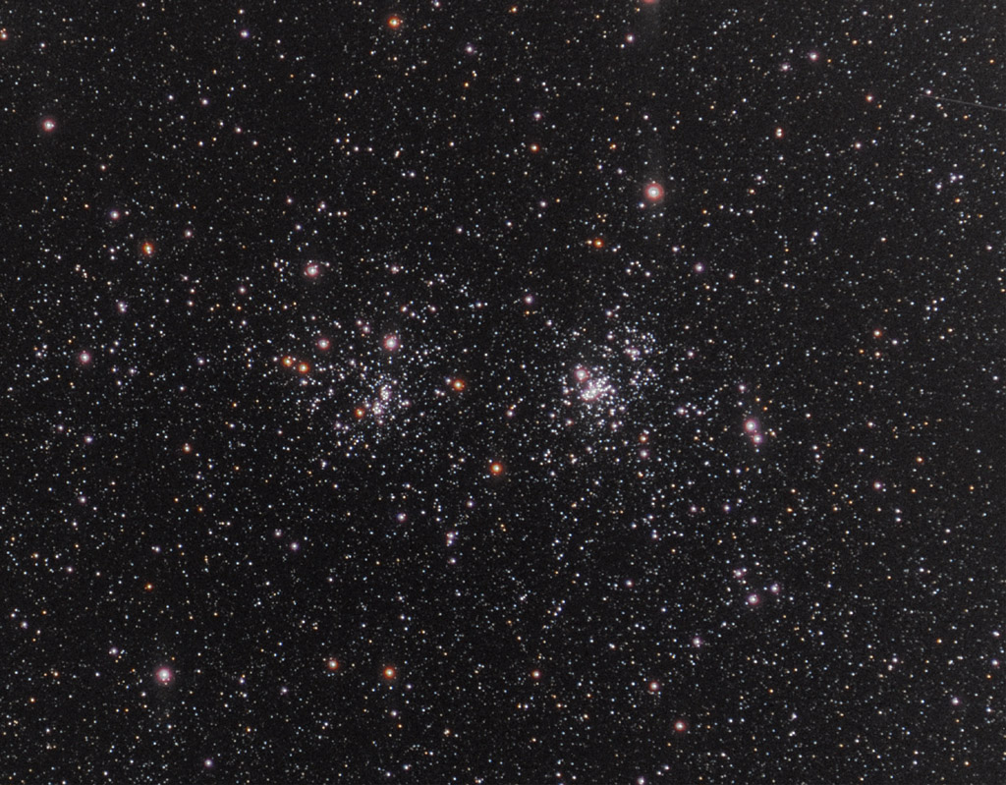
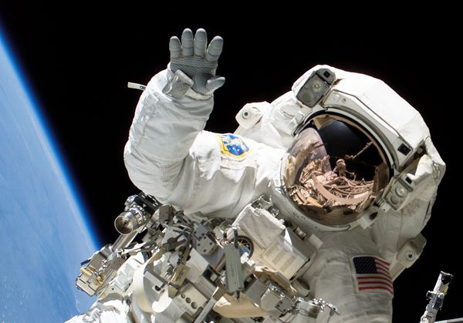
PowerPoint Sandwich
We have also researched true north and magnetic north and the declination of Reno.
We have also researched altitude and azimuth
Research the history and use of a sextant.
We have to build a sextant.
We have to record the azimuth and altitude of the sun for ten days. (or ten times)
This is one of our favorite slides. We added a sandwich in the astronauts hand for our astronomy and navigation PowerPoint. We used a faded textbox over the picture so that our test would still show. It adds a cool touch when you add little details.

Slide 13
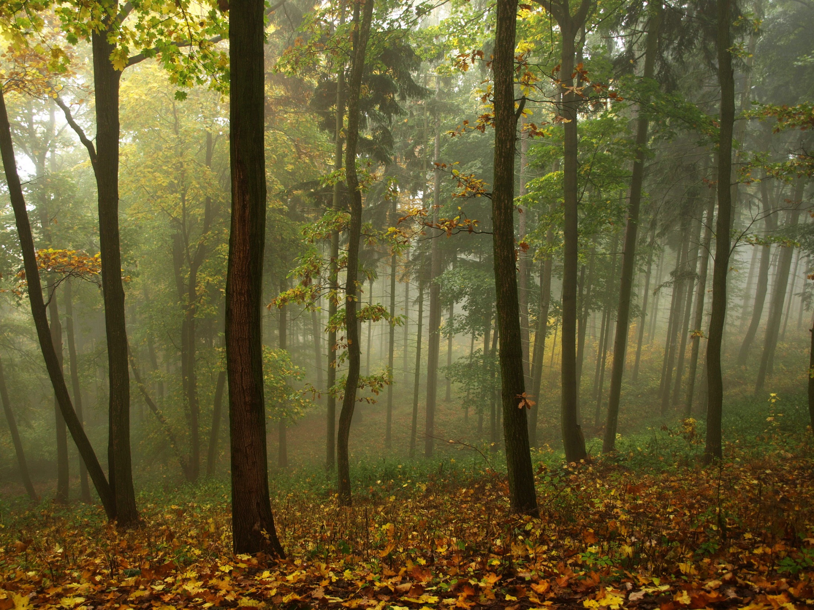
Add introduction slides when appropriate to hook your readers. The beginning of your PowerPoint is very important because it sets the tone for the rest of the presentation.
Imagine This:
You are on a short hike through the woods. All you and a friend have are empty water bottles, an extra sweatshirt, a pocket knife, and some sunscreen. On the short hike you lose your way. You are confused and panicked. Every move you make forces you deeper into the damp forest. You quickly realize that you will have to spend the night and without fire you could die.

Slide 14
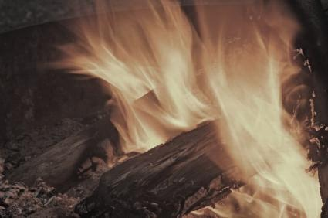
Present your research in interesting ways. This keeps your audience interested. Add a couple of effects and bright colors to catch your readers attention.
The
three things
a fire needs to start are:
HEAT
Without heat a fire
cannot begin or continue.
Without fuel a fire will stop.
Without sufficient t oxygen a
fire cannot begin or continue like heat.
Oxygen
If any one of these things are removed fire can’t be made.
Fuel

Slide 15
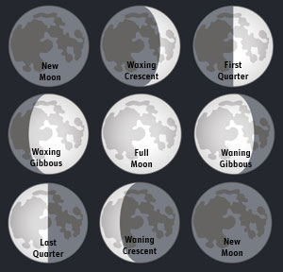
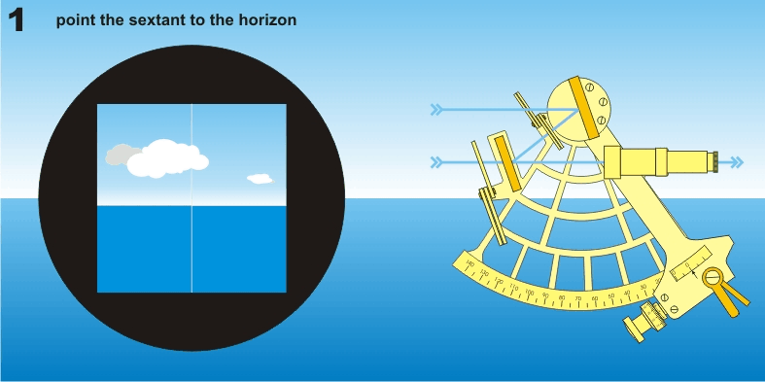
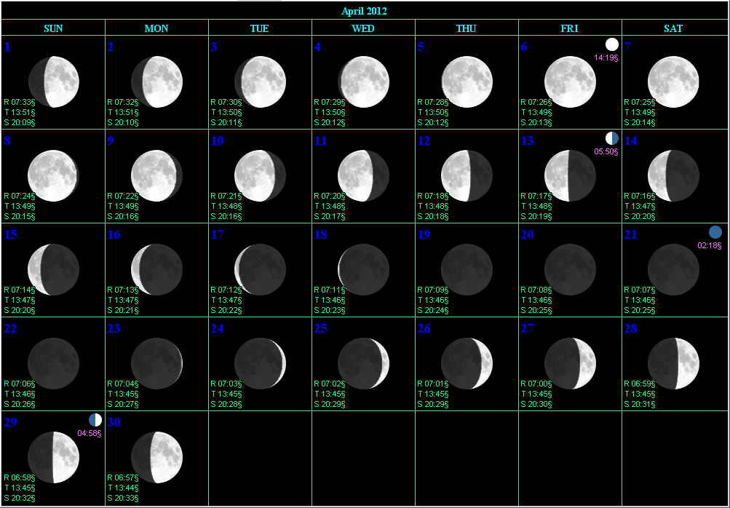
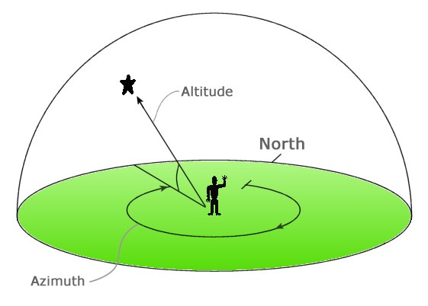
Research
Lots and lots of it…
Break up the information so you allow the reader a break. It also allows them to know what is coming next. Personalize these slides with pictures and animations.

Slide 16
Information
Present information in cool ways. Here are some examples…

Slide 17
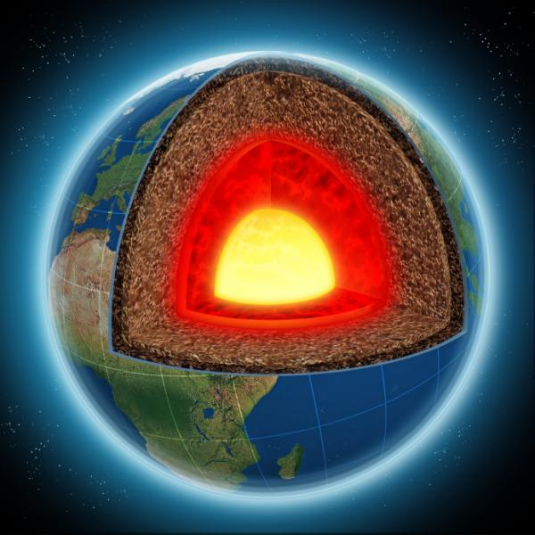
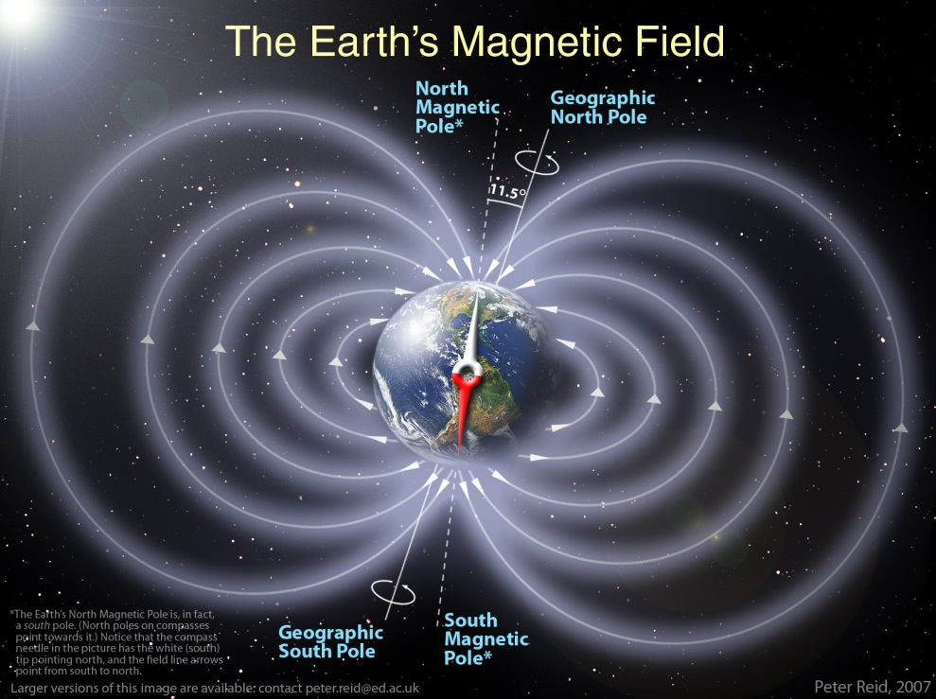
True north and magnetic north
The earths outer core is what causes a magnetic field.
Our planet has a magnetic north and south as well as a magnetic field.
It has a magnetic field because of the outer core. An area made out of iron and nickel.
This liquid is slowly moving as hot material rises and cool material sinks.
This is called convection. Because of convection as well as the rotation of the earth we end up having moving electrical currents.
This creates our magnetic field.

Slide 18
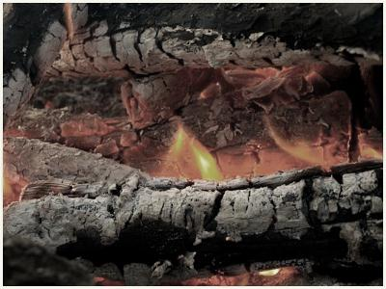
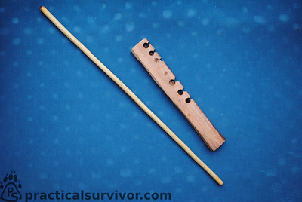
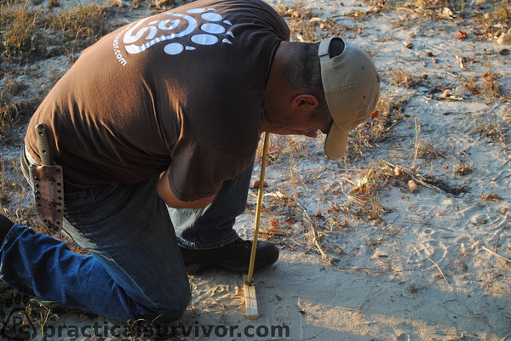
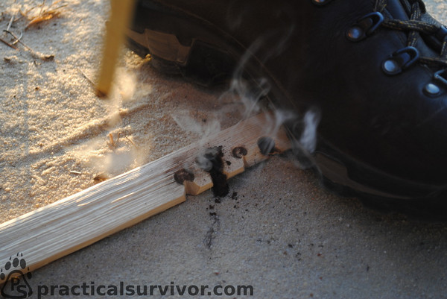
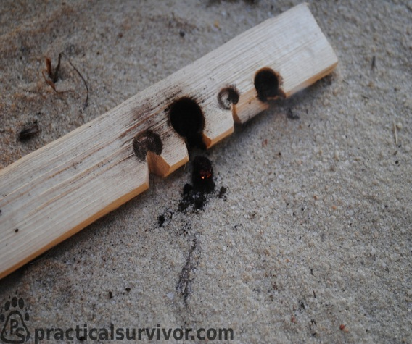
Fire Methods
The next method we researched used friction. It is called the hand drill method.
You need a fire board and a long straight stick. Some good woods to use are; Cedar or Willow.
You start by placing your foot on the board to apple pressure . Place your hand at the top of the drill and move back and forth. It will spin in the hole on the fire board creating friction. After doing this for so long it will begin to smoke until you have an ember. Place the ember in the nest and blow, you have your fire.

Slide 19
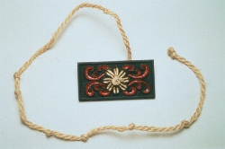
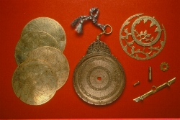
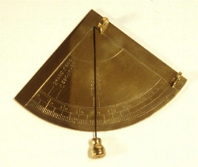
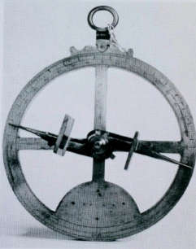
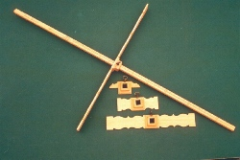
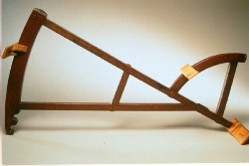
Kamal
Astronomers Astrolabe
Mariners Quadrant
1200’s - 1731
Mariners Astrolabe
Cross-Staff
Mariners Quadrant

Slide 20
Finish it up
Always include a PowerPoint sandwich as well as good documentation…

Slide 21
Imagine This:
So now if we are trapped in the woods we will know how to make fire!!! Here is what we learned:
How to carve.
How to make a fire set.
How to make a fire.
The fire triangle.
Knife Safety

Slide 22
What we learned
Basically everything on this PowerPoint was new to us. We had to learn a lot of new information. In the end we found out things we never would have had the patience to learn.

Slide 23
Remember…
Start your PowerPoint in the first day. Keep it blank and just add info so at the end you get to make it look nice with your extra time.
The PowerPoint is the funnest part but always focus on your engagement before your PowerPoint. After all what good is a PowerPoint without information and research, as well as good details.
Don’t be afraid to take your PowerPoints home or come in at lunch to work on them.

