Slide 1
Chapter 12
The South Expands: Slavery and Society (1800 – 1860)

Slide 2
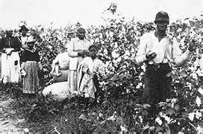
The Domestic Slave Trade
The Upper South Exports Slaves:
Many plantation owners moved South (AL, MI)
By 1850s, most African Americans lived in the Deep South
Sugar cultivation was incredibly arduous

Slide 3
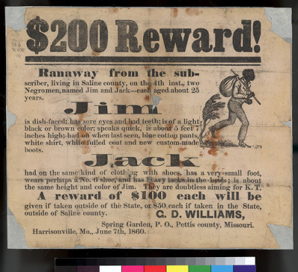
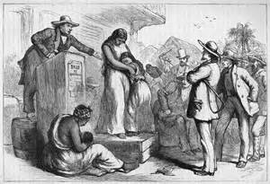
The Domestic Slave Trade
The Impact on Blacks:
Slave Codes:
Regulated behavior of slaves:
Could not own property, be
out after dark, strike a white
person, receive an education
Slave trade ripped families
apart
1/4 marriages
1/3 of children under 14

Slide 4
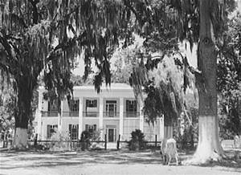
The World of Southern Whites
The Dual Cultures of the Planter Elite:
The Traditional Southern Gentry:
Lived in the Chesapeake, SC, and GA
Viewed themselves as nobles in other countries
Children married other aristocratic planters

Slide 5
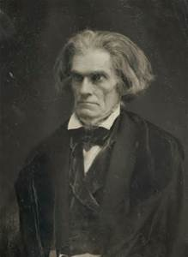
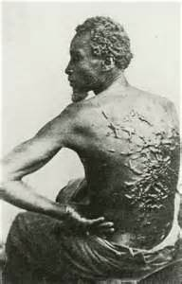
The World of Southern Whites
The Ideology and Reality of “Benevolence”:
By the 1830s, southerners argued slavery was a “positive good” – John C. Calhoun
Religion was used to justify slavery – Jesus did not condemn slavery

Slide 6
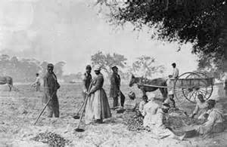
The World of Southern Whites
Cotton Entrepreneurs:
Overseers worked on many plantations – pay was based on production
Gang-labor system – enhanced productivity, made work harder for slaves

Slide 7
The World of Southern Whites
Planters, Smallholding Yeomen, and Tenants
Most southerners did not own slaves (3/4)
Planter Elites:
5% of the South’s population controlled much of the economy
Why were plantation owners so influential?
They controlled markets, credit, machines
They often had many relatives in town
- Many lawyers doubled as plantation owners, often elected to public office

Slide 8
The World of Southern Whites
Smallholding Planters and Yeomen:
Husbands had control over their homes in every aspect
Poor Freemen:
Few educational opportunities in the rural south
Education BAD

Slide 9
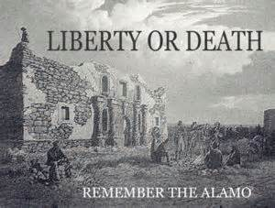
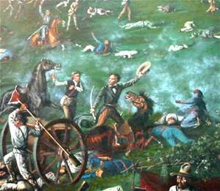
Expanding and Governing the South
The Settlement of Texas:
Mexico encouraged the migration of Americans
Immigrants were to be Catholic
1830, Mexico emancipated slaves, tensions between Mexico and US
Texas declares independence in 1836
Alamo: 13 day siege, all Americans are killed
Battle of San Jacinto:
Sam Houston captures Santa Anna, sign treaties
Texas wants to join Union
Fear from North over slavery

Slide 10
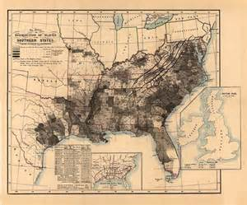
Expanding and Governing the South
The Politics of Democracy:
AL granted suffrage to all white men
90% of AL legislators owned slaves
Why did the South not industrially develop ?
$ could be made in agriculture
Capital was tied up in farming
Lack of adequate infrastructure (railroads, canals, etc.)

Slide 11
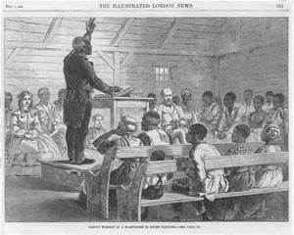
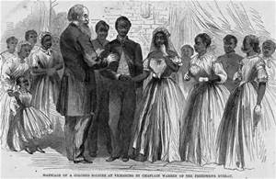
The African American World
Evangelical Black Protestantism:
Black Protestantism – did not follow predestination
Develop distinctive mass services – “ring shout”
Forging Families and Communities:
Combining of American and African cultures and languages
Pronouncing “th” as “de”
Slaves would get married, but were not binding
Surrogate families were often used
A frequent cause of running away was to be reunited with family

Slide 12
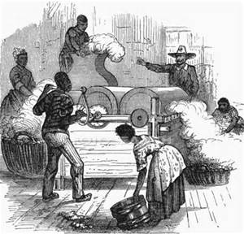
The African American World
Negotiating Rights:
Task System: completing a specific job each day
Resisting slavery:
Resistance took many forms:
Passive – working slowly, faking illness, running away, breaking tools
Slave rebellions did occur, but were rare (Nat Turner, Prosser)

Slide 14
The African American World
The Free Black Population:
Roughly 250,000
Free blacks in the North faced discrimination:
Lower-paying jobs, segregation, prohibited from voting
Free blacks in the South:
Over 200,000 by 1860
Faced similar discrimination as the North
Denied trials by jury
Kidnapped and sold into slavery

Slide 15
The Recap
Slave Codes
Slavery as a “necessary evil” to a “positive good”
TX and slavery
African American culture
Resistance to slavery

