Slide 1

WCSD PROMISE
We will know every student by NAME, STRENGTH and NEED
so they graduate prepared for the future they choose and we will deliver on this promise in partnership with our
FAMILIES and COMMUNITY.
Notes:
School Year 2024-2025
Contact:
WCSD Assessment Support
AssessmentSupport@washoeschools.net
Phone: 1.775.348.0248
PPT Template: Transparent_Squares
District-branded PowerPoint templates
Accessed August 2024
Office of Communications and Community Engagement
https://www.washoeschools.net/Page/1265

Slide 2

A Primer for Testing: Policies and Professional Expectations
Training Presentation
Department of Assessment
September 2024
Notes:
Title Slide Notes (Introduction):
This presentation is a companion to the annual Test Security and Administration Training provided by the Nevada Department of Education. These presentations together with the reading of the Washoe County School District, A Primer for Testing, fulfill the annual training requirement for school principals, school test coordinators, test administrators, room proctors, and other personnel involved in state and district test administrations.
No personnel may assist with test administrations in the Nevada testing program without first completing required training in test security and test administration.
Information presented in this training is subject to revision based on direction from the Nevada Department of Education or Washoe County School District Superintendent.
Forms and Resources
https://www.washoeschools.net/Page/1247

Slide 3
Professional Expectations
ANNUAL
Read the Primer in its entirety and become familiar with policies and professional expectations
Participate in “Primer Training”
Read and sign the Acknowledgment form included with the Primer; turn-in form to school principal
REFRESHER (before the test administration window)
View the NDE Test Security and Administration presentation (video)
Participate in “refresher” training prior to each major test administration
Notes:
Slide Notes:
Principals provide assurances that staff involved with testing will complete training in test security and test administration. Prior to each test administration, principals also assure that testing staff will participate in “refresher” training and review the school’s test security plan and guidance specific to the test(s) to be administered. Signed acknowledgment forms, records of training in test security and test administration, and attendance and signature logs from testing sessions are kept with a school’s test security documentation for 3 school years.
If you are unsure about something, review the Primer and manuals, and ASK questions. Check with the school principal or test coordinator and reach out to Assessment Support.

Slide 4
Refresher Training
Prior to each major test administration…
1._View the NDE Test Security Training video (11 minutes)
Visit: https://www.washoeschools.net/Page/452
2._TOPICS for Discussion and Review
Communication plan; students, staff, and families
Content of test administration manual(s)
Testing accommodations and accessibility supports
Test environment; technology readiness
Test security; permissible materials
Schedule for test administration; plan for extended time
Student eligibility & preparation; electronics policy
Responding to emergencies and interruptions
Reporting irregularities & Whistleblower Protections
Notes:
Slide Notes:
The principal or assisting school test coordinator will conduct refresher training for all personnel involved in a test administration prior to the start of the testing window at their school. Refresher training will review the importance of test security, procedures from the school’s test security plan, and provide guidance about the specific test to be administered.

Slide 5
School Test Security Plan
Plan addresses site specific provisions for test security including:
Storage and handling of secure test materials; data privacy
Selection and training of testing staff
Scheduling and communications
Online test administration, technology support and readiness
Student eligibility; compliance with testing accommodations plans
Irregularities in test security and test administration
Emergencies and evacuation protocols
Make-up procedures, verification of absences and reason not tested
Procedures for providing additional time
School Test Security Plans are submitted to the district and retained for 3 school years. Plans are subject to audit.
Notes:
Slide Notes:
Schools are required to prepare a test security plan that is consistent with district and state procedures.
School test security plans should include site specifics.
School test security plans are collected by the Department of Assessment.

Slide 6
Major Duties: STC
School Test Coordinator (STC)
--Principal or designee (e.g., AP, Dean, Counselor)
Prepare and implement school test security plan
Train authorized personnel to assist with testing
Troubleshoot during test administrations
Respond to incidents and report irregularities to district
Liaison to Assessment Support (District Test Director)
The principal is ultimately responsible for all testing activities at the school.
Notes:
Slide Notes:
The principal is ultimately responsible for all testing activities at the school. However, the principal may delegate test coordinator responsibilities to one or more other site administrators.

Slide 7
Major Duties: TA
Classroom Test Administrator (TA)
--Licensed Nevada educational personnel
Prepare testing environment
Verify student identity and planned testing conditions
Follow procedures in manual; respond to needs of students
Supervise students and test materials including technology
Actively circulate, monitor student conduct
Report irregularities and test security violations to TC
Notes:
Slide Notes:
Test Administrators assume primary responsibility for their assigned test administration and group of students.
Personnel authorized to be a test administrator in the state assessment program must be a Nevada licensed educator. Licensed school counselors and substitute teachers with a non-provisional Nevada license hired to fill a classroom teacher vacancy may also be a test administrator.

Slide 8
Major Duties: Proctor
Room Proctor
--School personnel; may be licensed or unlicensed
Assist the Test Administrator (TA):
  Observe testing room; escort students on breaks
  Ensure students are on task; monitor student conduct
  Help distribute and collect testing materials
Assist in emergencies
Report irregularities and test security violations
Note: Unlicensed room proctors/staff must not be left alone with actively testing students or secure test materials.
Notes:
Slide Notes:
Licensed and unlicensed personnel may be assigned as a room proctor or assume other roles in which they are responsible for assisting the test administrator or test coordinator.

Slide 9



Notices for SY 2024-2025
Smarter Balanced Summative move to “Adjusted Blueprint”
  Beginning spring 2025, Nevada will implement the adjusted blueprint version of the Smarter Balanced assessments in ELA and math
  Length of “CAT” portions (number of items) are reduced
  Claim level reporting will be condensed into composite claims
  Information: Smarter Balanced Content Explorer, Test Development & Design
  https://contentexplorer.smarterbalanced.org/test-development
WCSD Schools
  Second year district implementation of i-Ready program for math and reading
  i-Ready Reading Diagnostic + LNF Literacy Task used for KEA
  Continued administration of district semester finals using SchoolCity for Biology courses (HS, GT-MS) and CTE courses
  SchoolCity tool available to secondary educators for individual teacher, school, and shared assessments
Notes:
Slide Notes: Notices for school year 2024-2025
Additional information: Smarter Balanced Adjusted Blueprint (for CAT)
The adjusted CAT blueprint requires that students respond to fewer items while maintaining the content coverage of the full form assessment. The primary difference is that the adjusted form does not allow for individual student claim-level scores to be reported because there are not enough items in each claim to report on them with precision.
In ELA/literacy, claim scores are computed for Claim 1 and Claim 3 (without speaking items) combined and Claim 2 and Claim 4 combined. In Math, claim scores are computed for Claim 1, and Claim 2, Claim 3, and Claim 4 combined.
ELA/literacy:
Composite Claim 1: Reading and listening
Composite Claim 2: Writing and research
Mathematics:
Composite Claim 1: Concepts and procedures
Composite Claim 2: Problem Solving, Communicating Reasoning, and Modeling and Data Analysis

Slide 10
Assessment Participation
Smarter Balanced Summative in ELA & Math; NV-CRT, Gr 3-8
Science; NV-CRT, Gr 5, 8, 9 or 10
NAA/Nevada Alternate; Gr3-8 & 11; NAA gr11 required for alternative diploma
(ELPA) WIDA ACCESS and WIDA Alternate ACCESS; K-12
MAP Growth Reading (interim, NV Read by Grade 3); K-3
BRIGANCE EC Screens III (KEA, developmental screening)
NAEP/National Assessment of Educational Progress
Notes:
Slide Notes:
State, district, and national tests should be administered to eligible students ONLY. Eligibility for a test is based on student information in Infinite Campus. Per Nevada Revised Statutes, participation in testing is expected of all students enrolled in grade levels, courses, or special programs for which a state-mandated test is administered.
Details and descriptions…
The Nevada criterion-referenced tests or CRTs for state and federal accountability include Smarter Balanced Summative assessments in English Language Arts and Math administered in grades 3-8, and Science assessments administered in grades 5, 8 & taken one time during high school in grade 9 or grade 10.
In place of the general CRT (3-8) and high school assessments (Science, CCR), IEP students eligible for alternate assessments will participate in the Nevada Alternate Assessment in English Language Arts and Math taken in grades 3-8 and 11, and Science taken in grades 5, 8, and 11. Participation in the NAA during grade 11 is a requirement for the alternative diploma.
For the English Language Proficiency Assessment in Speaking, Listening, Reading and Writing, Nevada uses the WIDA ACCESS and Alternate ACCESS to assess students identified as an English learner and limited English proficient. Students may qualify for exit from the English learner program based on their performance on the assessment.
MAP Growth Reading assessment is required in grades K-3 statewide under the Nevada Read by Grade 3 program.
BRIGANCE Early Childhood Screens III is used as a kindergarten entry assessment (KEA) and developmental screening for certain enrollment situations.
National Assessment of Educational Progress known as NAEP, is a congressionally mandated program. NAEP representatives will visit pre-selected schools to administer assessments to a sampling of students. (NRS 390.830)

Slide 11
Assessments in High School
College Readiness/Career Readiness; Results may be used toward diploma seals, certificates, or endorsements
  CCR/College and Career Readiness (ACT with Writing); Required for standard+ diploma
  CTE/Career & Technical Education
  Civics Exam (HS); Required for graduation; all diploma types
  Other: PSAT/NMSQT, SAT, ACT, AP, IB, ASVAB, ACT WorkKeys (NCRC), Industry Certification (OWINN), AAPPL, Avant WorldSpeak, OPI, ASLPI
Notes:
Slide Notes:
Participation in the high school College and Career Readiness or Nevada Alternate assessments and a high school Civics exam are required for graduation. Results from several college and/or career readiness assessments may fulfill criteria for different diploma seals, certificates, or endorsements.
Details and descriptions…
For the College and Career Readiness assessment, Nevada uses the ACT with Writing. The ACT with Writing supplies the ELA and math assessment results required for state and federal accountability in high school.
The Career & Technical Education/CTE assessments include a Workplace Readiness Skills test and End-of-Program Technical assessment.
Participation in a Civics assessment is a requirement for graduation.
Secondary students may participate in other college and career readiness assessments including Advanced Placement, industry certifications, and world language proficiency assessments.
PSAT/NMSQT (Pre-SAT and National Merit Scholarship Qualifying Test) is a national assessment for interested high school sophomores and juniors.

Slide 12
Assessment Eligibility
General Assessments
  State Criterion Referenced Tests (CRT)
  College and Career Readiness Assessments (CCR)
Alternate Assessments; (IEP, ≤1%)
English Language Proficiency; (EL)
IMPORTANT! – IEP/Special Education Program Eligible
Before October 31, ALL K-12 students, determine eligibility for alternate assessments and revise IEP if necessary; verify “Alternate Assessment” is indicated in Infinite Campus (Enrollments > (current/active enrollment) > State Reporting Fields)
*TIP: The “Alternate Assessment” field in Infinite Campus informs state accountability, pre-ID rosters, test ordering, course enrollment, and diploma options.
Notes:
Slide Notes:
Before identifying supports and accommodations for testing, first determine which assessments a student will participate in during the school year.
Program eligibility for alternate and English language proficiency assessments should be updated in the student information system before November of each school year and verified again before the start of the testing window(s).

Slide 13

Communicate About Testing
Notify guardians/households of participating and affected students at least one month prior.
Utilize multiple modes of communication (e.g., phone, email, newsletter).
*Remember to arrange testing or determine a test participation plan for students enrolled in home/hospital, distance education, and alternative placements.
Notes:
Slide Notes:
Additional notes for this slide:
The WCSD Assessment Calendars list the specific date or date range for state and district test administrations with prescribed windows.
Schools are individually responsible for coordinating administrations and communicating testing schedules to teachers, staff, and student’s families. This includes planning for off-site testing of enrolled students when appropriate.
Testing windows and the order of administration for some tests are flexible, allowing schools to schedule testing according to their needs and interests. Notify guardians and staff well in advance and provide appropriate reminders to help encourage full participation and reduce make-up administrations.
All students will be required to test in-person including students enrolled in online learning programs.

Slide 14

Student Test Data & FERPA
Reporting and accessing test scores of individual students by anyone other than authorized school officials, the student’s authorized guardian, or the student is prohibited.
What is FERPA?
http://www.washoeschools.net/Page/448
Notes:
Slide Notes:
All school and district employees with access to student records must adhere to FERPA guidelines for the appropriate use or sharing of sensitive data.
To safeguard the rights of WCSD students, parents, and staff, all requests to engage in research within the Washoe County School District, including research conducted by WCSD staff, must be reviewed and approved by the Office of Accountability prior to project initiation.

Slide 15

Testing Students with
Special Assessment Needs
remove obstacles to the test-taking process without changing, lowering, or reducing expectations for learning
Notes:
Slide Notes:
All educational staff in a school share a professional responsibility to assist the principal with ensuring all students with special assessment needs receive appropriate accessibility supports for testing.

Slide 16
Accessibility Supports
Learn about each test students will take.
Not all instructional accommodations listed in a student’s IEP or 504 Plan may be appropriate for state or district tests.
Use of non-permissible materials and non-standard accommodations may result in invalid scores.
Consult test specific guidelines; determine if the instructional support or accommodation is also allowed for a test.
Notes:
Slide Notes:
Allowed accessibility supports do not invalidate test results.
Learn about each assessment. Educators involved in the decision process should be familiar with the purpose and measured constructs of each assessment a student will take, and the state policies and guidelines governing the assessment.
In some cases, accessibility supports used during instruction may not be allowed on a test because they would invalidate the results of the test. This means that the performance no longer reflects what the test was designed to measure. It is also important to remember that certain accessibility supports may be used on some types of assessments but are prohibited on other types, and realize that certain accommodations may become modifications, depending on the purpose of the test.
Review test specific guidelines. IEP Committees and Section 504 committees should check for and discuss accommodations specified in a student’s plan that are not allowed on tests the student will take.

Slide 17
Three-Tiered Approach to Accessibility
Designated supports and accommodations should be beneficial to the student, consistently provided in the classroom, consistently used by the student and promote independence.
UNIVERSAL TOOLS (1)
DESIGNATED SUPPORTS (2)
ACCOMMODATIONS (3)
Notes:
Slide Notes:
Test providers may use different terms to describe levels of embedded and non-embedded accessibility features available for a program of assessments. For the Nevada assessment program, including Smarter Balanced and Science tests, the three tiers are referred to as universal tools, designated supports, and accommodations.
Tier 1—Universal Tools. These are generally available to all students and are self-selected during a test. Using only universal tools, students are testing under regular conditions.
Tier 2—Designated Supports. When universal tools are not sufficient, designated supports may be considered for a student by a committee of educators including the student and their guardian. Designated supports are for students who regularly benefit from use of the support during instruction and on classroom assessments. English learner supports and local arrangements are part of this tier.
Tier 3—Accommodations. These must be specified in a student’s IEP or 504 Plan, allowed for the tested grade level and content area, and should match to what is regularly used by the student and found to be beneficial.
Educator committees should follow a consistent decision-making process for identifying designated supports and accommodations a student will use during instruction and on assessments.

Slide 18

Selecting Accessibility Supports for Testing
ALL--Designated Supports & Accommodations
  Based on student’s identified learning needs
  Currently provided/used during classroom instruction, on classroom assessments
  Agreed upon by staff members who provide services to the student, student and guardian(s)
English Learner Supports
  EL or Former EL in monitor status
Accommodations
  Stated in the student’s current IEP or 504 Plan
Notes:
Slide Notes:
All students may be considered for designated supports and features available for an assessment. Students without documented supports or accommodations must test under regular conditions.
Be Judicious. Too many unneeded designated supports or accommodations has been found to DECREASE student performance.
In making appropriate decisions, the education committee should consider:
--the type and purpose of the test and how results will be used;
--the student’s individual strengths and needs;
--the instructional accommodations and/or supports currently provided to the student, and their willingness to learn to use the support; and
--the types of testing accommodations and supports allowed for a test.
English learner supports are designated supports that may be appropriate for some students identified as EL or Former EL.
Students with a current IEP or 504 Plan are provided accommodations specified in their plans.
Decisions should be made thoughtfully based on individual characteristics and needs. Making blanket decisions for groups of students at particular language acquisition levels or with particular disabilities is not appropriate. Providing a support simply because it is available is not appropriate. Use of non-standard or unauthorized accommodations that invalidates the score is not appropriate.

Slide 19
August to October…
Review IEPs, 504 Plans, and plans for EL and general education students.
Are universal tools and features sufficient or are additional supports needed?
Should documented supports or accommodations be continued, continued with changes, or discontinued?
Is the support or accommodation
  necessary and appropriate?
  regularly used by the student for instruction and classroom assessments?
  perceived as helpful by the student and by the committee?
  allowed on the assessment(s)?
Notes:
Slide Notes:
Annually, within the first quarter of instruction and by October 31, review accessibility support needs for students who will participate in Nevada assessments for accountability. Determine if individual plans cover all present needs that a student has and if documented accommodations or supports should be,
1)_continued,
2)_continued with changes, OR
3)_discontinued.

Slide 20
Accommodations vs. Modifications
What’s the Difference?
Accommodations support access to the assessment without compromising validity of results. | Modifications alter the scope of what is being assessed; results are not comparable.
Notes:
Slide Notes:
How are accommodations different from modifications used during testing?
Testing accommodations remove obstacles to the test-taking process that are presented by a student’s disability without reducing expectations for learning. Accommodations frequently required by students include:
• flexibility in scheduling or timing;
• flexibility in the setting;
• changes in the method of presentation; and
• changes in the method a student uses to respond.
On the other hand, testing modifications are changes made to the testing process or to the content of the test itself that may change, lower, or reduce learning expectations. Testing modifications are non-standard accommodations that alter the construct measured by an assessment thereby affecting the validity of the test results.
Allowed accessibility supports, judiciously selected and appropriate for a student, do not reduce learning expectations, and will generate valid results.

Slide 21
Confidentiality Agreement
Read & Sign Prior to Testing
Testing staff will sign a confidentiality agreement prior to test administration.
A confidentiality agreement (form) must be signed by test administrators providing read aloud assistance and/or acting as a scribe, authorized D/HH interpreters, and medical caregivers prior to test administration.
Notes:
Slide Notes:
Prior to test administration, the test administrator providing read aloud assistance and/or acting as a scribe, authorized interpreters for deaf and hard of hearing students, and medical caregivers must read and sign a confidentiality agreement. This signed form is required of anyone who will have access to secure test content or student responses as part of the administration of a test or as a result of providing a specific accommodation to a student.

Slide 22
Follow Test Specific Manuals and Guidelines
Test specific guidelines for accommodations or designated supports must be followed exactly.
Only provide students with authorized accommodations specified in their IEP/504 Plan.
Misadministration may result in invalid scores and disciplinary action.
Notes:
Slide Notes:
Staff providing read aloud, scribing, transcribing, interpretation or translation, and other accommodations and supports must adhere to published guidelines. Misadministration may result in the invalidation of a test and disciplinary consequences for the staff member.

Slide 23
Test Security and Administration
careful adherence to test administration procedures contributes to the validity and reliability of each student’s results
Notes:
Slide Notes:
Standardization in test handling and administration procedures attempts to control for external factors to the greatest degree possible so that the test is a valid measurement tool that produces meaningful results.

Slide 24

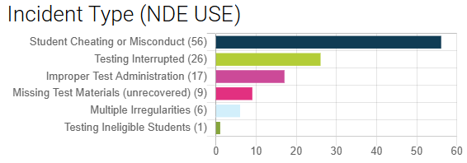
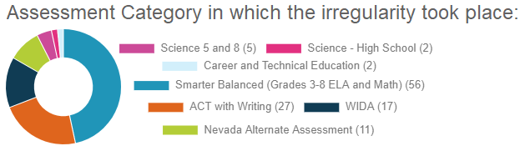
A Look Back at 2023-2024
Reported Irregularities in State Testing – WCSD
Close to half are cases of student cheating or misconduct, including cell phone and device violations.
A typical consequence of student cheating or misconduct is the invalidation of test scores.
Improper test administration errors and loss of test materials are entirely preventable.
prevent, deter, detect and respond
Notes:
Slide Notes:
A testing irregularity is any unusual test handling or event occurring during test administration that calls into question the security and confidentiality of the test and related material, or the accuracy of the test data. Irregularities can damage the school, community, students, and the integrity of the assessment program.

Slide 25


PROTECT TEST SCORE VALIDITY
An exam is only valuable if the test scores it produces can be confidently used for their intended purpose.
validity & reliability of test results
standardized test administration procedures
strict observance of test security protocols
Notes:
Slide Notes:
Validity and reliability of test results are dependent upon adherence to standardized test administration procedures and strict observance of test security protocols.
Protecting valid test scores takes effort. Follow procedures for test administration and read test day scripts verbatim. Consciously avoid any conditions in the administration of the test and prevent wrong-doing that might invalidate the results.
All students should have the opportunity to test under similar conditions. Adherence to procedures will ensure uniformly favorable testing conditions.

Slide 26
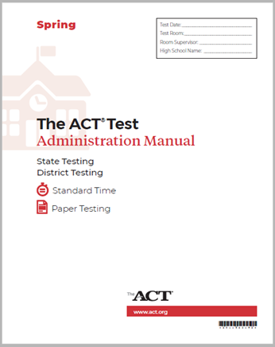
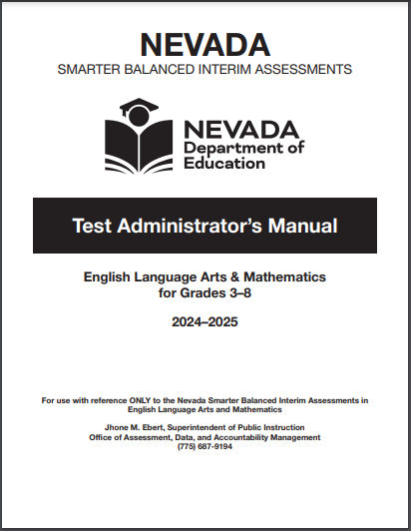
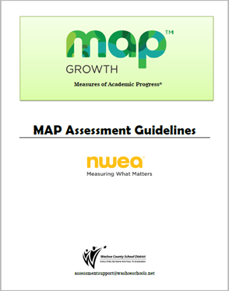

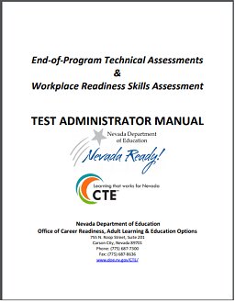
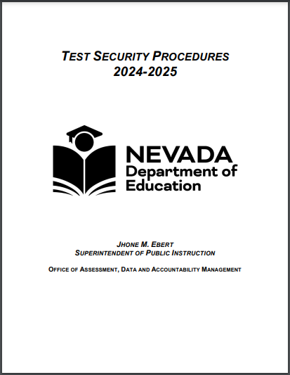
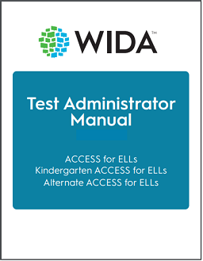
CARRY OUT PROCEDURES
Strict adherence to procedures ensures
  consistency in test administration
  security of test materials
  validity of scores
Notes:
Slide Notes:
Each test administration in the Nevada and Washoe County School District testing programs may differ from one another. Test administrators are responsible for reading the manual for the test to be given and adhering to procedures for before, during, and after testing. This includes but is not limited to secure handling of test materials, time limits for a test, breaks during testing, allowed materials, and prohibited behaviors.
Well in advance of a scheduled assessment, test administrators should access available manuals to read thoroughly and practice scripts for use during testing.
Test coordinators and test administrators are responsible for complying with the contents of test administration manuals.
The read aloud instructions or script for the test administration must be delivered with exactness.
Strict adherence to policies and procedures for test administration ensures both test reliability and validity of results from classroom to classroom, teacher to teacher, school to school, and district to district.

Slide 27


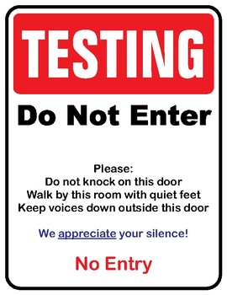
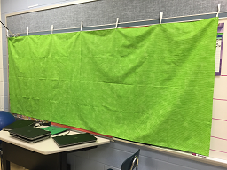
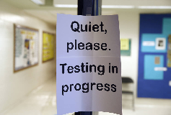

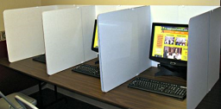
TESTING ENVIRONMENT
Prepare the testing environment
When in doubt, take it down or cover it up
Prevent and discourage interruptions
Notes:
Slide Notes:
In the testing room, materials related to test content or that may provide information, assistance, or instruction must be removed or covered prior to testing. When in doubt, cover it up. Any resources that students could use as cues or triggers should not be present during test administration. The aim is for all students statewide and districtwide to have the opportunity to participate in the same tests under similar conditions.
Music or white noise is not allowed in the testing environment.
Test administrators and room proctors MUST NOT provide additional assistance or direct students’ attention to any materials in the room for the purpose of enhancing test performance.

Slide 28

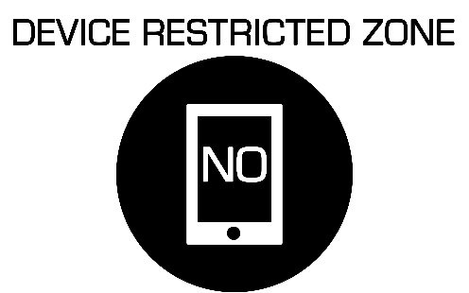

PREVENT THREATS TO SECURITY
Access to unauthorized devices or materials is prohibited.
Communicate and carry out policy and procedures for personal and unauthorized devices.
Account for all testing materials, secure and non-secure.
Collect what you distribute.
Notes:
Slide Notes:
In the testing room, PROHIBITED devices include, but are not limited to, cell phones, “smart” devices, all “i-” devices like iPod, iPhone, iPad, all “e-” devices, and wearable communication devices.
Ahead of scheduled testing inform students, families, and staff about the electronics policy. Students found with a prohibited device in their possession during the testing period, including after they have finished or during a break, may lead to the invalidation of their test and possibly others’ tests as well.
Pockets are NOT a place for securely storing personal devices and other prohibited items. Students may only use and have access to materials and/or supplies that are specified in the test administration manual or provided with the test for a specific grade level and assessment. Allowed accommodations and testing supports must be made available to students before starting a test.
Materials containing student identifying information, test items or content, and student responses are considered secure and must be accounted for before, during, and after testing.

Slide 29




PERMISSIBLE MATERIALS
BEFORE: turn off electronics, store personal items and devices away from students, distribute permissible materials
  Personal Electronics Exceptions: Authorized assistive technology, medical support device; documented in student’s testing plan (IEP, 504 Plan, Health Plan)
  Testing room without phone line--staff may use a designated mobile/cell phone to call the office
DURING: supervise access and use of materials
AFTER: collect and account for testing materials, supervise early finishers
Notes:
Slide Notes:
Do not assume that materials or tools allowed for one test are also allowed on other tests. Consult specific test manuals for a list of permissible materials.
Materials specified as a designated support or accommodation for a student may be used only if they are also allowed for the test. Students may not access additional instructional or support materials.
Mobile/cell phones must be turned off. Collect and store personal items, electronics, and other non-testing materials AWAY from students. Unauthorized possession of a non-permissible device may result in the invalidation of scores and other consequences.
Supervise student use of assistive technology or authorized medical support devices that may have tools and features or wireless capability that may pose a threat to test security or are not permissible.
For tests that include listening items, students will use headsets or may bring their own earbuds or headphones. Supervise closely to ensure students do not plug their listening piece into other student’s computers or other hidden devices.
If no room phone is available, staff may use a mobile/cell phone in the testing room only to call out or receive calls pertaining to the scheduled test session. Do not text, email, or access any other applications.
Students who finish before the testing period has ended may read a paper format book; no E-Readers. Students must not interact with others. Drawing, writing, or other activities are prohibited.

Slide 30
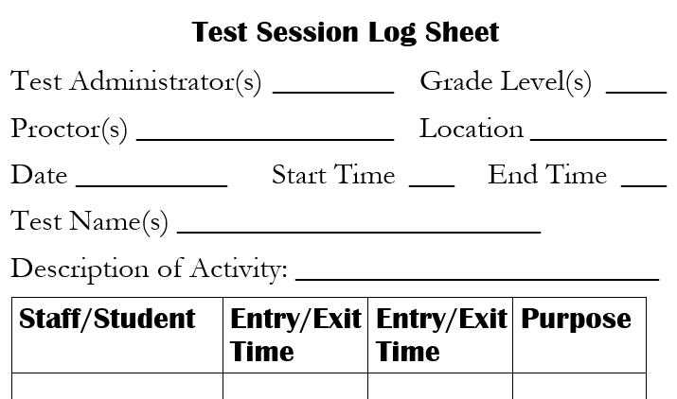
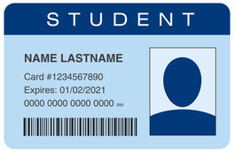
VERIFY IDENTITY & ELIGIBILITY
Account for ALL students and adults in the testing room.
Document authorized and unauthorized visitors.
Verify the identity and eligibility of ALL students
Do not admit students not on the testing room roster.
Photo ID verification required for high school test administrations.
Notes:
Slide Notes:
A testing room log is used to document authorized and unauthorized visitors during testing, including anyone who enters uninvited.
The identity of ALL students and adults in the testing room must be logged, including their entry and exit time-stamp and signature. Note, for all high school state tests, ID verification is required for every student in the room.
Changes to testing room rosters must be made by the School Test Coordinator. Test administrators and proctors should not admit students who are not on the testing roster.

Slide 31
TESTING STAFF
Testing staff must be authorized to be in the testing room.
Authorized testing staff must complete training in test security.
All testing must be supervised by a Nevada licensed educator or school counselor employed by the school/district.
Advise the principal or school test coordinator of conflicts with testing assignments.
  Guardians or adult relatives and members of the same household of testing students may not be in the testing room.
  Medical caregivers required to be present are NOT permitted to assist with test administration.
  Paraprofessionals may not administer tests.
Notes:
Slide Notes:
The testing room is for eligible students assigned to participate in the specific test. Students not participating in a test are NOT ALLOWED in the testing room.
It is vital for security purposes to know who administered a test.
Manuals for each test administration will specify who may and may not serve in various testing staff roles. Guardians or adult relatives and members of the same household of testing students may not be in the same testing room.
Additional notes for this slide:
--Guardians, relatives, or wards of testing students are NOT ALLOWED in the same testing room or permitted to observe test administration. For college readiness assessments like ACT or Advanced Placement, guardians, relatives, members of the same household, and athletic coaches may not be assigned certain staff roles or testing responsibilities.
--During kindergarten intake screening, a child’s guardian may observe from an appropriate distance but may not interfere with the assessment.
--Always consult test specific manuals to determine who is allowed in the testing room and who may or may not serve as testing staff.
--Medical caregivers required to be present must sign a Confidentiality Agreement prior to testing and are NOT permitted to assist with test administration.
--When remote administration and online proctoring is authorized for a test, caregivers may be required to assist students with technology and initial access to online tests.

Slide 32



ACTIVELY CIRCULATE
ATTEND TO STUDENTS
Do not engage in distracting activities or distract students.
Watch for students working on their own test, responding in the correct test section, etc.
Supervise students and keep test materials secure.
Protecting Valid Test Scores Takes Effort
Notes:
Slide Notes:
Anything that takes the test administrator or proctor’s attention away from the students and supervision of test materials during testing is not appropriate.
Examples include:
--Working on the computer, checking email, or using cell phones
--Grading papers or working on lesson plans
--Chatting with other adults in the room
--Reading a book, magazine, or newspaper
--Individual interest activities like knitting, crafting, or personal grooming
--Leaving the room without another licensed and trained test administrator in the room
--Leaving students unattended during breaks
Staff and students should understand and support monitoring efforts to report and detect breaches of security, cheating, and other prohibited behaviors.

Slide 33

NO ASSISTANCE ON TESTS
Administer tests in ENGLISH ONLY
Translation of any test material into another language during test administration is prohibited.
Give NO ASSISTANCE of any kind beyond ensuring students understand the instructions, for taking the test and accessing the correct test (e.g., launch browser, log in, select test).
Students must NOT assist or interact with other students.
Disclosure of test content is strictly prohibited by state law.
Notes:
Slide Notes:
Verbal instruction during testing and on the day of the test is provided in English only, with the exception of allowed signed interpretation for deaf or hard of hearing students with a documented accommodation. Translation and review of non-secure student directions prior to the test date is permitted for some assessments.
Test administrators must not influence student performance during test administration. Assistance of any kind, beyond making certain that students understand instructions for taking the test, is a violation of ethical testing practices and professional expectations and will result in a testing irregularity, possible licensure sanctions, and may invalidate test scores.
Students must NOT assist or interact with other students during a test administration.

Slide 34


BREAKS DURING TESTING
Log (signature, time-stamp) all persons entering and exiting the testing room.
Breaks must be closely supervised by authorized staff; peer interaction is prohibited.
Access to personal items during breaks are authorized for medical supports only.
Limit breaks except for students taking the NAA or as noted in a student’s plan (IEP, 504, EL) and authorized for the test.
Notes:
Slide Notes:
Additional notes for this slide:
Provide a restroom break prior to starting a test.
Document by name and include a time-stamp for all adults and students entering or exiting the testing room.
Time restrictions must be followed for test results to be valid.
Breaks taken during untimed and timed test administrations must be closely supervised.
Peer interaction and access to non-permissible materials are prohibited during supervised breaks.
Fixed-form tests must be completed during an uninterrupted session and students must not be allowed to return to an unfinished test part or section after an unsupervised break.
While students have access to test materials, both paper and online, they must be supervised by Nevada licensed educational personnel with long-term district employment assignments at the site
Students taking the Alternate assessment should be permitted as many breaks as needed.

Slide 35

TRANSITIONS & TRACKING MATERIALS
ACCOUNT FOR ALL TEST MATERIALS AT ALL TIMES!
DO NOT distribute test books, tickets, or other secure materials until the date of the examination.
Log each exchange; materials must not be left unsupervised.
Untimed Tests: Provide additional time for students working productively.
Unsupervised Break/Subsequent Day: Students may not return to a previously-administered section or part of a test after a break in supervision.
Changing Location or Test Administrator: Students must be accompanied by trained staff and secure materials transported by licensed educational personnel.
Notes:
Slide Notes:
ACCOUNT FOR ALL TEST MATERIALS AT ALL TIMES!
DO NOT distribute test books and secure materials until the date of the examination.
Each time secure test materials change hands the exchange must be logged on a time-stamped sign-out and sign-in sheet.
Secure test materials must be supervised by authorized licensed personnel.
The Test Administrator must collect and account for ALL testing materials before a student is allowed to leave the testing area for any reason.
Students working productively should be afforded time to complete an untimed assessment, at their own pace, and within the school day. Untimed fixed-form tests must be completed within the standard school day. Accommodated testing over multiple days must be authorized prior to the administration. If a test has no time limit, students must remain supervised from start to finish throughout the testing session, including all breaks. Students who typically require extended time for classroom learning tasks and tests should be scheduled to start single-day administration tests earlier in the day to ensure the student will finish before the school day ends.
Students may not return to a previously administered section or part of a test after an unsupervised break.
When moving students with tests in progress, secure materials must be transported by the licensed test administrator and students must remain supervised.

Slide 36
Irregularity in Test Security or Test Administration
Professional Responsibility
Report unusual events even if you are unsure about the severity or whether it qualifies as an irregularity.
Varying degrees of severity
Interruption of testing
Administration errors
Security breaches
prevent, deter, detect and respond
Notes:
Slide Notes:
A testing irregularity is any unusual event occurring with test handling or during administration that calls into question the security of the test or the accuracy of the test data. There are varying degrees of severity and consequences.
It is the professional responsibility of all school personnel to follow procedures that will prevent and deter an irregularity, to respond to unusual events appropriately, and to report irregularities related to testing.

Slide 37
Irregularities: Reporting Procedure
Report incidents.
Test Administrators & Proctors: Notify your school Principal or School Test Coordinator ASAP.
School Test Coordinator or principal notifies district office by phone or email within 24 hours of discovery; begin compiling evidence and documentation.
District office notifies Nevada Department of Education
STC/Principal submits formal report and evidence for review to Department of Assessment using online reporting system (Caveon).
IMPORTANT: Report any alleged or suspected breach of test security and unauthorized disclosure of test content within 24 hours of discovery.
Notes:
Slide Notes:
The school test coordinator will be responsible for documenting reported incidents and communicating with the WCSD Department of Assessment. School staff cooperation is essential to determining what happened and the impact on the assessment program, including students and school personnel.
Additional notes for this slide:
In the event of any alleged or suspected breach of test and/or examination security or unauthorized disclosure of test and/or examination content (for both state and district assessment programs), this sequence must be followed.
The situation must be immediately reported to the school test coordinator (STC) AND school principal.
Within 24 hours of the time the alleged or suspected breach has been brought to the STC or principal’s attention, the STC or principal should first report the breach of test security to the Director of Assessment or their designee (WCSD Assessment Support). Second, the STC or principal must complete and submit the “Report of Testing Irregularity” online form through Caveon.
The Director of Assessment or their designee will communicate with appropriate WCSD district level administrators about the suspected breach or unauthorized disclosure.
For all state-mandated tests, within 24 hours, the Director of Assessment or their designee must report any breach of test security or suspected irregularity in test administration to the Nevada Department of Education.
Reported instances of alleged breaches of test administration or test security shall be investigated by the school district or by the Nevada Department of Education.

Slide 38
Irregularities: Follow-up and Consequences
Follow-up may require student/staff interviews and written statements.
Possible Consequences
  Corrective action administered by the State or District
  Invalidation of scores
  Accountability consequences
  Disciplinary action (student, staff)
  License sanctions, changes to employment
Notes:
Slide Notes:
Be prepared to provide a detailed statement if you were involved in or witnessed an incident with test security or test administration. The Nevada Department of Education may investigate an incident on their own or in conjunction with the district.
Additional notes for this slide:
If investigated by the school district, the Director of Assessment, shall work collaboratively with the WCSD Legal Division, Human Resources, the school principal, and other appropriate district leadership to investigate the alleged breach of test administration or test security after submission of the completed Report of Testing Irregularity.
If investigated by the Nevada Department of Education (NDE), the Director of Assessment or their designee, shall obtain other testimony or conduct further investigation as directed by the NDE after submission of the completed Report of Testing Irregularity.
Both the school district and the Nevada Department of Education may issue a subpoena, as needed, to compel the attendance or testimony of a witness or the production of relevant materials. If the witness refuses to attend, testify, or produce relevant materials, the school district or the Nevada Department of Education may report that refusal to the district court.
Members of the various professional associations involved in such investigations are entitled to representation from their associations.

Slide 39
Irregularities: Reporter Protections
In accordance with Nevada Revised Statutes (NRS), all students, school officials*, and others must report any suspected irregularities in testing administration or testing security.
NRS 390.405 specifically prohibits any school official from directly or indirectly using their official authority to influence another school official and interfere with or prevent the disclosure of information concerning a testing irregularity.
See: NV Summary of Whistleblower Protections
*School Officials include members of school district board of trustees, charter school governing members, licensed and unlicensed employees of school district or charter school
Notes:
Slide Notes:
Details from reported irregularities in testing including persons involved, collected evidence, statements, and interviews are kept confidential.
Nevada Whistleblower Protections https://www.washoeschools.net/cms/lib/NV01912265/Centricity/domain/160/state/WhistleblowerMemo_24.25.pdf

Slide 40

Professional Integrity
Copying, reproduction, or paraphrasing in any manner the test items, problems, answer sheets or questions and the approved answers for grading them by any means or disclosure of those items, problems, or questions and the approved answers for scoring them is a breach of NRS provisions, NAC regulations, WCSD testing procedures, and ethical expectations for the professional behavior of all district employees
Useful (valid) test scores are an asset to educators in supporting student academic growth and achievement.
Notes:
Slide Notes:
Copying, reproduction, or paraphrasing in any manner the test items, problems, answer sheets or questions and the approved answers for grading them by any means or disclosure of those items, problems, or questions and the approved answers for scoring them is a breach of NRS provisions, NAC regulations, WCSD testing procedures, and ethical expectations for the professional behavior of all school and district employees.

Slide 41
Next Steps
STC: Submit school test security plan to department.
Primer Training (site-based); complete by October 31.
Read the Primer in its entirety and reference throughout school year (keep for all 2024-2025).
Read and sign tear-away Acknowledgment form (or digitally sign electronic form) included with the Primer; form collected by school principal.
Review the Primer, applicable manuals, and participate in refresher training before each major test administration.
Testing Program Resources for Staff
Notes:
Slide Notes:
The school principal or school test coordinator will submit verification of initial training in the Primer on or before October 31, 2024. Staff not trained in the Primer must not assist with test administrations in the Nevada assessment program.
WCSD and Nevada Testing Program Resources for Staff; Training Materials
https://www.washoeschools.net/Page/1247
Note: Information presented in this training is subject to revision based on direction from the Nevada Department of Education.

Slide 42

Contact
Dr. Sandra Aird
Director of Assessment
WCSD Assessment Support Team
Phone: 775.348.0248
AssessmentSupport@washoeschools.net
Report irregularities in testing by phone or email within 24 hours of discovery.
Notes:
End Slide
Thank you for participating in this training presentation. Please contact WCSD Assessment Support with questions.

