Slide 1


Test Security Training
2025
SPRING
SPRING
2025
Nevada Accountability Assessments
Science, Smarter Balanced Summative, and Alternate
Notes:
February 2025
Test Security Refresher Training Presentation

Slide 2
WCSD
Assessment
Support
Department of Assessment
  Dr. Sandra Aird, Director
  Rebecca Curtright
  Anna Kanarowski
  Laney Porter
Phone: 775-348-0248
AssessmentSupport@washoeschools.net
Notes:
The Department of Assessment provides guidance and support to schools administering Nevada accountability assessments.
Contact your Special Education Facilitator (SEF) for additional support with the NAA administration.

Slide 3
Nevada Ready Assessments
Supported through
DRC INSIGHT
CRT = Criterion-Referenced Test / NAA = Nevada Alternate Assessment
Nevada students participate in either the general assessment or alternate assessment.
Nevada accountability assessments include:
Grades 3-8 – CRT in English Language Arts and Mathematics (Smarter Balanced Summative); online
Grades 5, 8, and High School (gr 9 or 10) – CRT in Science; online
Grades 3-8, and High School (gr 11*) – NAA in English Language Arts and Mathematics; paper
Grades 5, 8, and High School (gr 11) – NAA in Science; paper
*HS/gr 11 general assessment for ELA & Math is ACT with Writing
Notes:
WCSD
SAY:
Students in tested grade levels will participate in either the general CRT or alternate assessments.

Slide 4
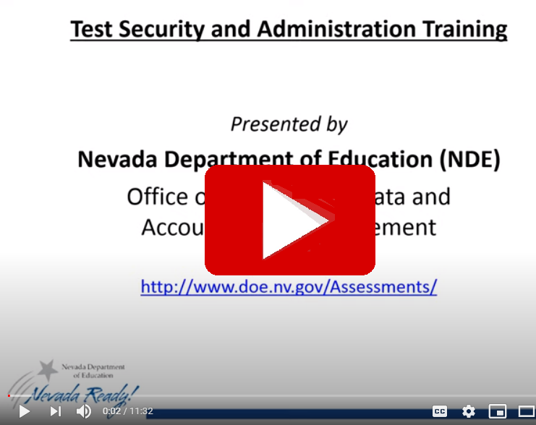

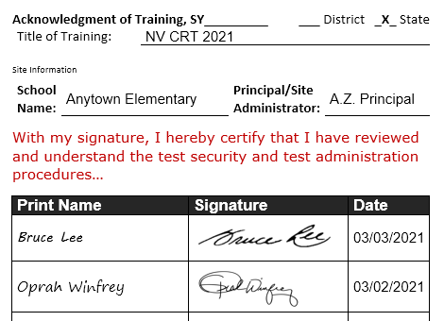
Participate in Training
Sign Confidentiality Agreement
Testing Staff reminder: Guardians or adult relatives and members of the same household of testing students may not be in the same testing room.
ALL: Testing & room support staff
Sign acknowledgment of training form/log.
Sign confidentiality agreement form.
Testing staff must acknowledge that they have participated in training, and that they have been informed of and understand procedures and the potential consequences of irregularities in testing.
**No personnel may handle test materials or be assigned to a testing room without first being trained in test security and signing the confidentiality agreement.
Notes:
The school principal must ensure all personnel assisting with assessment-related activities receive appropriate training and sign the confidentiality agreement prior to testing.

Slide 5


Video Presentation
Presentation from the Nevada Department of Education (8 min)
NDE Test Security and Administration Training
https://www.washoeschools.net/Page/452
Notes:
Testing staff and authorized district or state visitors must participate in test security training. Please view the Nevada Department of Education presentation on NDE Test Security and Administration Training.
Video, 11 minutes
Link: https://youtu.be/5WDSHXC1rOQ

Slide 6
Test Security
The goal of test security is to PROTECT the integrity of the assessment and investment of resources and to ASSURE results are accurate and meaningful.
Notes:
The goal of test security is to PROTECT the integrity of the assessment and investment of resources and to ASSURE results are accurate and meaningful.
Uniform procedures are essential to a standardized testing program, and strictly following these procedures gives students the best guarantee of fair testing.

Slide 7
Nevada Test Security is a Shared Responsibility
All educational personnel involved in the Nevada assessment program share responsibility for maintaining the security of all materials.
Handle test materials and student responses securely and confidentially.
Test Directions and Scripts may not be altered.
Online tests are not to be accessed or viewed by anyone prior to students taking the test.
Assessments are “student-facing”. Except where allowed by a specific accommodation, only the student may view the content of the test materials for their assigned session(s).
Materials from student assessments must NOT be copied or recorded* in any manner.
  *Only the NAA will be recorded as required for the administration.
The principal is ultimately responsible for all testing activities at the school.
Notes:
We are all responsible. First, consistency in administration practices across schools and districts ensures the results of the assessments are valid for accountability purposes. Second, maintaining the security of test items and content ensures items and stimuli may be used in future years thus supporting measurement comparability and use of results to identify trends in performance.
Student login/test tickets & used scratch paper must be kept secure throughout the testing window, should be returned daily to the school test coordinator for storage, and must be securely destroyed (shredded) after testing is completed.
Be advised, the mishandling of secure test materials and unauthorized access to test content or student responses is a breach in test security procedures and must be reported to the school test coordinator, district test director, and the state.

Slide 8

Forms & Protocols for Test Administrators
Test Administrators must be actively licensed Nevada educators, trained in Nevada test security and test administration procedures.
  Participate in training; sign applicable forms.
  Follow published procedures including the Test Administrator’s Manual, Read Aloud, Scribing, or Transcribing Protocol(s).
All testing staff must be trained in test security and sign the confidentiality agreement prior to testing, including D/HH interpreters, medical caregivers, and other personnel authorized to be in the testing room.
Schools retain signed training logs and forms for 3 years.
Guardians, adult relatives and members of the same household of testing students may not be in the same testing room.
Notes:
Test administrators must hold an active Nevada educator license. Staff assisting with testing acknowledge their participation in test security training. A confidentiality agreement must be signed by all personnel assigned to a testing room and/or authorized to handle secure test materials. Adult family members of testing students may not be in the testing room.

Slide 9
Testing Environment
Electronics | Cell phones and “Smart” devices (students & staff) must be collected and stored prior to distributing test materials. Follow protocol for authorized “Medical Supports”.
Size of Test Session | Smaller group sizes provide better test conditions. Schedule at least one adult for every 30 students in a testing room.
Testing Room | The testing room must be free from distractions and have adequate light, ventilation, and heating or air-conditioning.
Seating | Use a seating chart and arrange seating to minimize the possibility of students communicating with each other verbally or visually.
Materials on Walls | Charts, posters, bulletin boards, etc., that provide guidance or information must be removed or covered with blank, opaque material.
Materials on Desks | Student desks or tabletops must be cleared of any materials not specified in the TAM. Material affixed to desks or tabletops must be covered with blank, opaque material.
Notes:
Ultimately, the goal of maintaining a secure testing environment ensures that no students have an unfair advantage or disadvantage during testing.
Security refers to:
Who has access to secure test materials
What students can see and hear while testing
What resources students can access while testing
Before Testing: remove or cover materials around the room and on desks, assign seating, post “testing” or “do not disturb” signs at every entrance to the testing room
During Testing: maintain a quiet environment and closely supervise students

Slide 10

Day of Testing
Test Administration Materials
Test Administrator’s Manual with read aloud script
Test Session Log Sheet for time-stamps and signatures (use new log sheet for each test session) all “visitors” must sign in, both planned and unplanned!
Test Session Roster – document attendance and test completion status
Test Tickets (Online Testing); one for each student on the room roster (remember to collect tickets immediately after students log in to their test)
List of students receiving designated supports or accommodations
Permissible materials and authorized support/accommodation materials
TIP: Scan the room and student workstations before starting a test session to ensure no materials were left behind by a previous class. Post a testing sign.
Notes:
Each day of testing, test administrators will check out materials from the school coordinator. Secure test materials must remain in the custody of a licensed educator trained in test security and test administration.
Before starting, scan the testing room and student workstations to ensure no materials were left behind by a previous class. Post a testing sign to prevent interruptions.

Slide 11
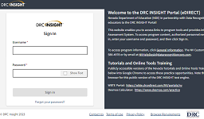
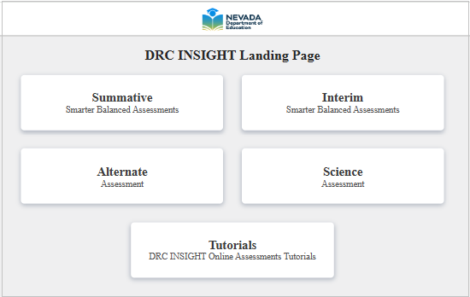


DRC Systems
STC
DRC INSIGHT Test Engine
Online test delivery system with lockdown security features
Installed on student computers in advance of the testing window
Accessed using a desktop icon
DRC INSIGHT (Nevada) Portal
Used by school and district personnel to manage technology for test administration, manage student information, test sessions and materials, and monitor student and test session progress
https://nv.drcedirect.com
Notes:
The DRC INSIGHT Portal and DRC INSIGHT Test Engine are secure systems used for the administration and delivery of the Nevada assessments. Security features protect student and test information to ensure the validity and reliability of assessment results.

Slide 12

ONLINE TESTING: INSIGHT Security Features
Desktop Lockdown: During testing, the system prevents copying, pasting, or printing of screen images. The system also blocks access to other applications and prevents interference from automatic software processes such as virus scans.
Inactivity Timeout Feature: The system will timeout and close the test after a defined period of inactivity (e.g., no mouse movement or typing for 20 minutes). The application will display an inactivity countdown clock and timeout warning message prior to logging the student out of the test and closing the application.
>>REMINDER: Personal devices/electronics must be collected and stored away from students BEFORE testing, including cell phones, wearable technology and “Smart” devices, Bluetooth devices, cameras, personal computing devices, etc..
Notes:
The lockdown browser is designed to restrict access to other applications or sites while the testing is active.
Reminder: It is a testing irregularity for students or testing room staff to access personal devices during a test session, including during supervised breaks. Devices must be powered off or silenced and collected before testing begins. Violation of the electronics policy may result in the invalidation of test results and other consequences.

Slide 13
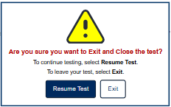
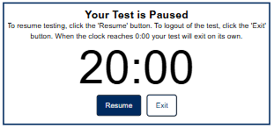


Pausing and Exiting a Test
*Monitor for students exiting and logging back in to their test.
A test may need to be paused or exited for the following reasons:
  Supervised break
  Taking the CAT (ELA, Math) over multiple days
  Moving a student; changing computers
  Testing irregularity (e.g., emergency evacuation, student illness, interruption)
To exit a test:
click “Pause”
on the timer screen click “Exit”
next click, “Exit”
Notes:
A test may need to be paused or exited when taking a supervised break, before changing locations or computers, and in response to an emergency or interruption. A paused test must be monitored. After exiting, a student must use their unique username and password from the test ticket to log back in to the test.

Slide 14
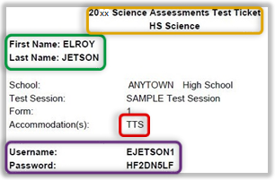
Student Login Tickets are Secure Test Materials
1
Test tickets are secure materials.
DO NOT share login credentials electronically (i.e., do not email).
SIGN OUT/IN test tickets each day. Return all used and unused test tickets to STC as directed and before the end of the school day.
TA must COLLECT test tickets after students successfully log in to each session/test part.
TA must ACCOUNT FOR every test ticket prior to dismissing students from testing room.
2
3
4
(1)_Test Name
(2)_Student Name (first, last)
(3)_Accommodation
(4)_Username & Password
TIP: Passwords are randomized, eight characters, alpha-numeric.
Notes:
Test tickets are secure materials.
DO NOT share login credentials by unauthorized means.
Check-out and return test tickets and other secure materials each day of testing. Only check out the materials needed for testing scheduled in that day.
COLLECT test tickets after students successfully log in to the correct session and part.
ACCOUNT for all secure test materials before dismissing students.
Test tickets indicate the online or presentation accommodation or designated support selected in the DRC INSIGHT portal that will be provided for the test. This area will be blank if nothing is selected for a student.

Slide 15
Report Irregularities
Immediately report any confirmed or suspected testing irregularity, non-standard administration, or suspected student plagiarism.
Report Irregularities
  Report incidents to the School Test Coordinator (STC) or School Principal. The STC will relay details to Assessment Support and begin gathering statements and evidence.
  The STC submits details through an online report (Caveon form) with documentation.
  WCSD Assessment Support reviews and submits the report to the Nevada Department of Education.
Report of Testing Irregularity (WCSD): https://www.washoeschools.net/Page/14303
Refer to the WCSD Primer, NDE Test Security Procedures, and the Test Coordinator’s and Test Administrator’s Manuals for each administration.
STC
Notes:
When an irregularity is suspected, an appropriate first course of action is to pause all impacted tests until the incident is reported, investigated, and resolved. Do not dismiss students! Immediate reporting gives the student the best opportunity to continue testing with no impact.
If there is any doubt about whether an incident or behavior is permissible, either for students or adults, always check the Test Administrator’s Manual and seek clarification.
FORM: Report of Testing Irregularity (WCSD): https://www.washoeschools.net/Page/14303

Slide 16
Administration Error
  These types of incidents are preventable!
Student logs in using another student’s ticket
  Stop testing and alert School Test Coordinator. Assessment Support will contact DRC to determine status of the student’s test and consult about next steps.
Student begins testing without required accommodation
  Stop testing and alert School Test Coordinator. Do not let the student continue testing without the appropriate accommodation. Note the test session, start & stop times, and number of items completed (if known).
  DOCUMENTATION will be requested (time-stamps, statements from testing staff, explanation of error).
BEFORE testing, verify accommodations and designated supports are provided
  Online/Presentation: Test ticket will indicate the pre-selected accommodation(s) or designated support. The student’s welcome screen (after login) will also specify the accommodated test form.
  Non-embedded: List accommodations students will use and provide information and materials to test administrator.
Notes:
Do not move forward with testing if the wrong ticket was used to log in or a student does not have their required accommodations and designated supports. Immediately alert the school test coordinator.

Slide 17
Emergencies
Evacuations, lock-downs, technical issues:
  Continue supervision; students may not access personal items.
  When testing resumes, students must not re-view items (same for online/paper administrations); test administrators/proctors will circulate and closely monitor students.
Student becomes ill during testing (“fixed-form” ELA PT, Math PT, Science, paper administrations):
  If a student becomes ill during testing, the decision to unlock a test or allow the student to resume the test is made on a case-by case basis.
  DOCUMENTATION will be requested (time-stamps, statements from testing staff, details of procedures followed).
Notes:
Decisions to unlock a test are considered on a case-by-case basis. There is no “universal” procedure that guarantees a test will be unlocked following an incident.

Slide 18
ONLINE TESTING: Test Status: “Locked”
Will lock overnight and must be completed during a single-day supervised administration:
  Summative Math Performance Task
  Summative ELA Performance Task Part 1 (Reading)
  Summative ELA Performance Task Part 2 (Writing)
  Science Test Part 1
  Science Test Part 2
Will NOT lock and may be completed over multiple days:
  Summative CAT sessions (ELA & Math)
  NAA (subjects: ELA, Math, Science)
Appropriate rationale and documentation required for the district to unlock tests.
TIP for NAA and paper administrations: Complete transcribing responses for all parts of a session within the same day.
Notes:
CAT sessions for ELA & Math will remain "open" until the student finishes the last item.
Students cannot log back into a test after it is submitted. If a student unintentionally submits a test part before responding to all questions, the part can be re-opened only if the student has been continuously supervised and not dismissed from the testing period.
If not submitted the same day they are started, parts for fixed-form test sessions will lock overnight to maintain security.

Slide 19
Who to call, Assessment Support or DRC Help Desk?
Suspected Issue with Test Item During Testing
Be prepared to provide:
Everything else…
Policy Questions
Student Participation
Testing Staff
Manuals, Training, Procedures
Accommodations, Designated Supports
Permissible Materials
Testing Irregularities
Test, Part, Test Session | Student Name
Grade | Student State ID
Question Number | Issue Summary
DRC Nevada Help Desk
1.866.588.4978
WCSD Assessment Support (district)
1.775.348.0248 or AssessmentSupport@washoeschools.net
Notes:
Contact the appropriate entity for information and assistance with the Nevada assessment program.

Slide 20

Support
WCSD Assessment Support
AssessmentSupport@washoeschools.net
1.775.348.0248
DRC Nevada Help Desk
7:30 am to 4:30 pm (Pacific)
NVHelpDesk@datarecognitioncorp.com
1.866.588.4978
Notes:
Call or email WCSD Assessment Support for assistance with state and district testing.

Slide 21
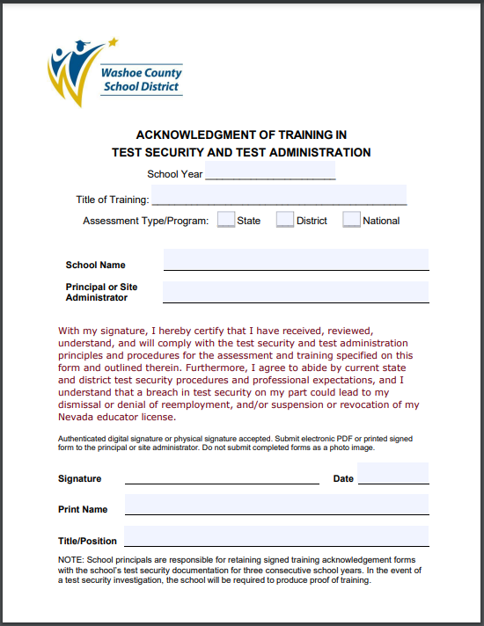
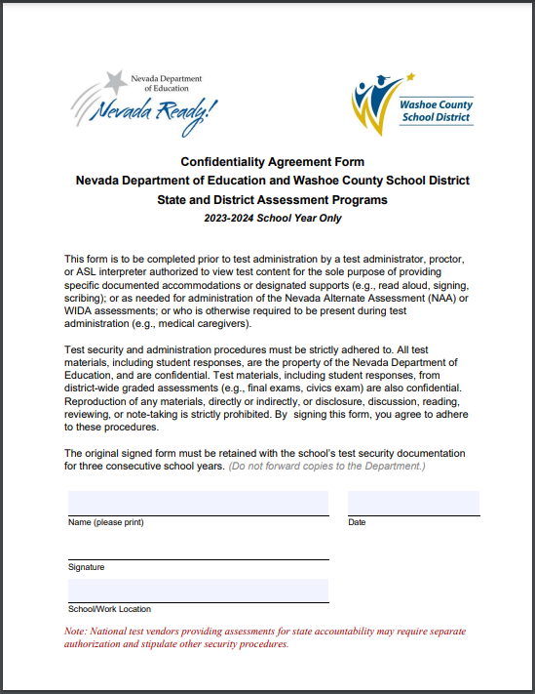
Next Steps
Complete form: Acknowledgement of Training
Complete form: Confidentiality Agreement
https://www.washoeschools.net/Page/1248
Notes:
Acknowledge your participation in training by signing the appropriate form. School staff will return their signed forms to the school principal or school test coordinator. District staff should return signed test training and confidentiality acknowledgment forms to the WCSD Department of Assessment.
Forms:
Acknowledgement of Training
https://www.washoeschools.net/cms/lib/NV01912265/Centricity//Domain/160/Forms/TrainingIndividualFORM.pdf
Confidentiality Agreement
https://www.washoeschools.net/cms/lib/NV01912265/Centricity//Domain/160/Forms/FORM_ConfidentialityAgreement.pdf

